Slide 1
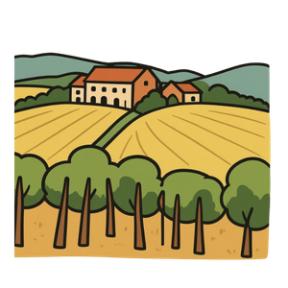
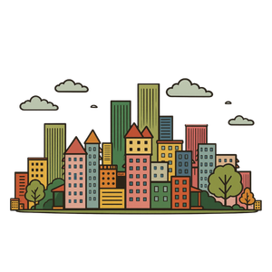
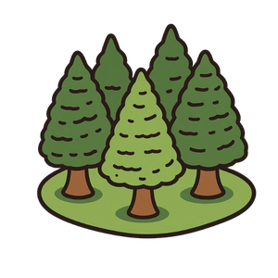
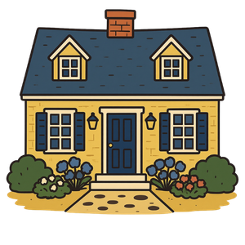
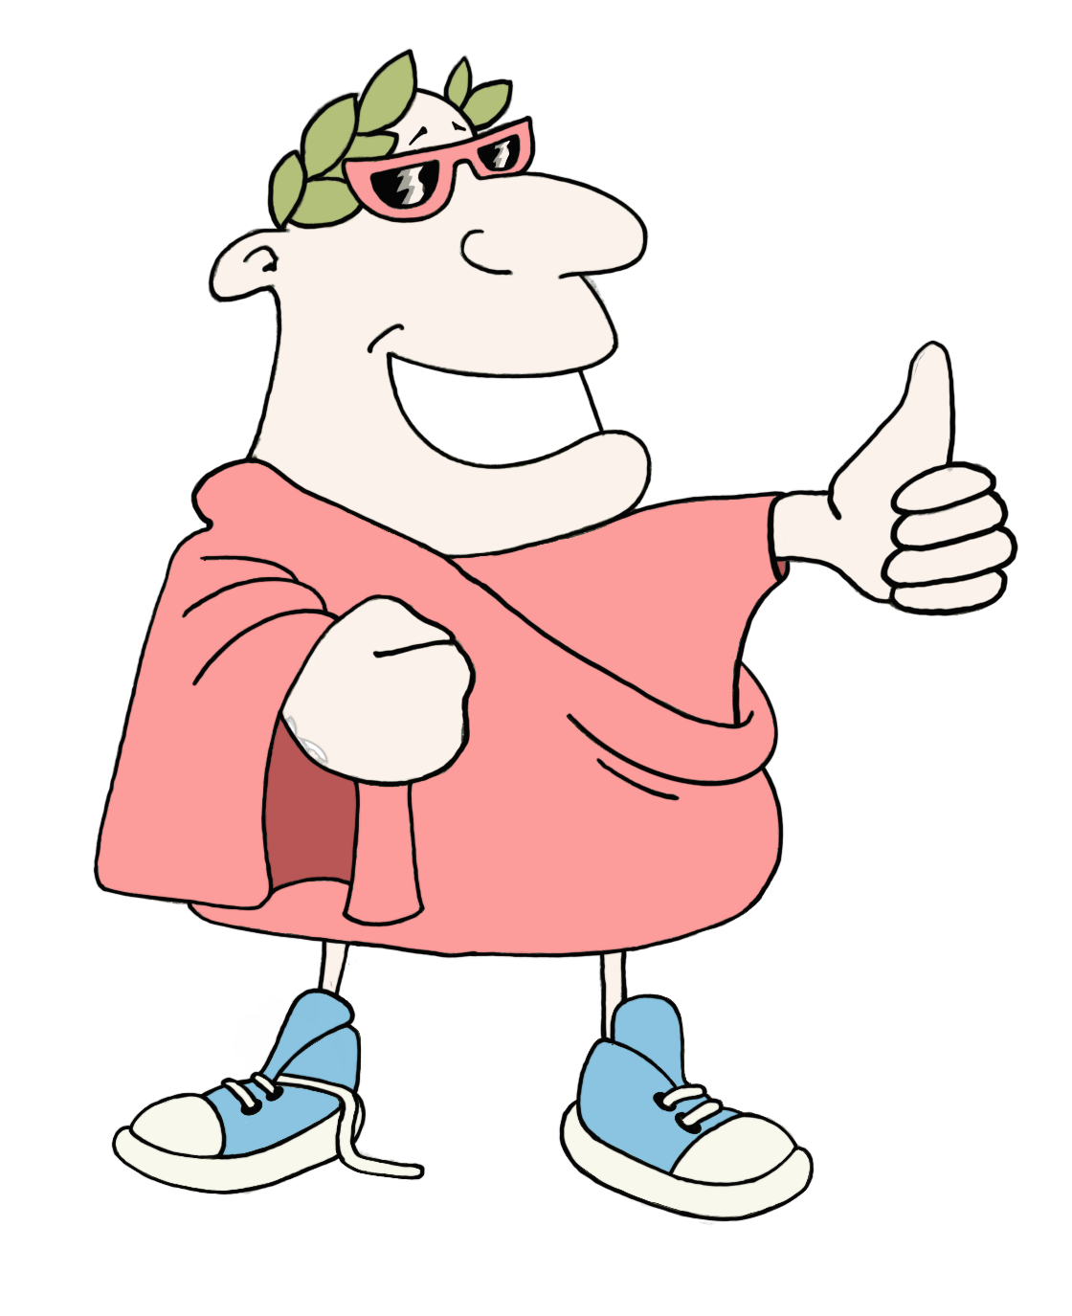
Connect the word root
Places
Instructions
Put this deck into slideshow mode and click on the start arrow below.
Click on the orange buttons to listen to the words or go to the game.
Choose the word that you think is the Latin root for the word on the card. Wrong answers will disappear.
start
MaximumClassics.com
Latin for literacy
© C Andrew 2026

Slide 2
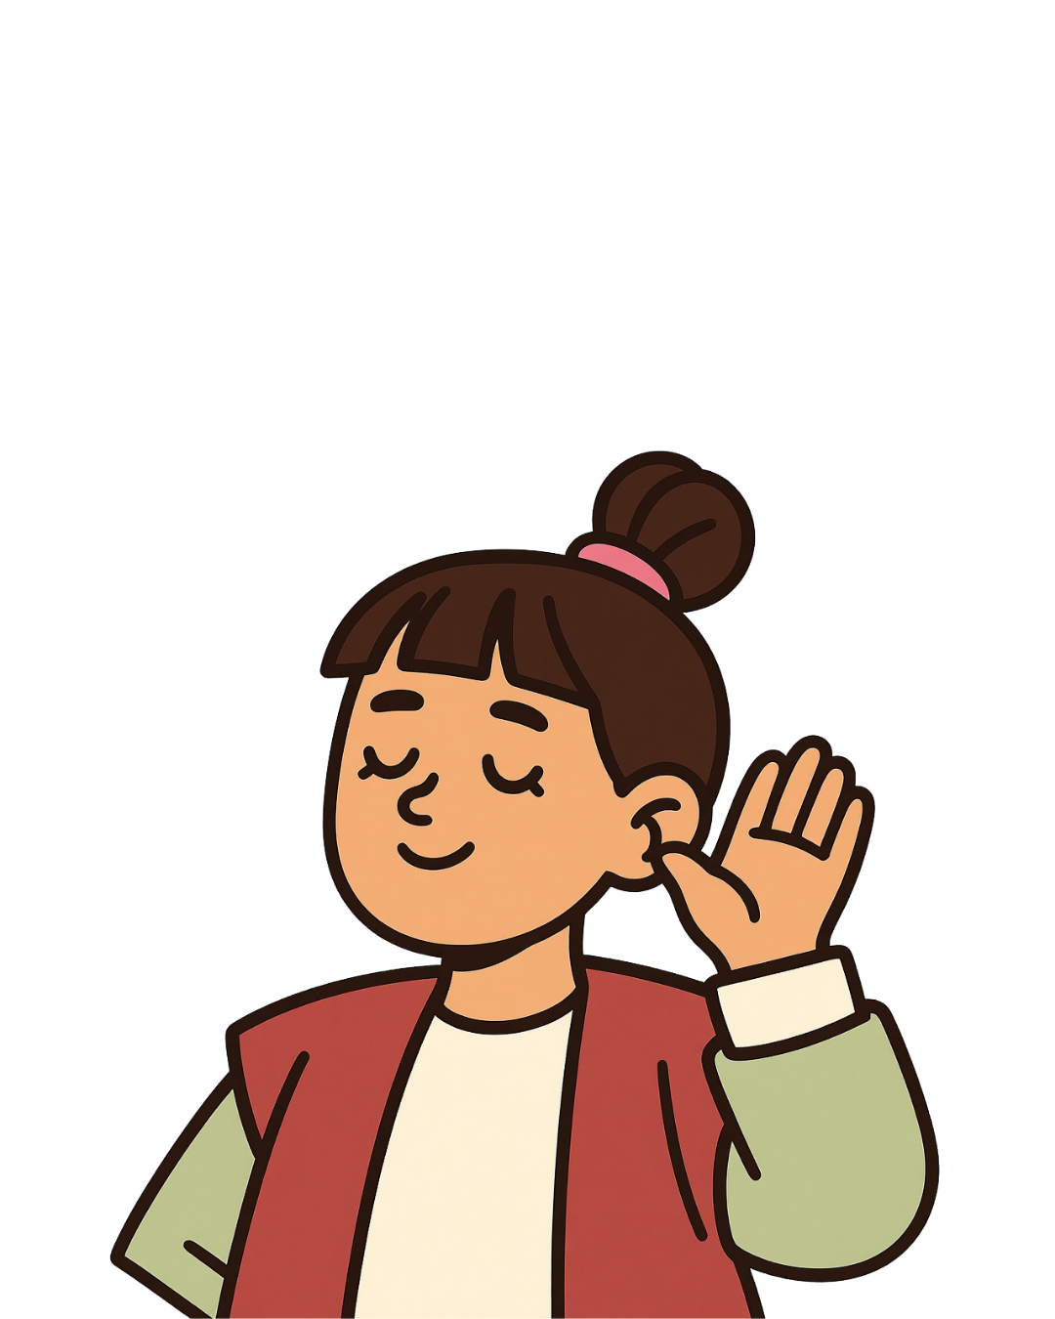

Connect the word root
Places
listen
play
© C Andrew 2026

Slide 3
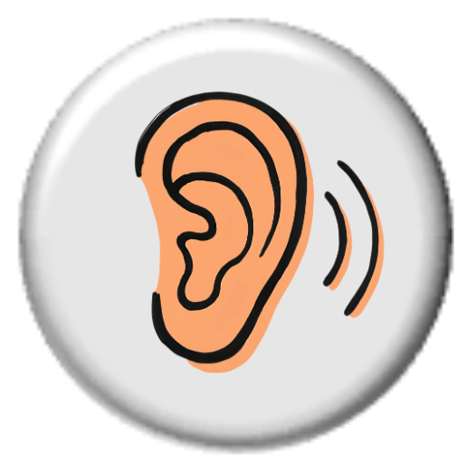

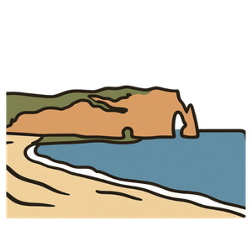
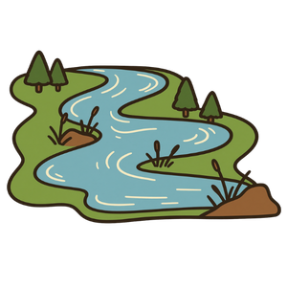

urbs
villa
rus
town, city
house
countryside
flumen
river
schola
mare
sea
school
play
© C Andrew 2026

Slide 4
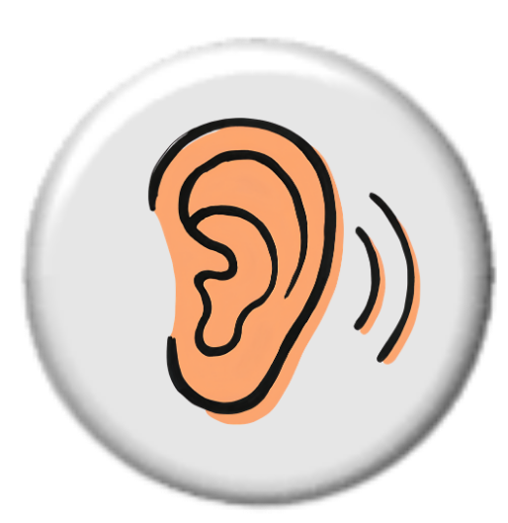

marine
To do with the sea
villa
mare
flumen
rus
next
© C Andrew 2026

Slide 5
urban
Located in cities or towns
rus
flumen
urbs
schola
next
© C Andrew 2026

Slide 6
scholar
Another word for a student
schola
villa
rus
mare
next
© C Andrew 2026

Slide 7
rustic
In a countryside style, plain or natural
flumen
urbs
villa
rus
next
© C Andrew 2026

Slide 8
suburb
The area around a town or city, normally with lots of houses
urbs
mare
rus
villa
next
© C Andrew 2026

Slide 9
flume
A man-made water channel or slide
schola
villa
mare
flumen
next
© C Andrew 2026

Slide 10
village
A collection of houses
mare
urbs
villa
rus
next
© C Andrew 2026

Slide 11
rural
Located in the countryside
rus
schola
flumen
urbs
next
© C Andrew 2026

Slide 12
gratias ludentibus!
Thanks for playing!
MaximumClassics.com
Latin for literacy

