Slide 1

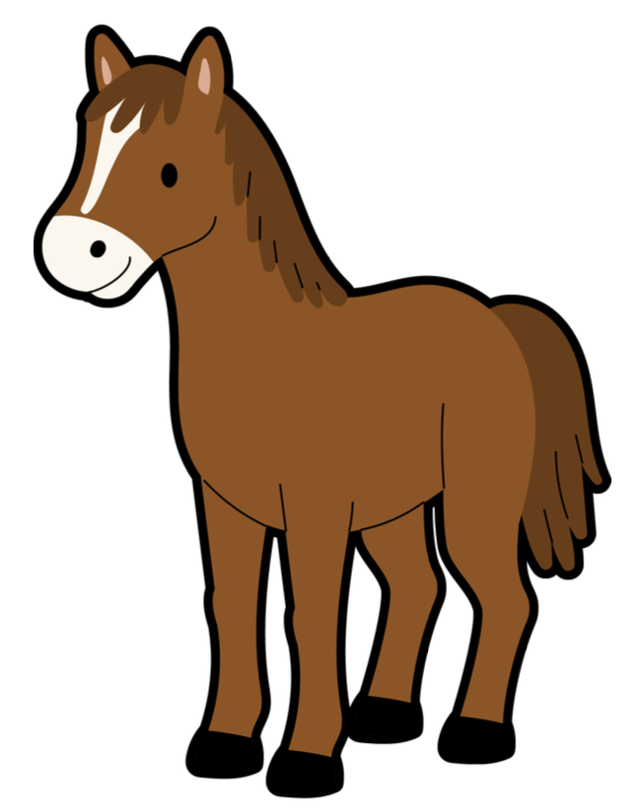

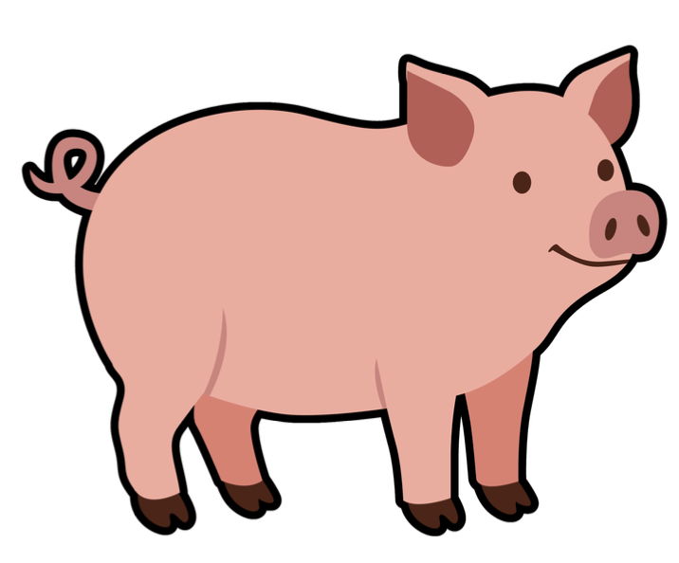

Connect the word root
Animals
Instructions
Put this deck into slideshow mode and click on the start arrow below.
Click on the orange buttons to listen to the words or go to the game.
Choose the word that you think is the Latin root for the word on the card. Wrong answers will disappear.
start
MaximumClassics.com
Latin for literacy
© C Andrew 2026

Slide 2


Connect the word root
Animals
listen
play
© C Andrew 2026

Slide 3
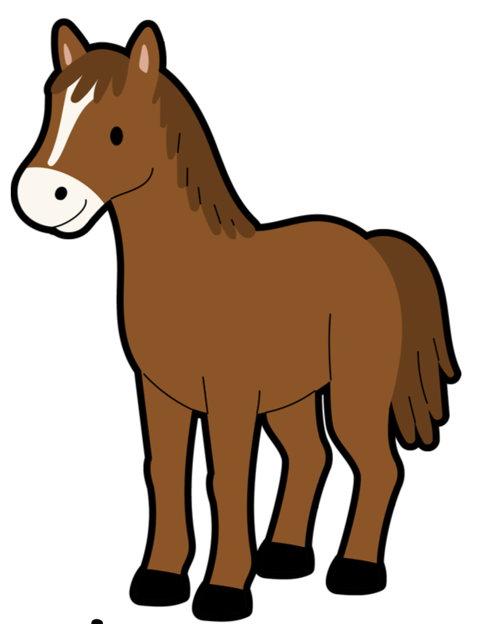


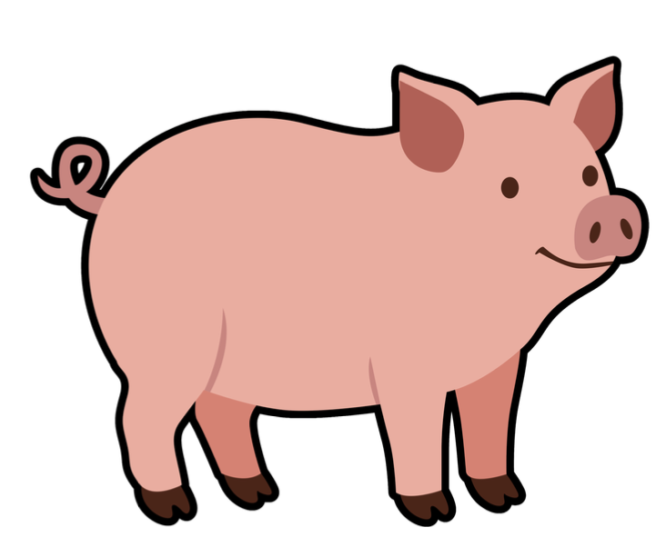


play
canis
feles
equus
porcus
dog
cat
horse
pig
© C Andrew 2026

Slide 4


feline
Like a cat, or to do with cats
canis
feles
equus
porcus
next
© C Andrew 2026

Slide 5
equestrian
Connected to horse-riding
canis
feles
equus
porcus
next
© C Andrew 2026

Slide 6
canine
Like a dog, or to do with dogs
canis
feles
equus
porcus
next
© C Andrew 2026

Slide 7
pork
Meat that comes from pigs
canis
feles
equus
porcus
next
© C Andrew 2026

Slide 8
🇮🇹 cane
The Italian word for dog
canis
feles
equus
porcus
next
© C Andrew 2026

Slide 9
🇫🇷 porc
The French word for pig
canis
feles
equus
porcus
next
© C Andrew 2026

Slide 10
🇪🇸 equitación
The Spanish word for horse-riding
canis
feles
equus
porcus
next
© C Andrew 2026

Slide 11
🇫🇷 chien
The French word for dog
canis
feles
equus
porcus
next
© C Andrew 2026

Slide 12
gratias ludentibus!
Thanks for playing!
MaximumClassics.com
Latin for literacy

