Slide 1
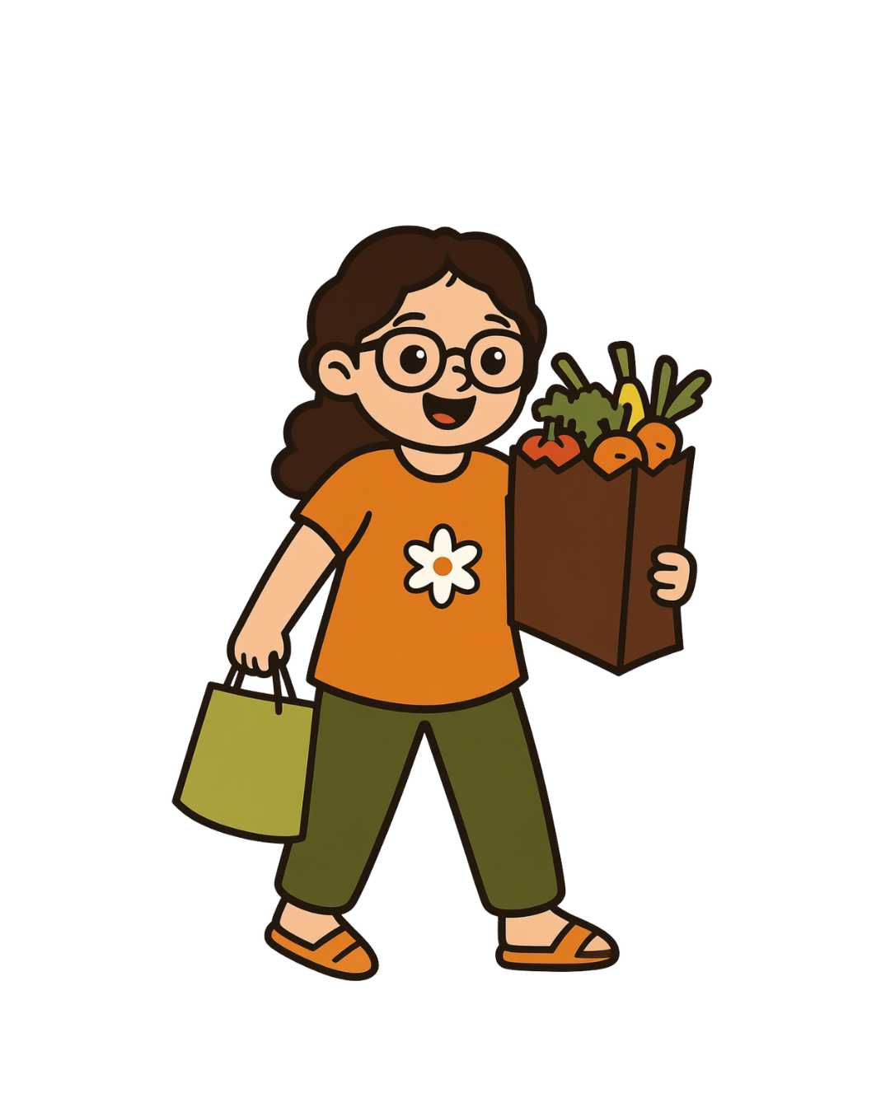
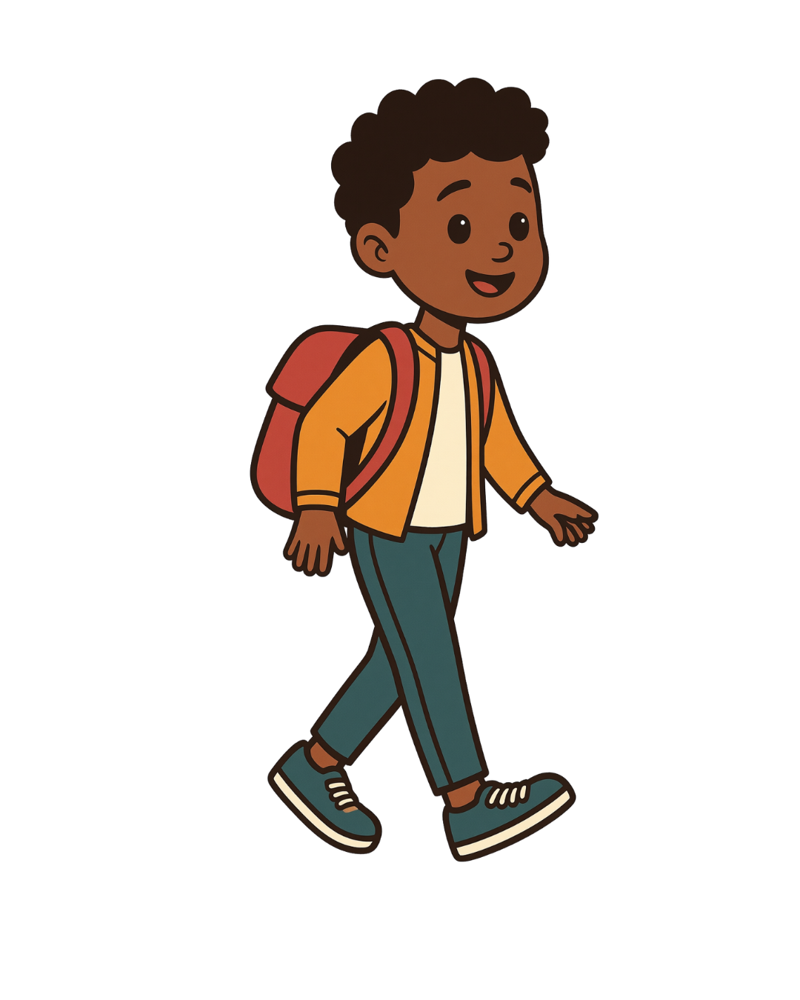
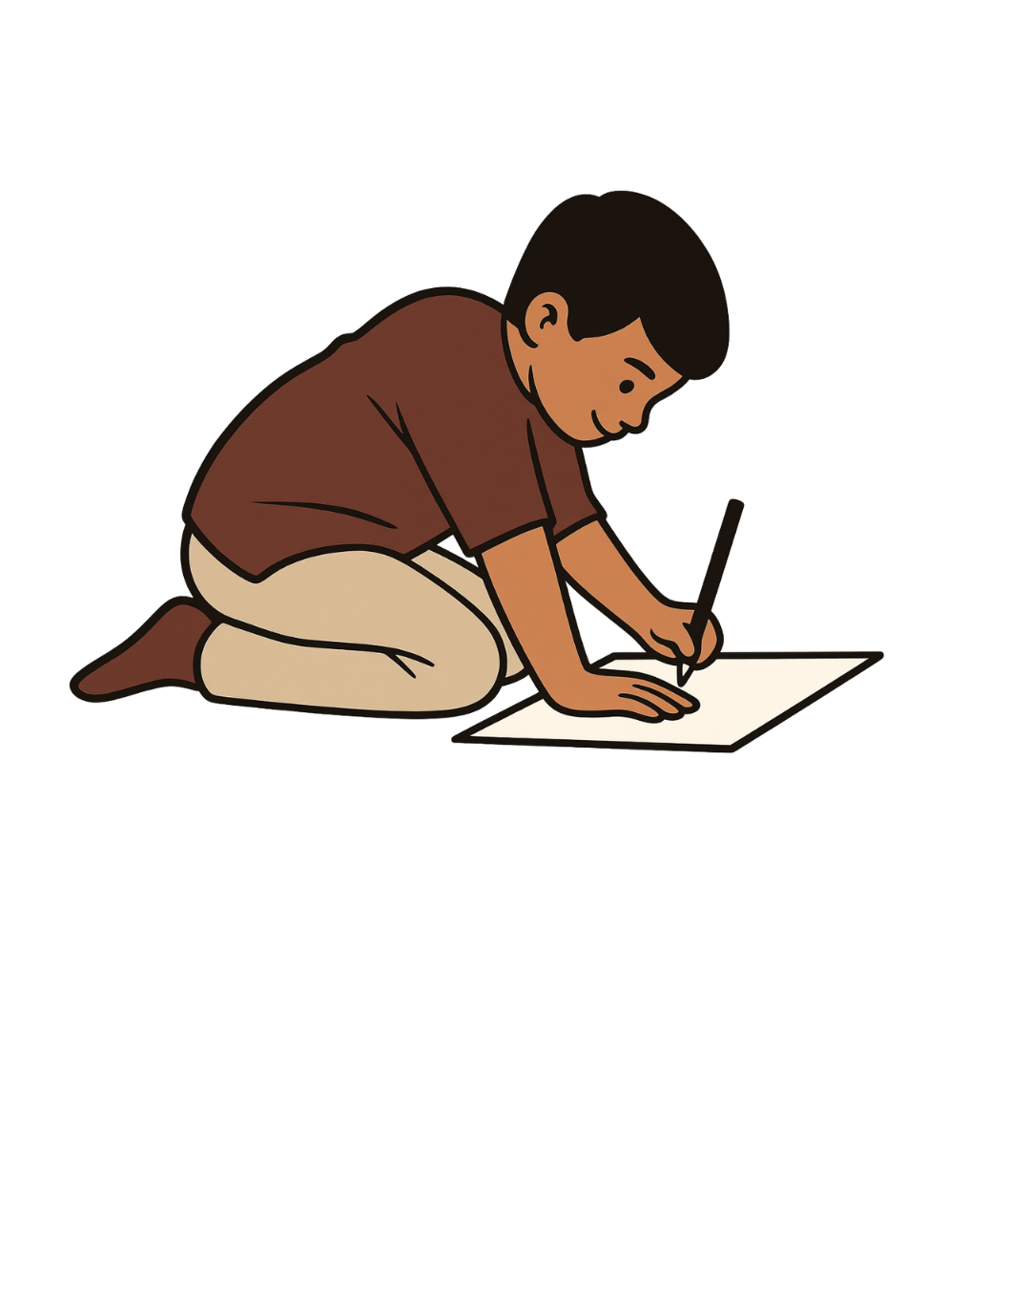
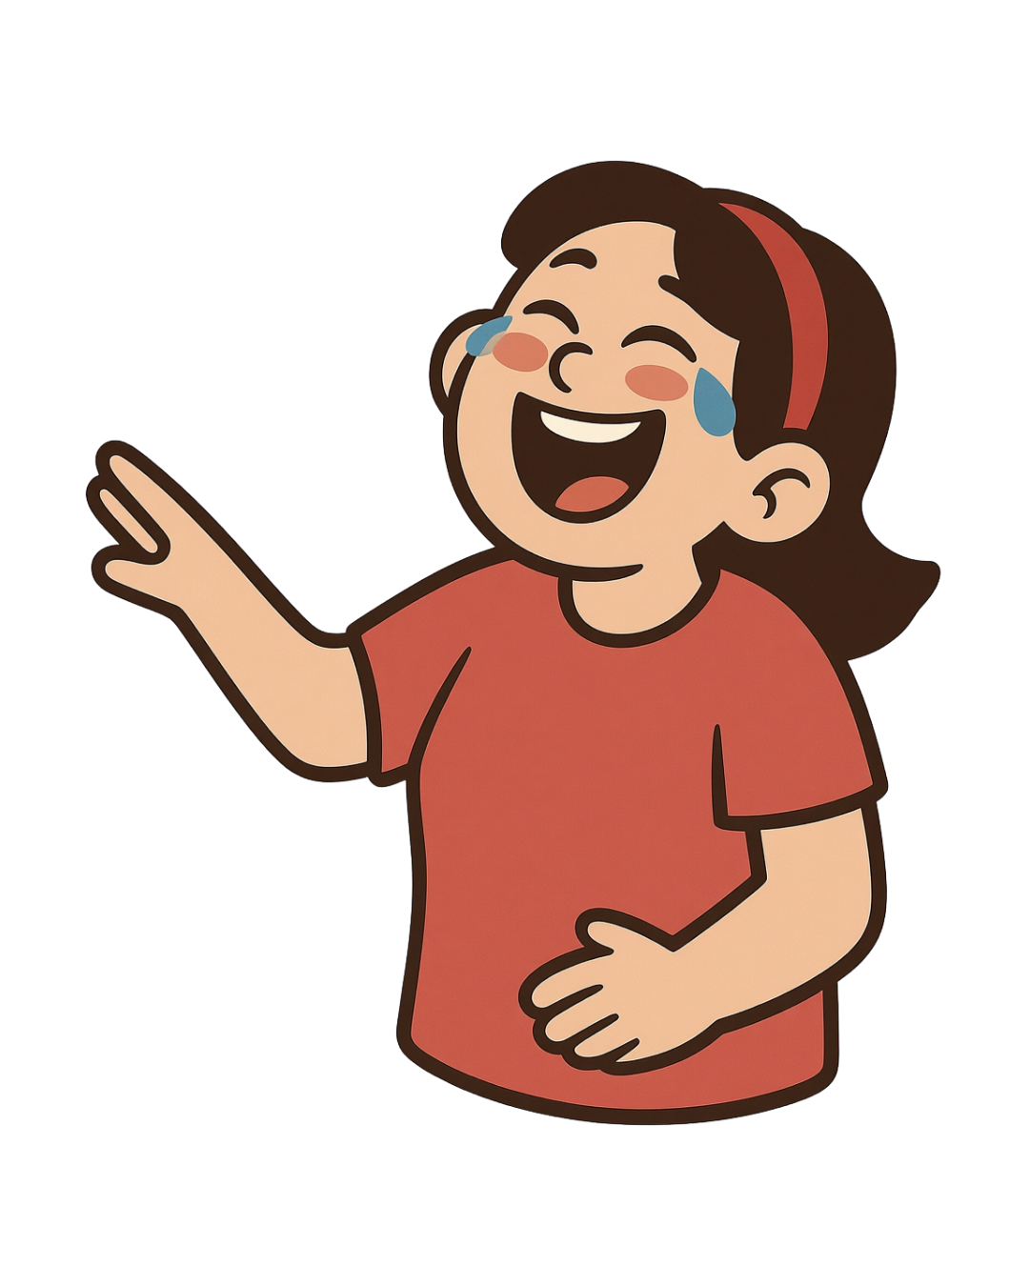
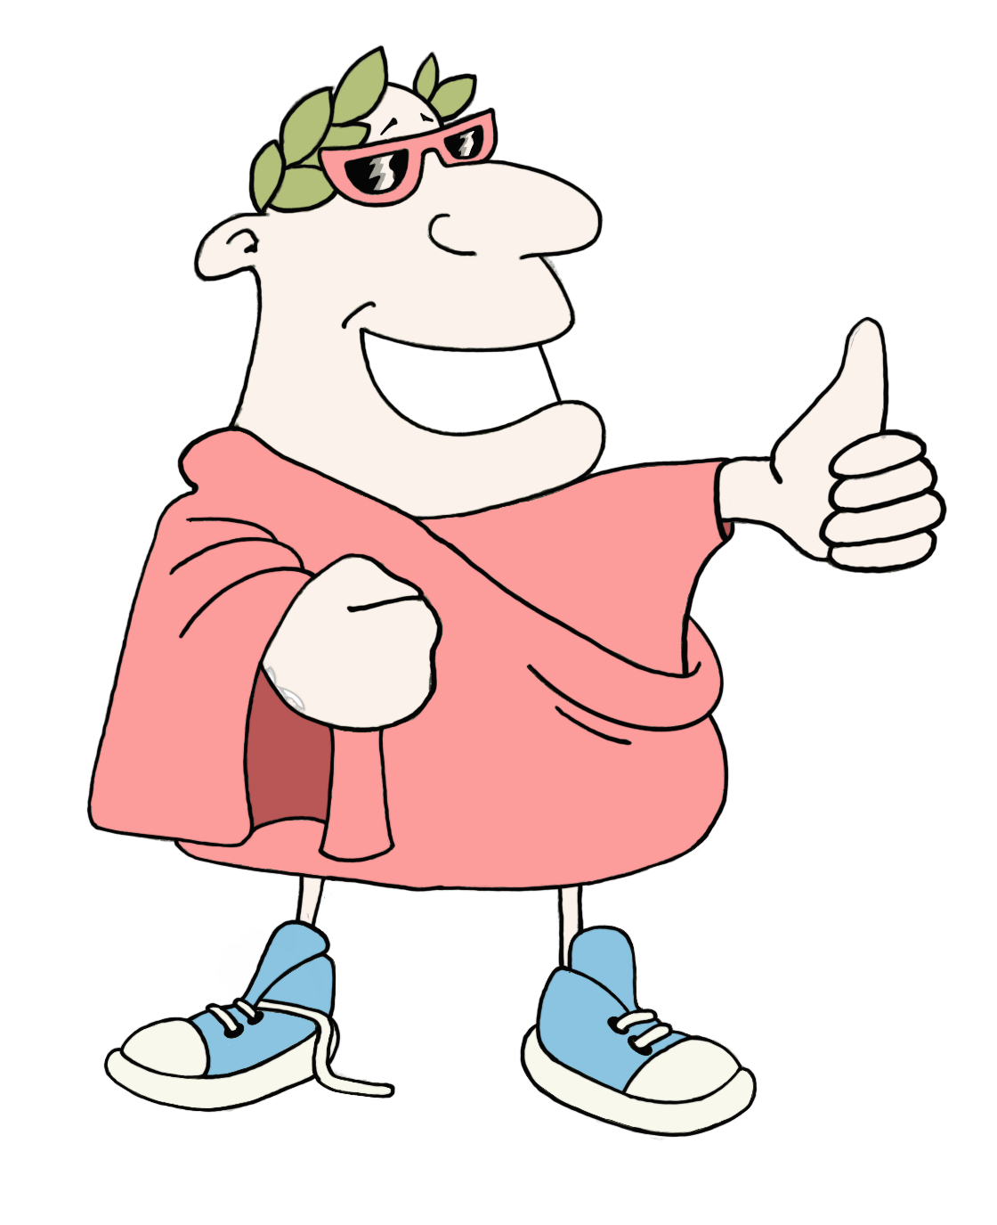
Connect the word root
Actions
Instructions
Put this deck into slideshow mode and click on the start arrow below.
Click on the orange buttons to listen to the words or go to the game.
Choose the word that you think is the Latin root for the word on the card. Wrong answers will disappear.
start
MaximumClassics.com
Latin for literacy
© C Andrew 2026

Slide 2
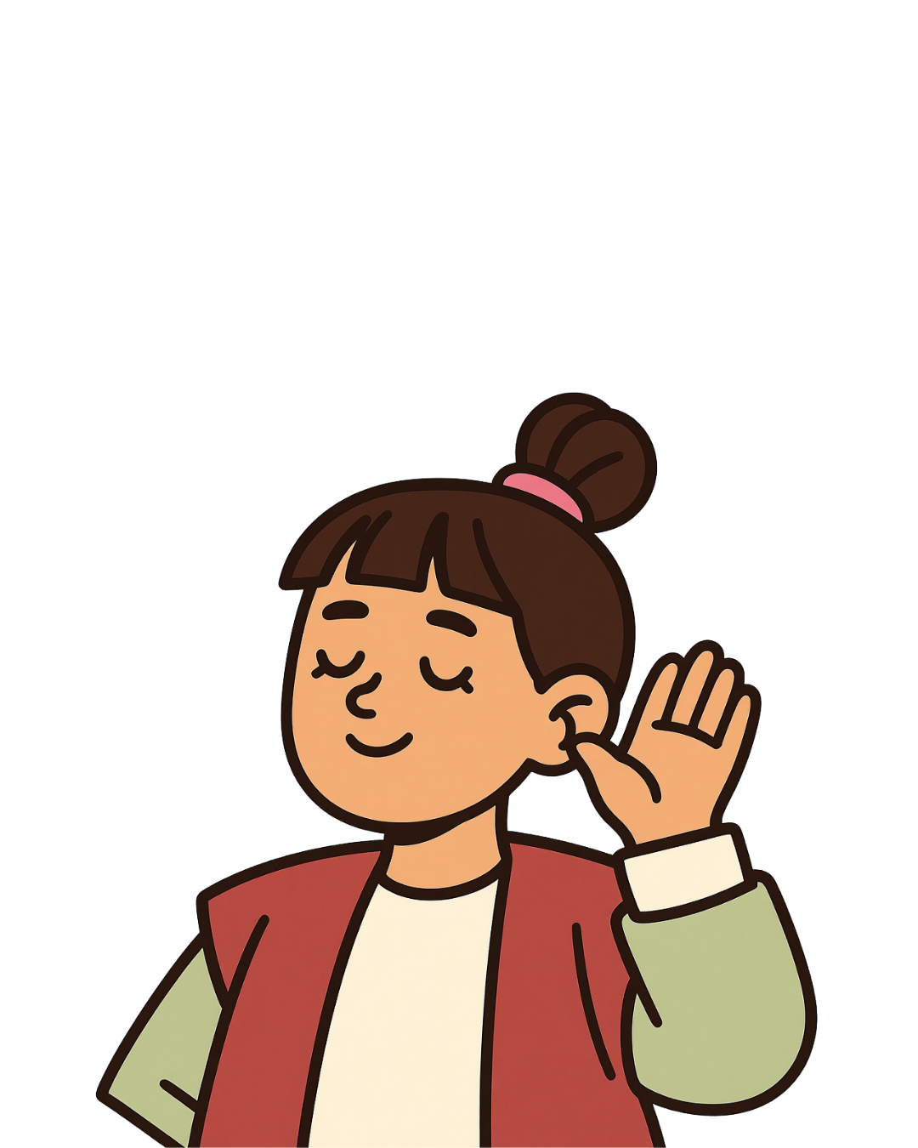
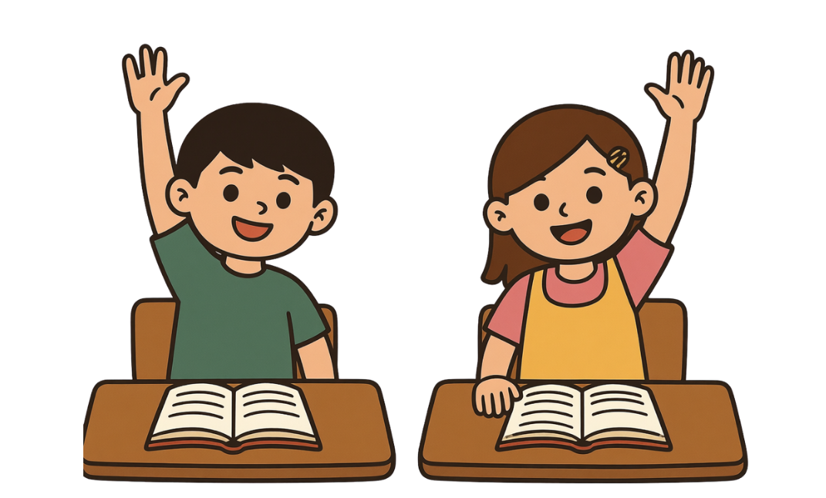
Connect the word root
Actions
listen
play
© C Andrew 2026

Slide 3
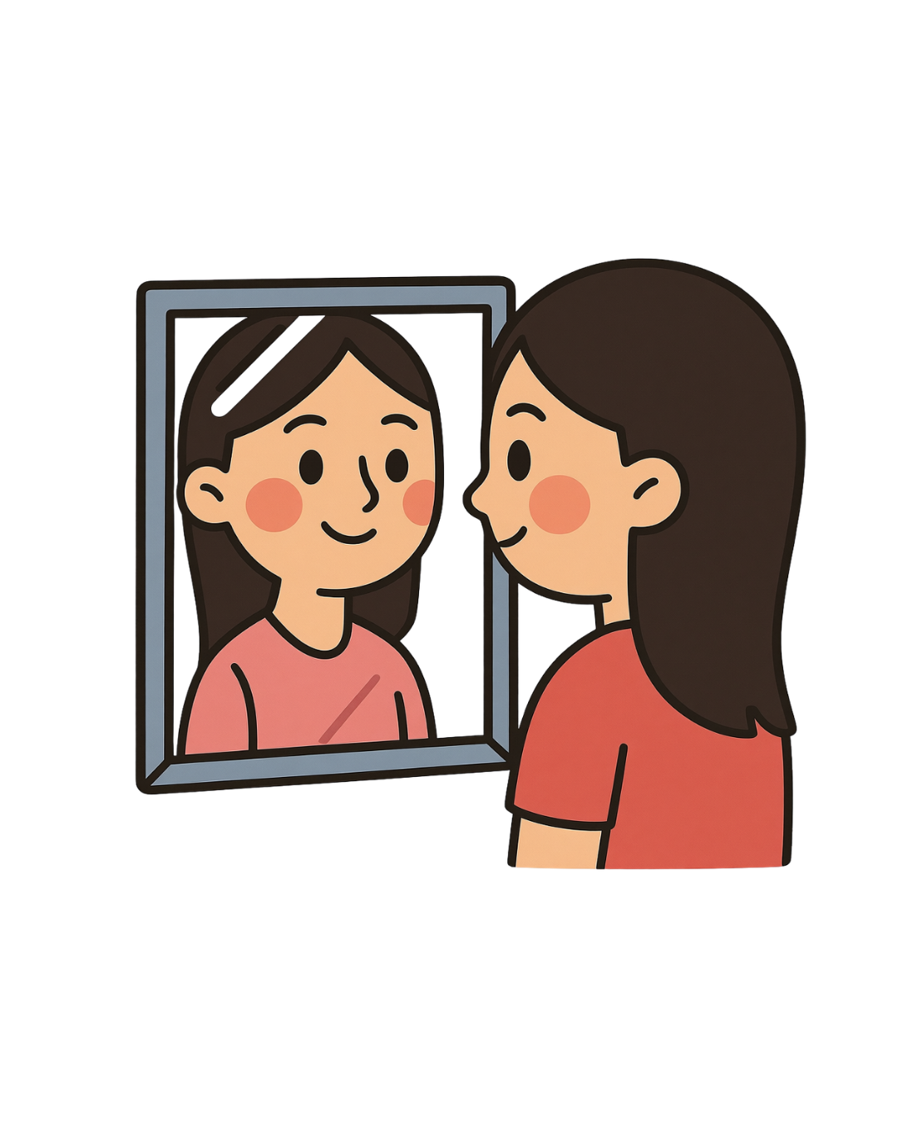
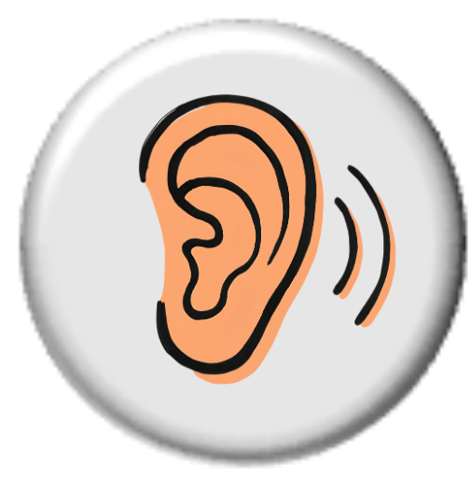
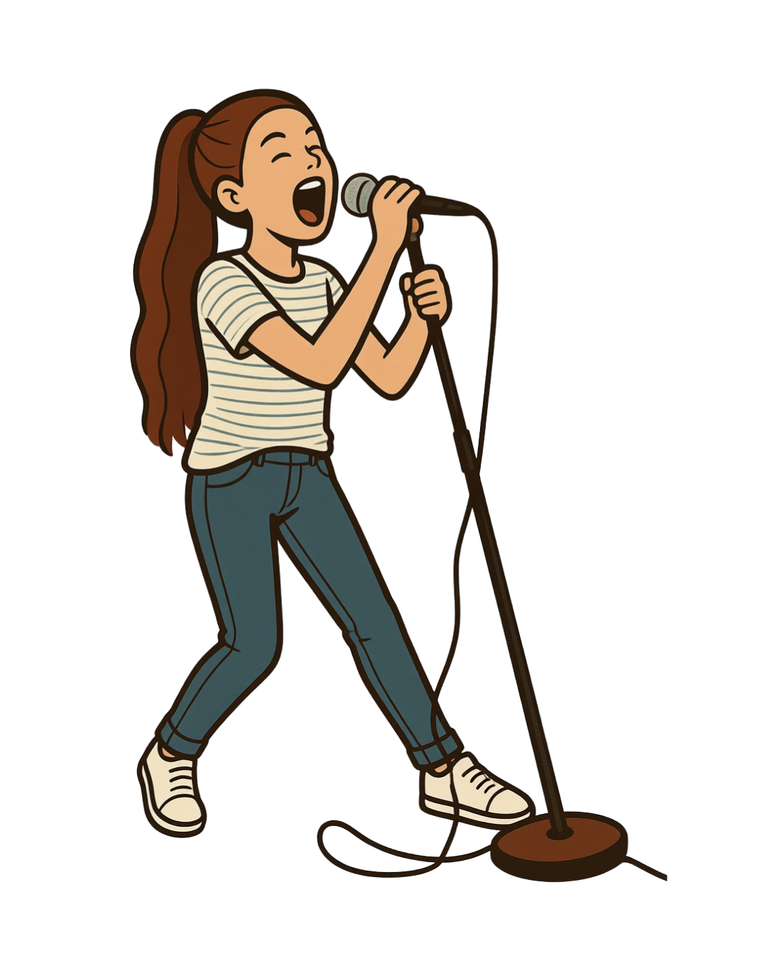

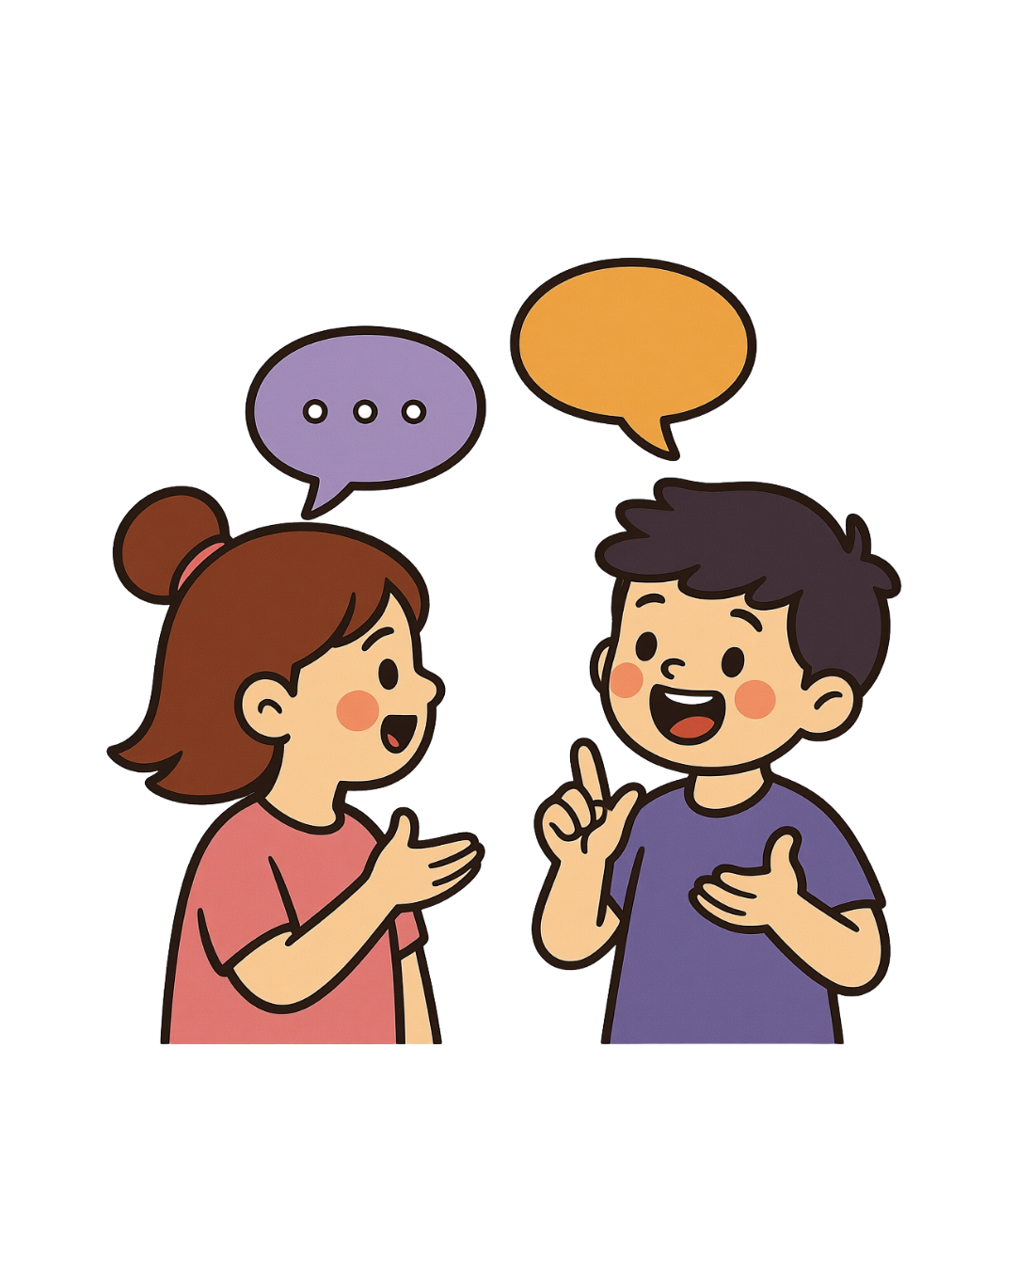
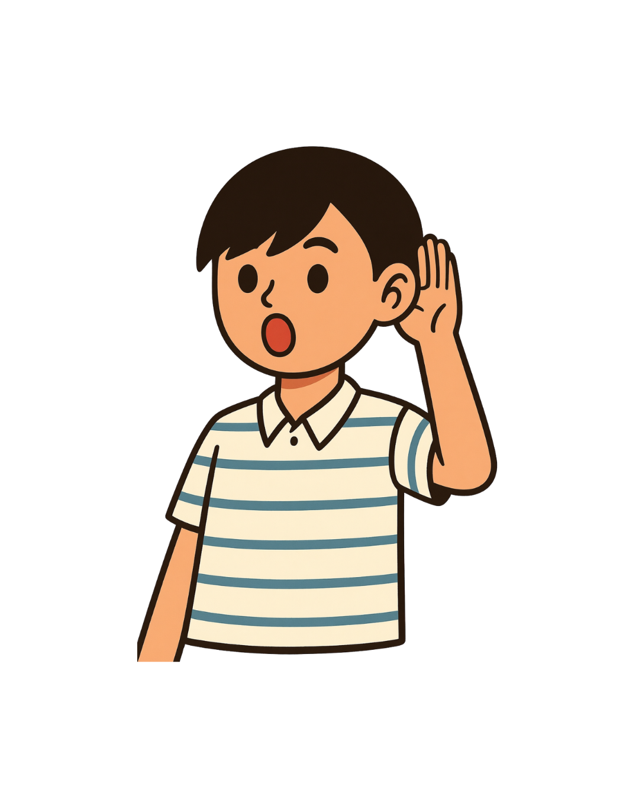
ambulare
ferre
cantare
videre
to walk
to see
to carry
to sing
scribere
ridere
to write, to draw
audire
dicere
to laugh
to hear
to say
play
© C Andrew 2026

Slide 4


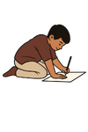
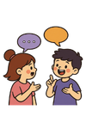
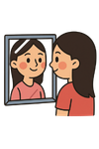

audible
Loud enough to hear
videre
scribere
audire
dicere
next
© C Andrew 2026

Slide 5



ferry
A boat that carries passengers
ambulare
ferre
videre
cantare
next
© C Andrew 2026

Slide 6

scribe
Someone who writes things down
scribere
ferre
audire
ridere
next
© C Andrew 2026

Slide 7
dictate
To say words out loud so they can be written down
ridere
videre
ambulare
dicere
next
© C Andrew 2026

Slide 8
amble
To walk slowly and calmly
ferre
ambulare
cantare
audire
next
© C Andrew 2026

Slide 9
chant
Speaking or singing words to a rhythm
cantare
ridere
scribere
videre
next
© C Andrew 2026

Slide 10
ridiculous
Something so silly that it makes you laugh
ridere
cantare
ferre
scribere
next
© C Andrew 2026

Slide 11
invisible
When something cannot be seen
audire
videre
ridere
dicere
next
© C Andrew 2026

Slide 12
gratias ludentibus!
Thanks for playing!
MaximumClassics.com
Latin for literacy

