Slide 1

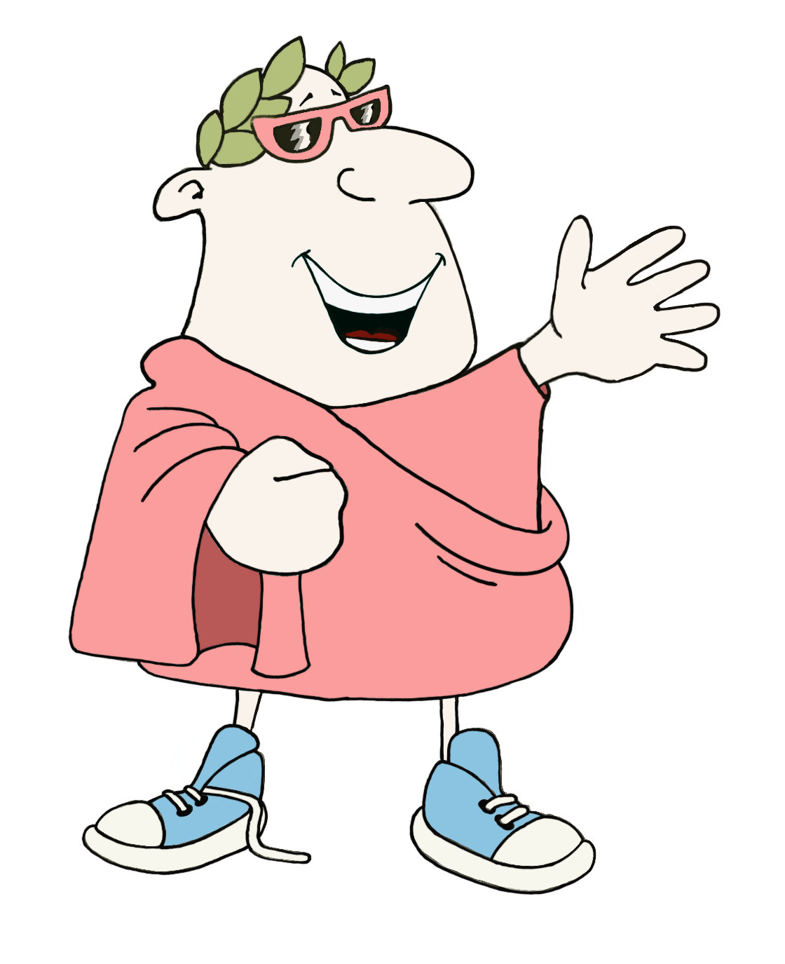
Maximum Classics
Latin for literacy
1. Put into slideshow mode
2. Choose your topic
3. Use the buttons to start chattin’
go to topics

Slide 2
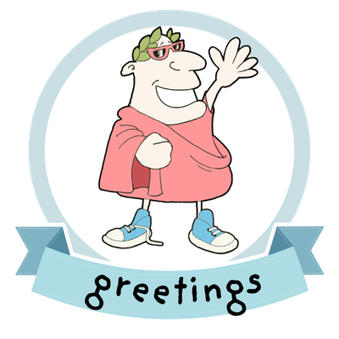
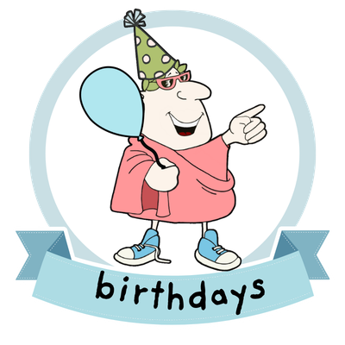
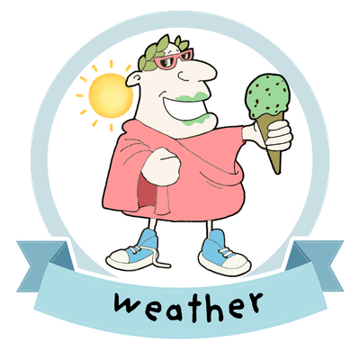



say hello and goodbye
wish someone a happy birthday
describe the weather
choose your favourite
what job would you rather do?
flags quiz – guess the country

Slide 3
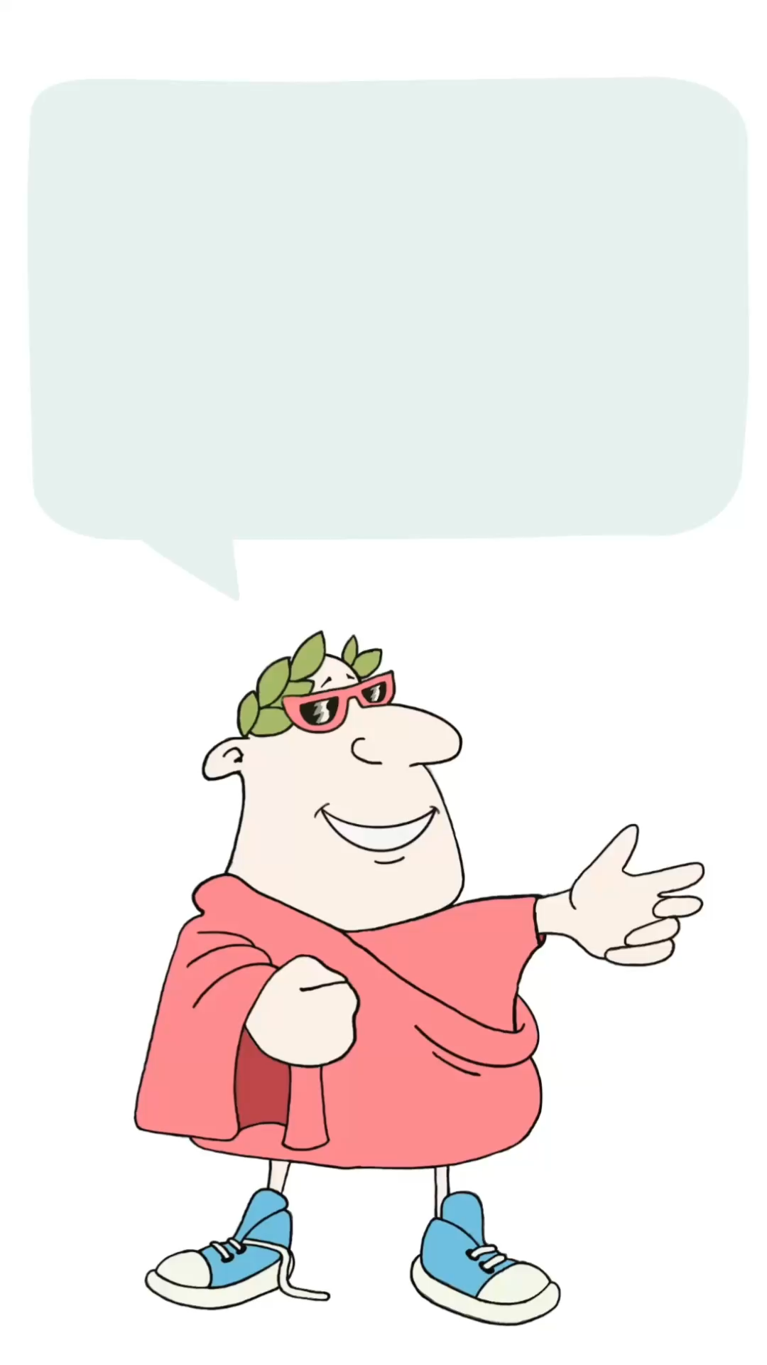
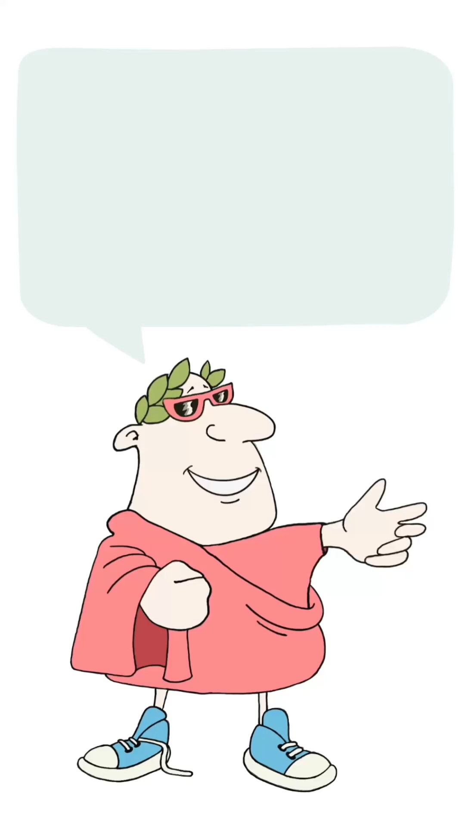
salve(te)
be well
quid agis(tis)
how are you doing
hello
say hello
to one person
say hello
to more than one person
translation
back to topic page
say goodbye

Slide 4
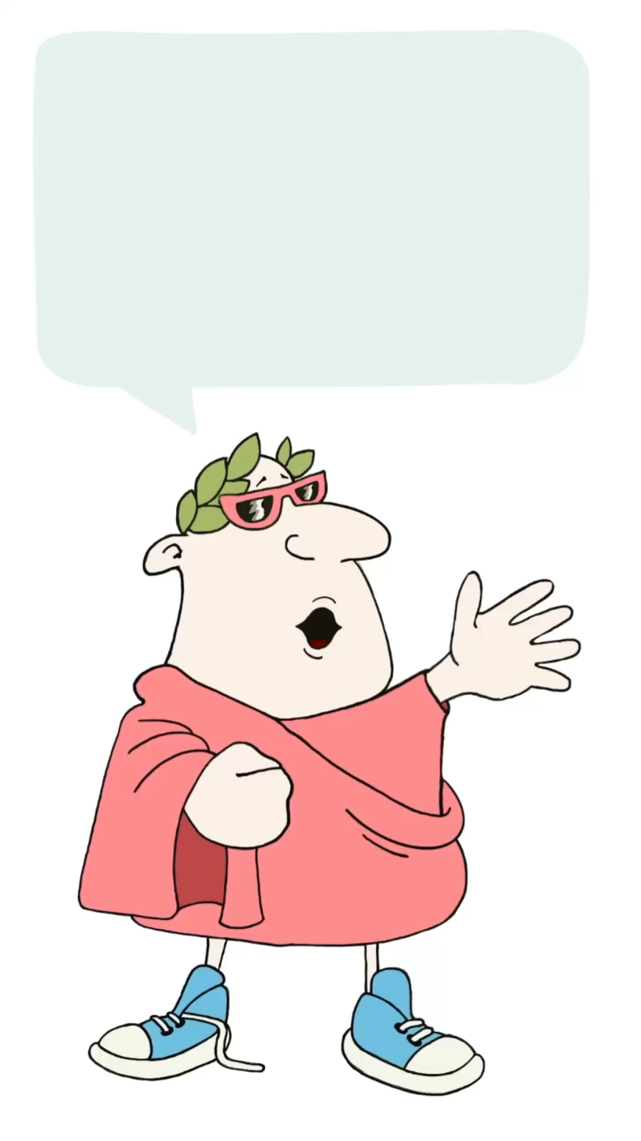
goodbye
vale(te)
be well
say goodbye
to one person
say goodbye
to more than one person
translation
back to topic page

Slide 5
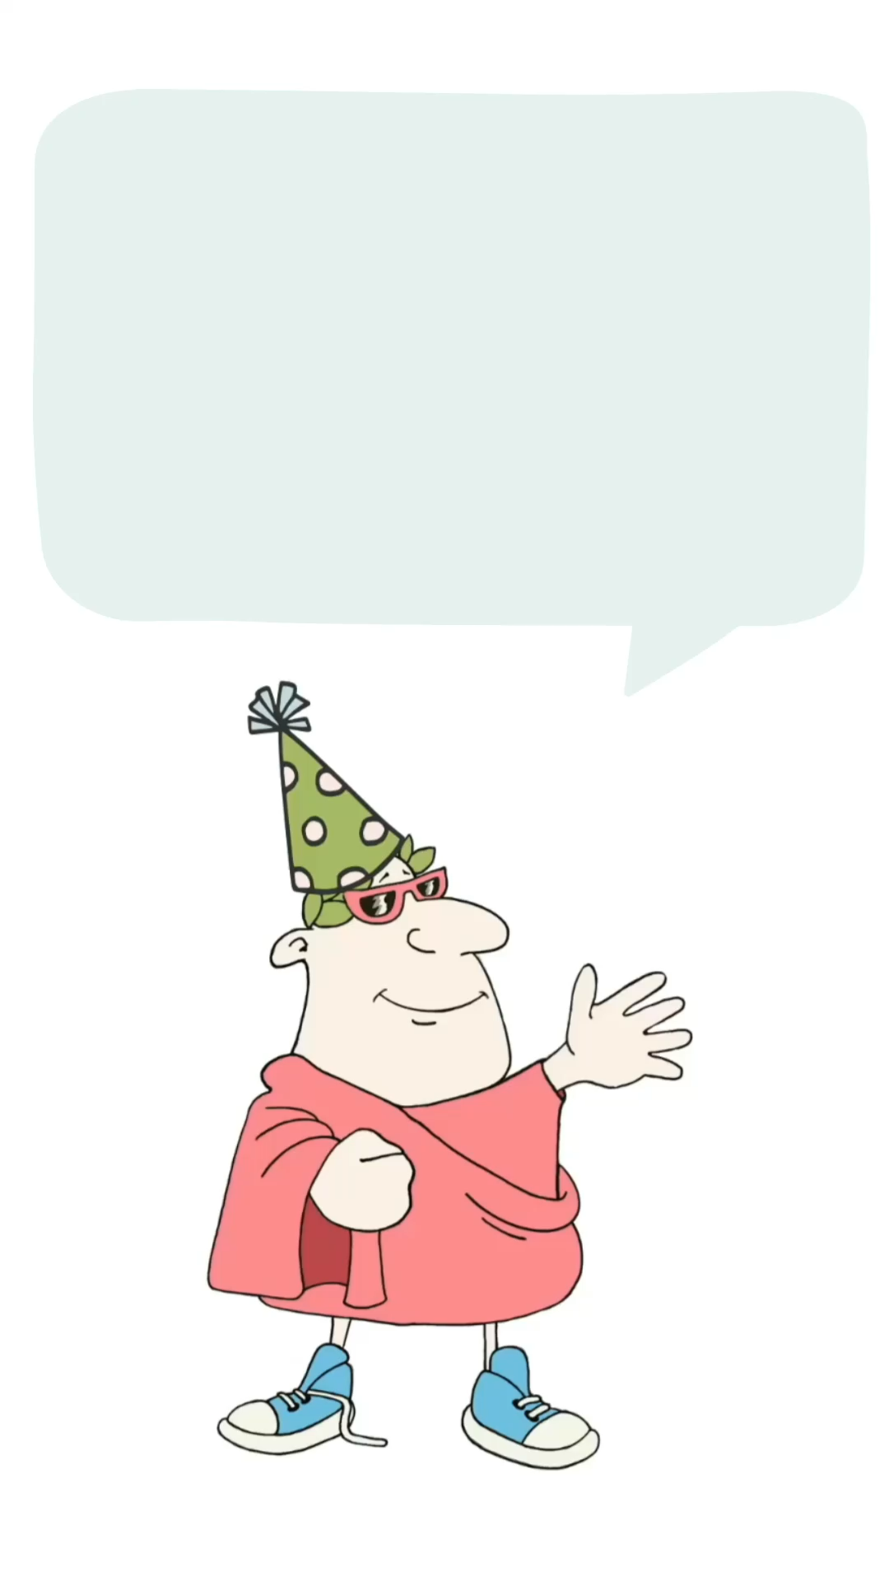
felix happy/lucky
dies day
tibi to you
sit may there be
wish someone a
happy birthday
translation
back to topic page
sing Happy Birthday

Slide 6

felix happy/lucky
dies day
tibi to you
sit may there be
cara/care dear
start the song
translation
back to topic page

Slide 7





Choose your weather
back to topic page
next topic

Slide 8
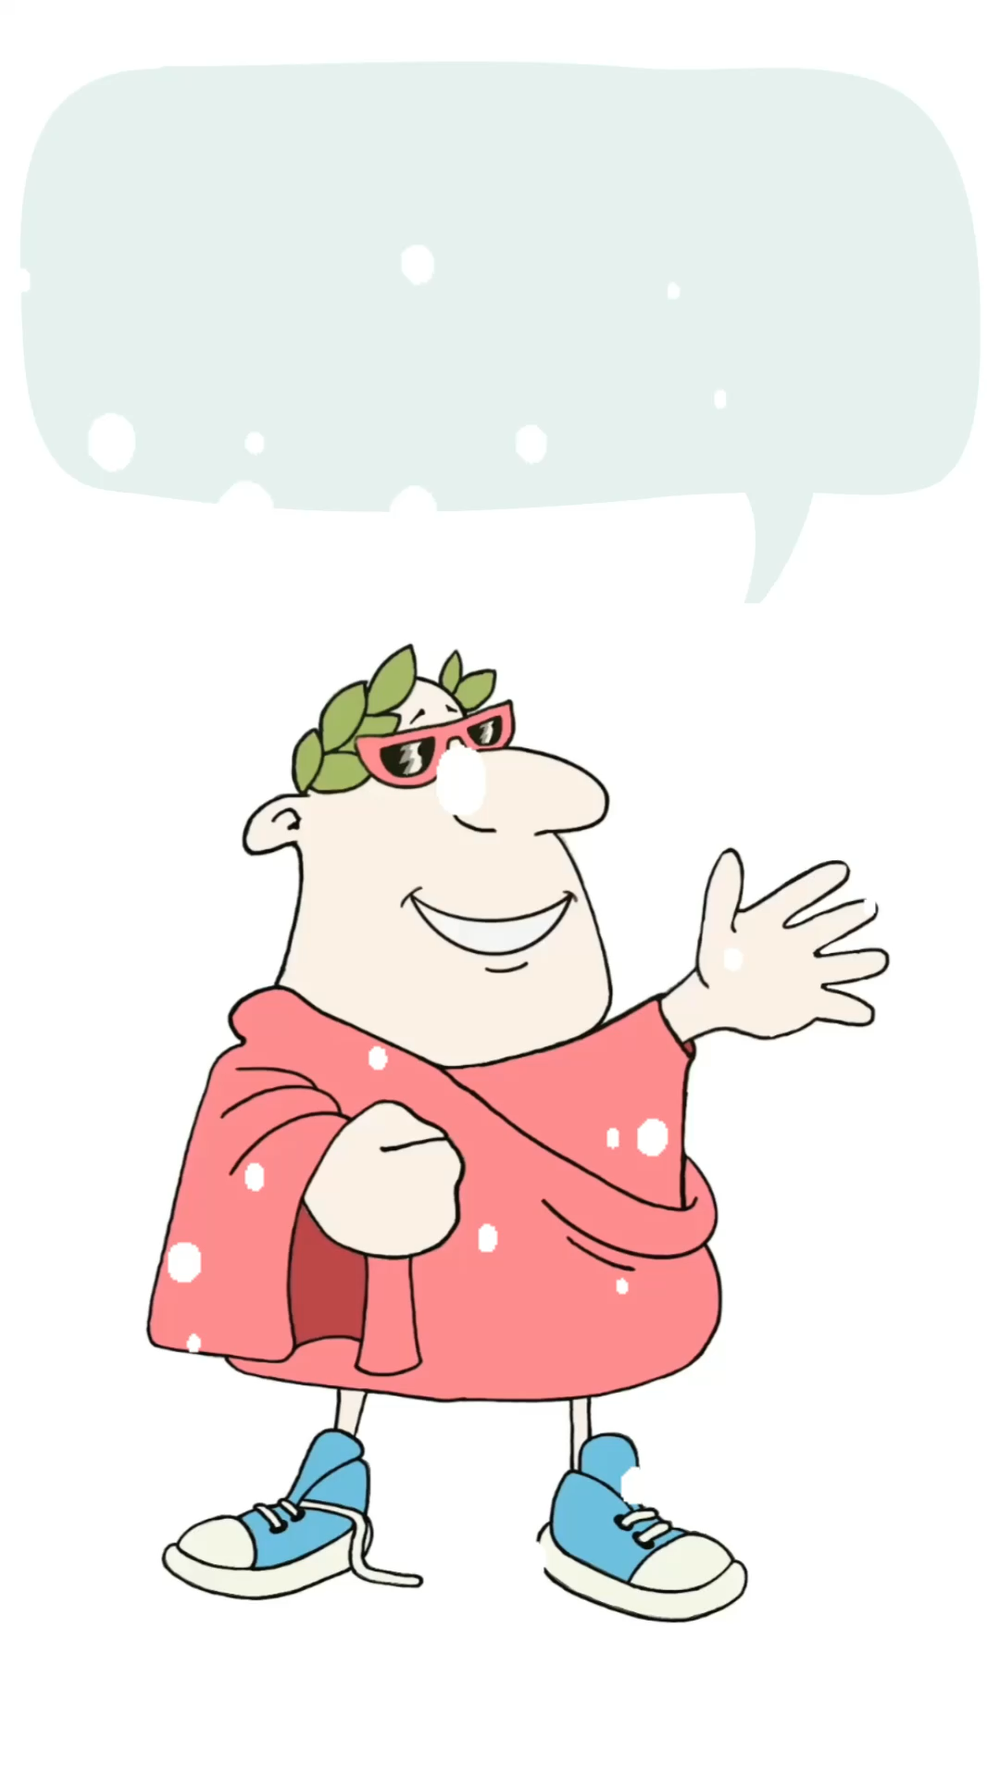
hodie today
nix snow
adest is here
say it’s snowing
translation
back to weather page

Slide 9
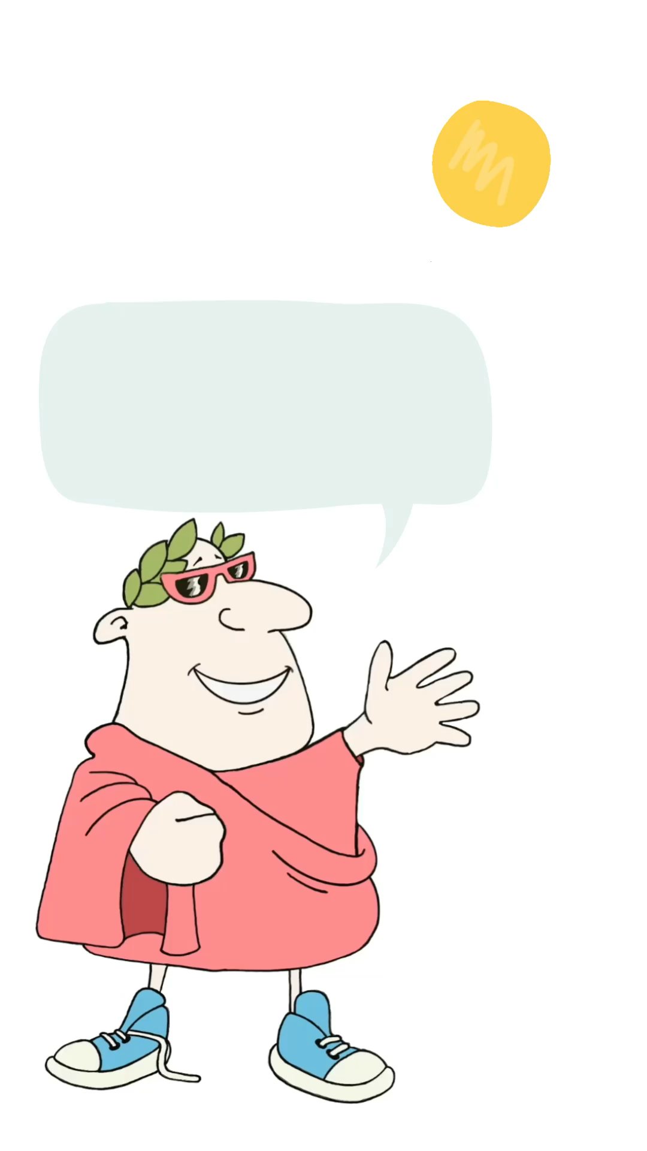
hodie today
sol the sun
lucet is shining
say it’s sunny
translation
back to weather page

Slide 10
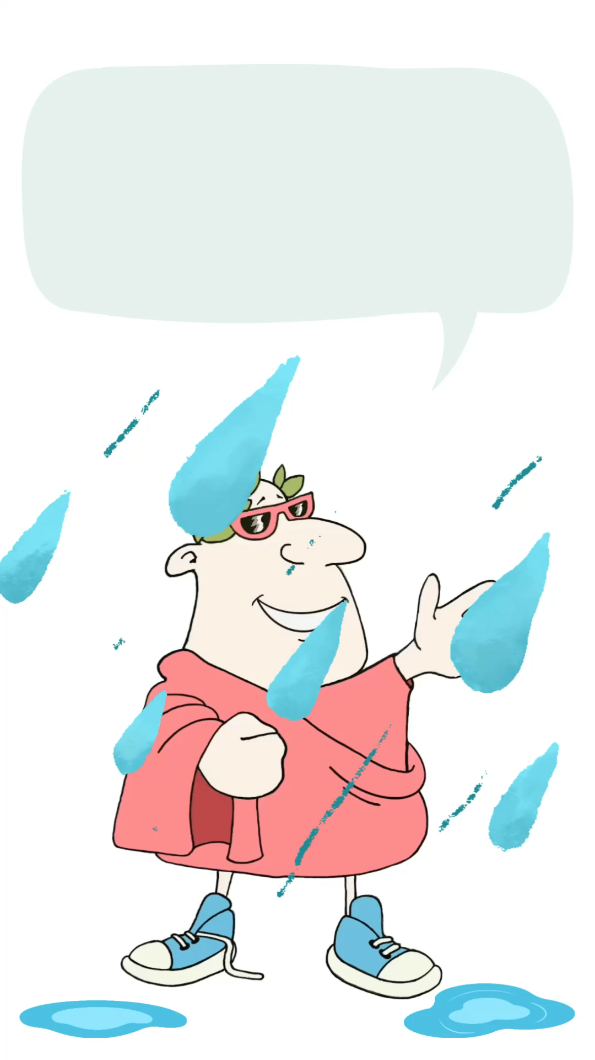
hodie today
pluit it’s raining
say it’s raining
translation
back to weather page

Slide 11
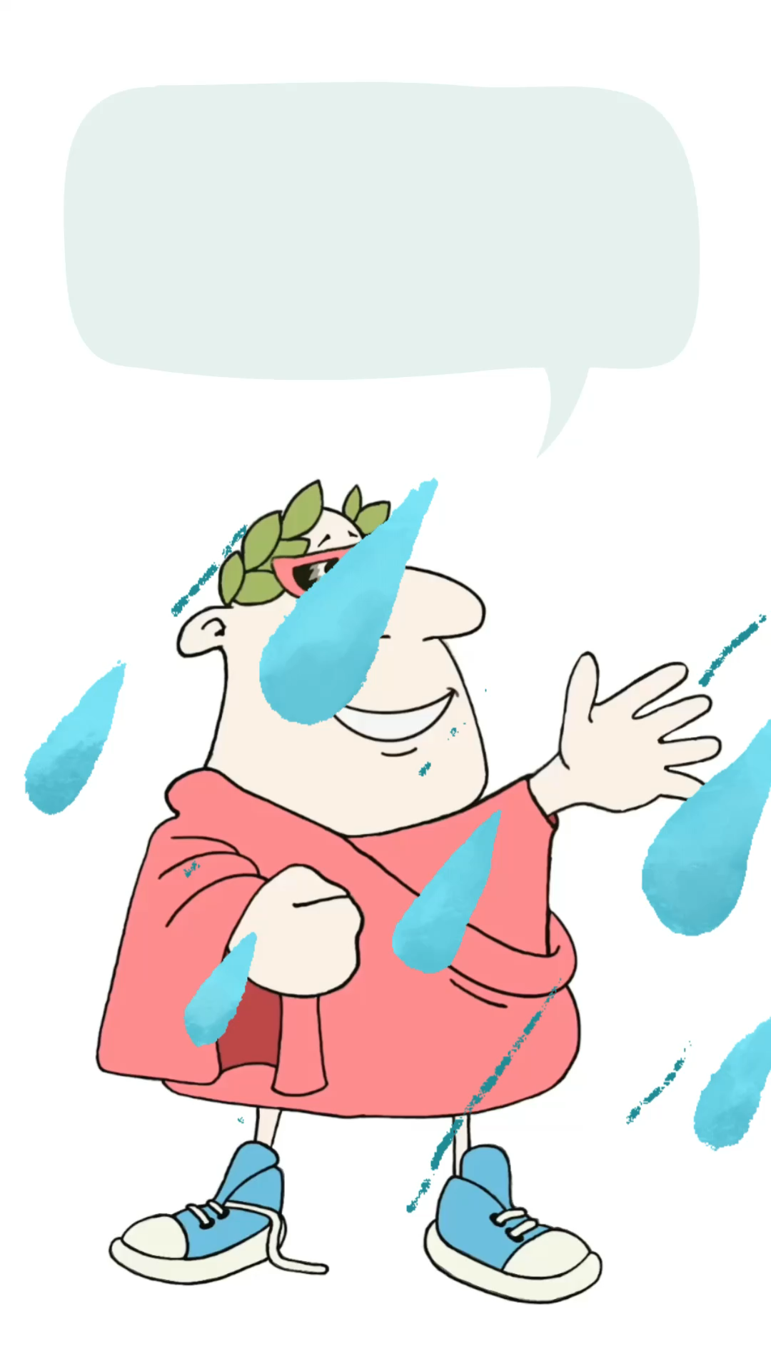
hodie today
tempestas a storm
adest is here
say it’s stormy
translation
back to weather page

Slide 12
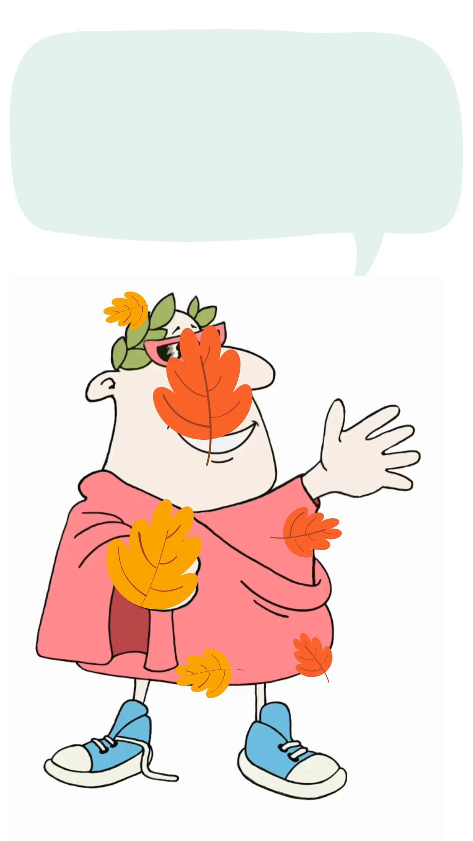
hodie today
ventus the wind
efflavit is blowing
say it’s windy
translation
back to weather page

Slide 13
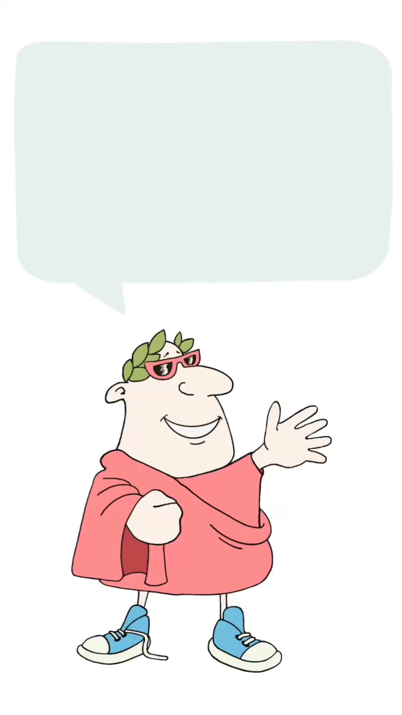
quid what
adultus (as) a grown-up man
aut or
adulta (as) a grown-up woman
fieri to become
mavis you prefer
agricola a farmer
argentarius a banker
1/8
ask what job someone would prefer
translation
back to topic page
more jobs

Slide 14
quid what
adultus (as) a grown-up man
aut or
adulta (as) a grown-up woman
fieri to become
mavis you prefer
cantor a singer
athleta an athlete
2/8
ask what job someone would prefer
translation
back to topic page
more jobs

Slide 15
quid what
adultus (as) a grown-up man
aut or
adulta (as) a grown-up woman
fieri to become
mavis you prefer
coquus a cook/chef
actor an actor
3/8
ask what job someone would prefer
translation
back to topic page
more jobs

Slide 16
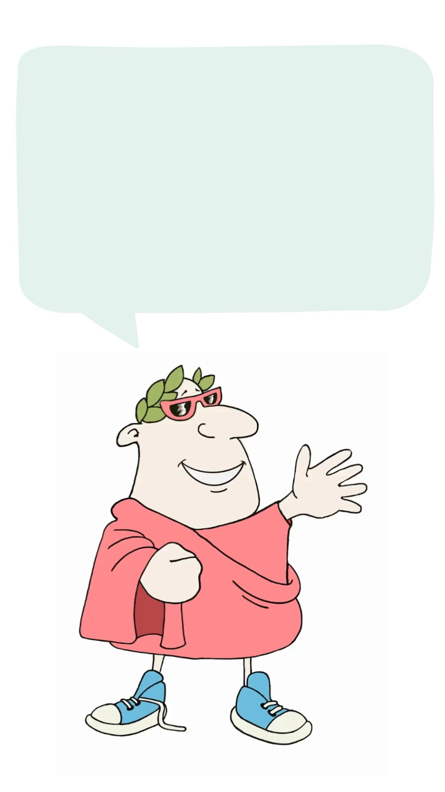
quid what
adultus (as) a grown-up man
aut or
adulta (as) a grown-up woman
fieri to become
mavis you prefer
caupo a shopkeeper
miles a soldier
4/8
ask what job someone would prefer
translation
back to topic page
more jobs

Slide 17
quid what
adultus (as) a grown-up man
aut or
adulta (as) a grown-up woman
fieri to become
mavis you prefer
magister/magistra a teacher
scriptor a writer
5/8
ask what job someone would prefer
translation
back to topic page
more jobs

Slide 18
quid what
adultus (as) a grown-up man
aut or
adulta (as) a grown-up woman
fieri to become
mavis you prefer
medicus a doctor
aedificator a builder
6/8
ask what job someone would prefer
translation
back to topic page
more jobs

Slide 19
quid what
adultus (as) a grown-up man
aut or
adulta (as) a grown-up woman
fieri to become
mavis you prefer
nauta a sailor
architectus an architect
7/8
ask what job someone would prefer
translation
back to topic page
more jobs

Slide 20
quid what
adultus (as) a grown-up man
aut or
adulta (as) a grown-up woman
fieri to become
mavis you prefer
pictor a painter
physicus a scientist
8/8
ask what job someone would prefer
translation
back to topic page

Slide 21
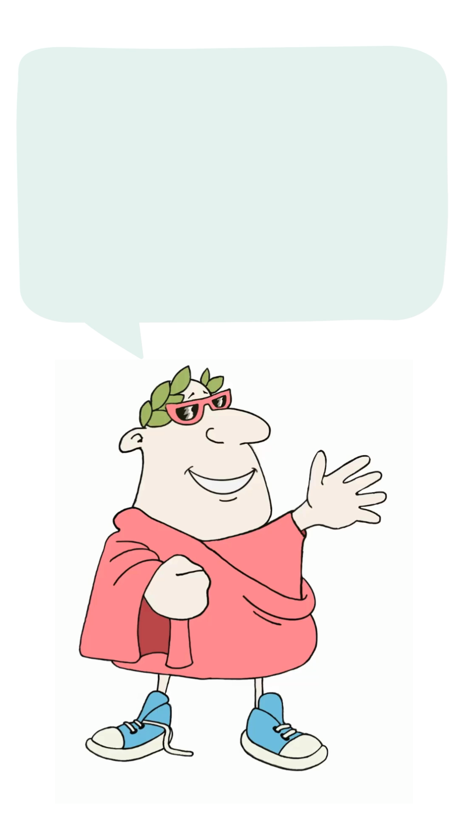
quid what
tibi to you
maxime most
placet is pleasing
canis a dog
aut or
feles a cat
1/7
ask what animal someone likes most
translation
back to topic page
more animals

Slide 22
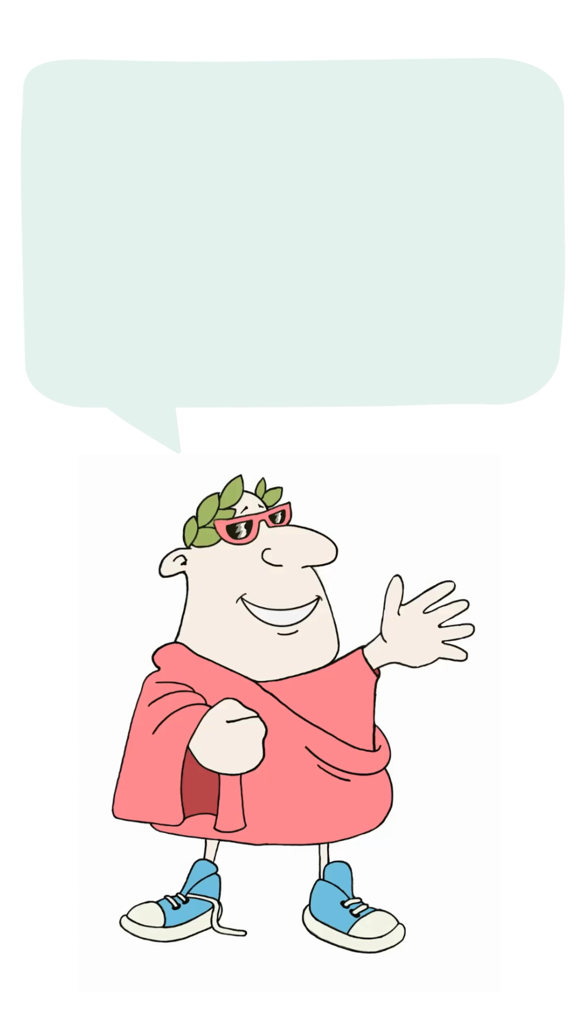
quid what
tibi to you
maxime most
placet is pleasing
tigris a tiger
aut or
leo a lion
2/7
ask what animal someone likes most
translation
back to topic page
more animals

Slide 23
quid what
tibi to you
maxime most
placet is pleasing
elephantus an elephant
aut or
crocodilus a crocodile
3/7
ask what animal someone likes most
translation
back to topic page
more animals

Slide 24
quid what
tibi to you
maxime most
placet is pleasing
cygnus a swan
aquila an eagle
4/7
ask what animal someone likes most
translation
back to topic page
more animals

Slide 25
quid what
tibi to you
maxime most
placet is pleasing
mus a mouse
sciurus a squirrel
5/7
ask what animal someone likes most
translation
back to topic page
more animals

Slide 26
quid what
tibi to you
maxime most
placet is pleasing
aranea a spider
serpens a snake
6/7
ask what animal someone likes most
translation
back to topic page
more animals

Slide 27
quid what
tibi to you
maxime most
unicornis a unicorn
draco a dragon
7/7
ask what animal someone likes most
translation
back to topic page

Slide 28
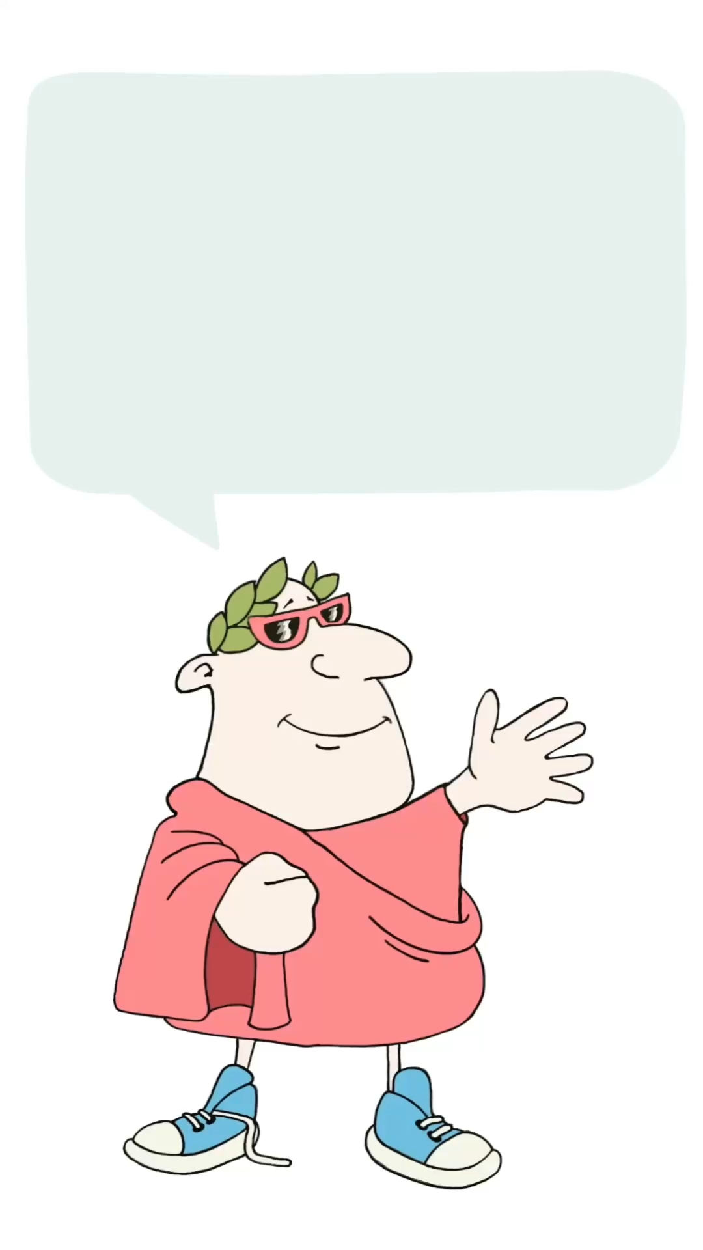
estne is…?
hoc this
vexillum flag
Britanniae Britain’s
aut or
Americae America’s
1/9
hear the flag
question
translation
back to topic page
next flag question

Slide 29
estne is…?
hoc this
vexillum flag
Aegypti Egypt’s
aut or
Scotiae Scotland’s
2/9
hear the flag
question
translation
back to topic page
next flag question

Slide 30
estne is…?
hoc this
vexillum flag
Australiae Australia’s
aut or
Indiae India’s
3/9
hear the flag
question
translation
back to topic page
next flag question

Slide 31
estne is…?
hoc this
vexillum flag
Germaniae Germany’s
aut or
Galliae France’s
4/9
hear the flag
question
translation
back to topic page
next flag question

Slide 32
estne is…?
hoc this
vexillum flag
Graceiae Greece’s
aut or
Helvetiae Switzerland’s
5/9
hear the flag
question
translation
back to topic page
next flag question

Slide 33
estne is…?
hoc this
vexillum flag
Hiberniae Ireland’s
aut or
Belgicae Belgium’s
6/9
hear the flag
question
translation
back to topic page
next flag question

Slide 34
estne is…?
hoc this
vexillum flag
Italiae Italy’s
aut or
Corsicae Corsica’s
7/9
hear the flag
question
translation
back to topic page
next flag question

Slide 35
estne is…?
hoc this
vexillum flag
Romaniae Romania’s
aut or
Hispaniae Spain’s
8/9
hear the flag
question
translation
back to topic page
next flag question

Slide 36
estne is…?
hoc this
vexillum flag
Siciliae Sicily’s
aut or
Cypri Cyprus’s
9/9
hear the flag
question
translation
back to topic page

