Slide 1
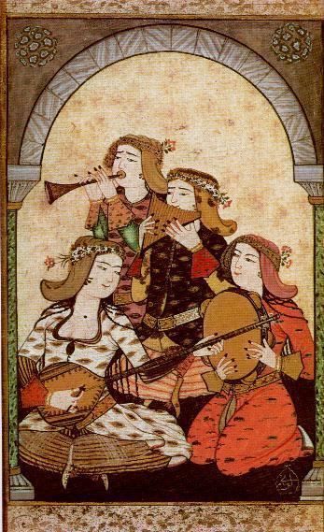
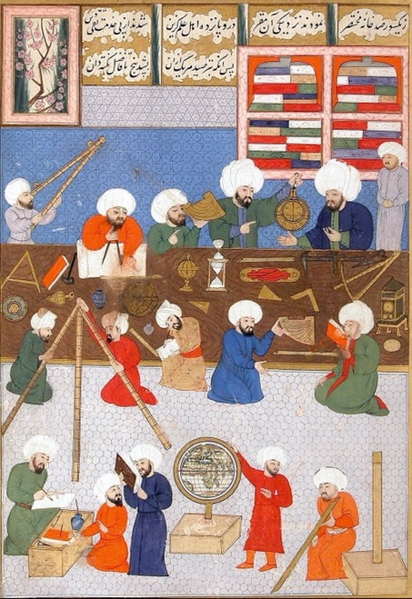
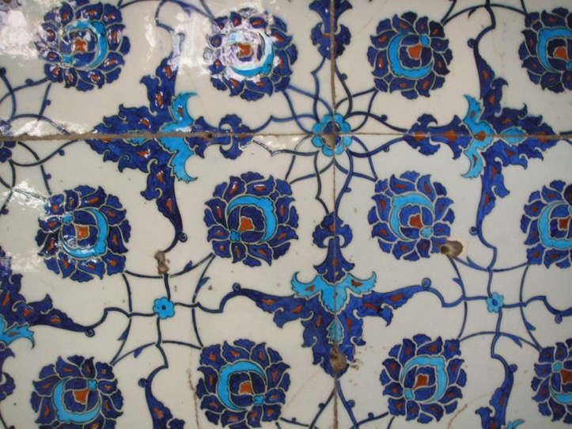
The Ottomans
L.O. To learn about the history & culture of the Ottomans and to create an iznik tile pattern

Slide 2
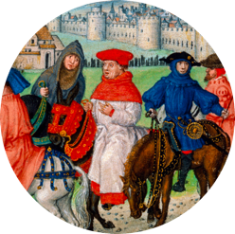
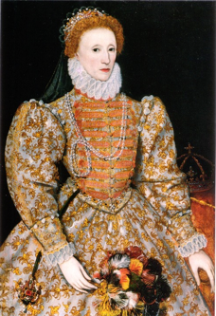
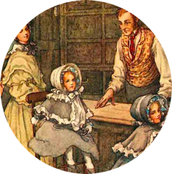
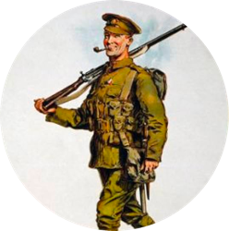
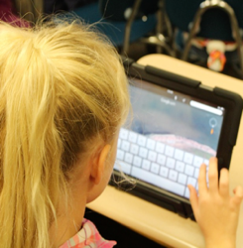
Time travel through British history
Middle Ages
1066-1485
Tudors & Elizabethans 1485-1603
Georgians & Victorians
1714-1901
20th Century
1900-1999
Modern times
1000 years ago
600 years ago
300 years ago
100 years ago

Slide 3
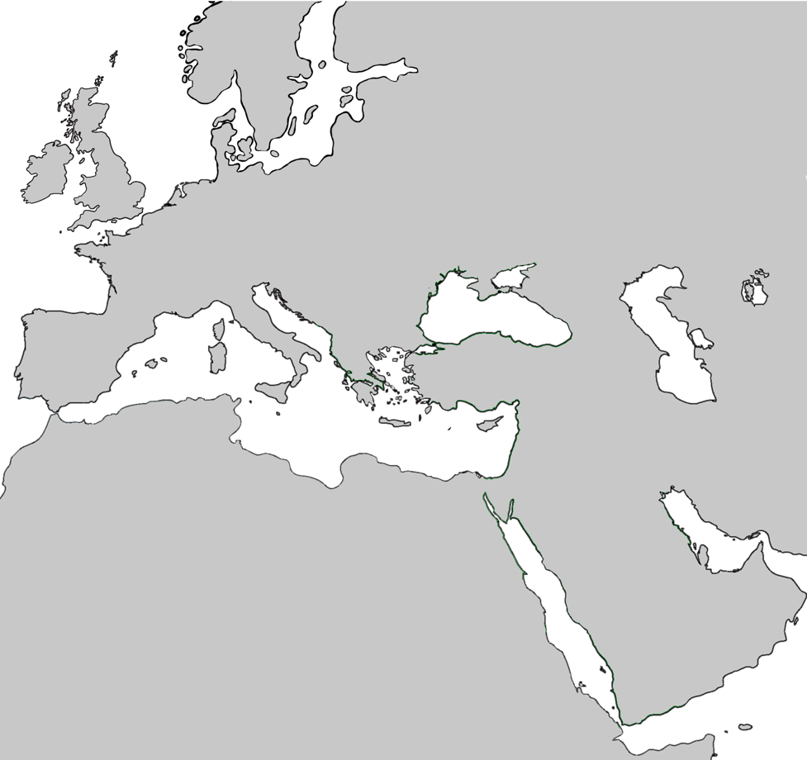
Eastwards From Britain
We just looked at the timeline for British history.
Can you identify Britain on this map?
Let’s move eastwards and look at the history of a different culture.
The country that in modern times we now call Türkiye (Turkey) was the centre of the Ottoman civilization, an important culture for hundreds of years.

Slide 4
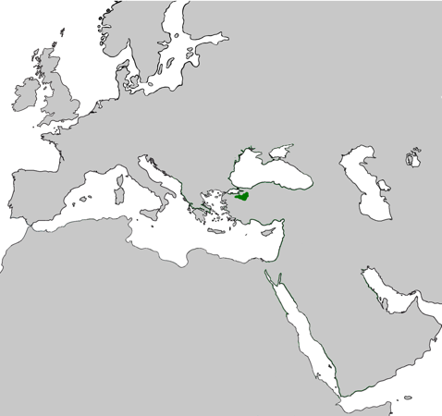
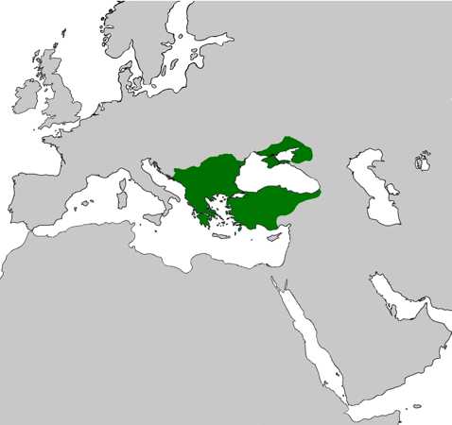
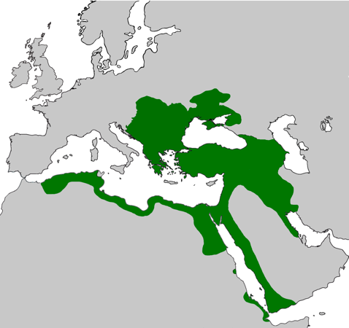
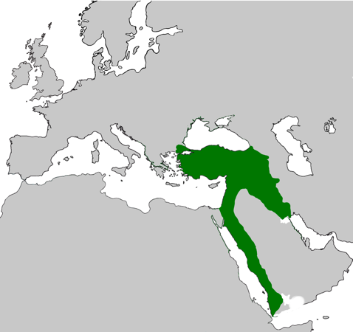
Ottoman civilisation
700 years ago
600 years ago
300 years ago
100 years ago
The Ottomans started off by ruling a small area in what is now northern Türkiye (Turkey).
The lands they controlled grew over time to include Greece, Serbia and Crimea.
At their most powerful, the Ottomans controlled a large part of Eastern Europe, North Africa and the Middle East.
Their lands eventually decreased in size as events such as wars in the 19th and 20th centuries unfolded.

Slide 5
Ottoman achievements & discoveries
Science
What do you think these people in the picture are doing?
What objects can you see in the background of the picture? What things can you see in the foreground?
What does this tell us about these people shown here?
Astronomers at the Taqi al Din observatory
(place for looking at the stars in the night sky), 1577-1580

Slide 6
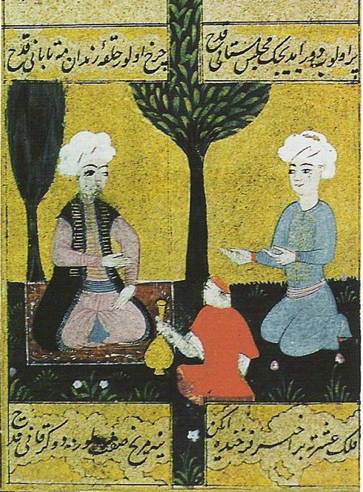
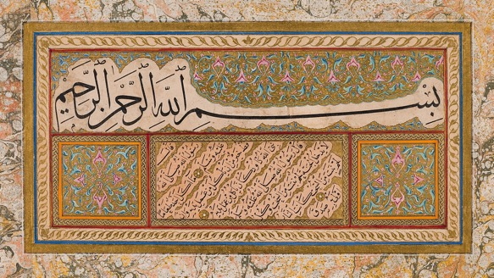
Ottoman achievements & discoveries
Writing
Ottoman culture produced great poetry & stories
Which one of these people do you think is the poet? Why do you think this?
What do you think the person holding the bottle is doing?
Ottoman writers also practiced calligraphy, the art of making written words decorative
Can you see the letters in Arabic script?
Page of a book written by Sheikh Hamdullah (1436–1520)
A poet and guest in a garden,
16th century picture

Slide 7
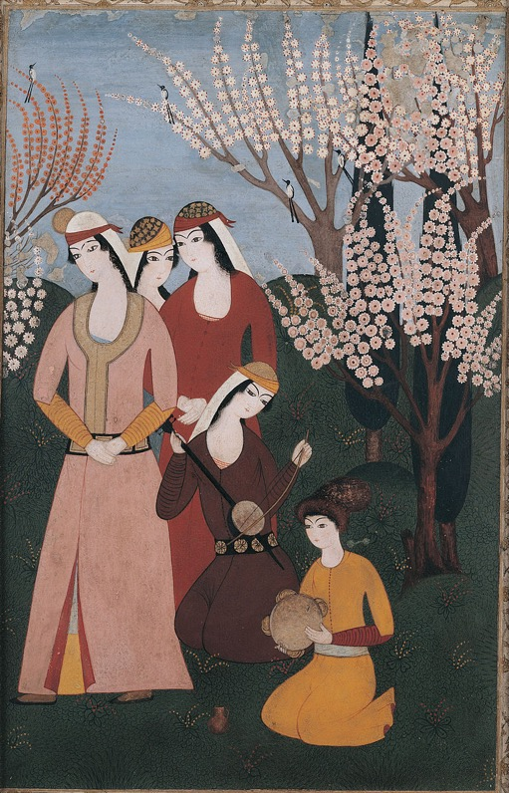
Ottoman achievements & discoveries
Music
Playing and listening to music was an important part of Ottoman life
What kinds of instruments can you see being played here?
Are any of them similar to modern instruments you know?
A picture of an outdoor musical gathering, 18th Century
A picture of a band of female musicians, 1720

Slide 8
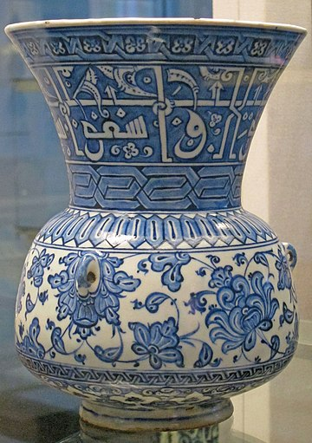
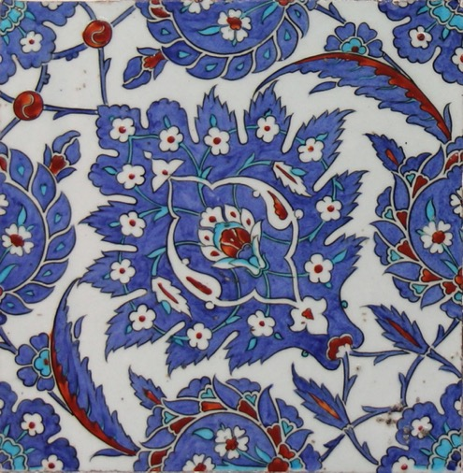
Ottoman achievements & discoveries
Design
A famous style of ceramic decoration, known as iznik, originated from the time of the Ottomans.
What shapes can you see painted on these pieces of pottery?
What colours have the artists used to decorate their works? What main colour is used?
The iznik style often makes use of symmetry. Can you spot any symmetrical decorations?
Iznik mosque lamp, 16th Century
Iznik tiles, 16th Century (above),
18th Century (left)

Slide 9
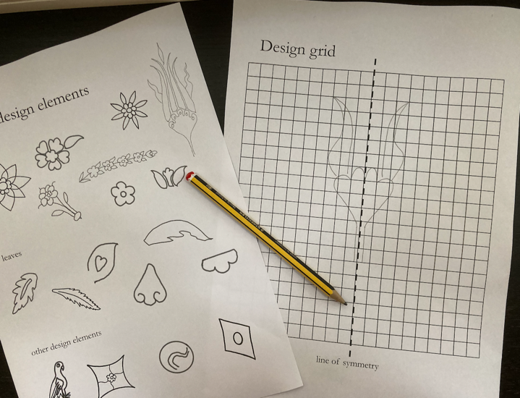
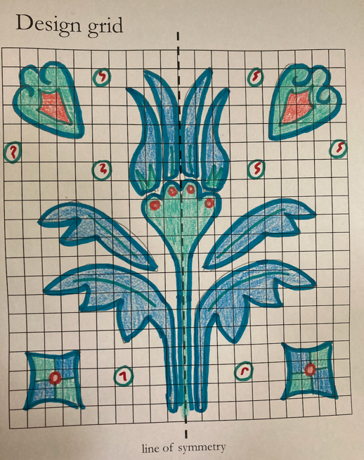
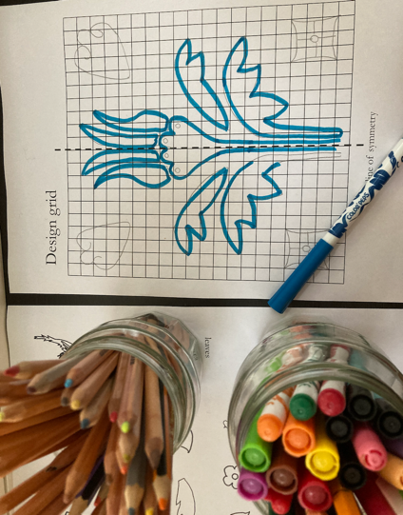
Task instructions
Your task is to design a symmetrical, square iznik tile
Start by creating a pattern in the left-hand side of your worksheet. There are some iznik-inspired shapes to inspire you – copy or trace them onto your worksheet. Use the grid and the central line of symmetry to reflect what is in the left hand design.
Colour or paint your design. Remember that blue and white are very important!

Slide 10
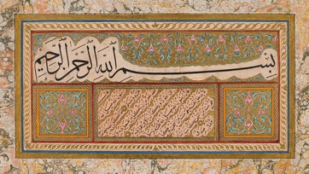
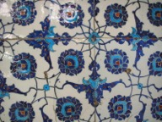
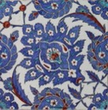
Plenary quiz
Name a science that the Ottomans were skilled at.
The Ottomans practiced the art of calligraphy. What is calligraphy?
What is the name starting with ‘i’ that describes the famous Ottoman style of pottery decoration?

