Slide 1
Maximum Civilisation
THE ROMANS
Roman food
LO: To discover ingredients and recipes available to the Romans

Slide 2
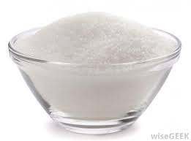
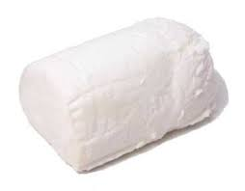
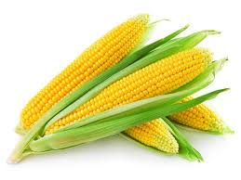
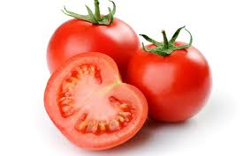
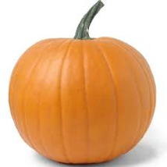
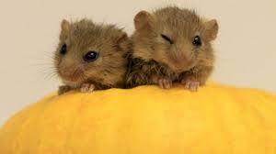
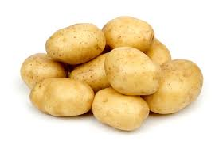
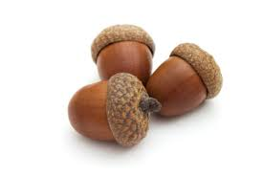
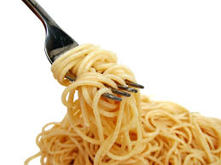
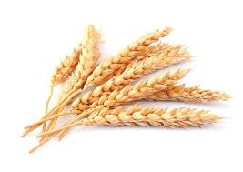
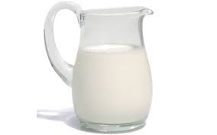
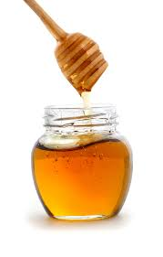
What ingredients did the Romans have?
✗
✔
✗
cheese
sweetcorn
sugar
✗
tomatoes
✔
✔
pumpkin
dormice
✔
✗
✗
acorns
potatoes
✔
pasta
✔
✔
milk
wheat
honey
MCR: Roman food

Slide 3
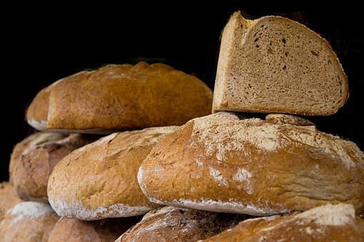
panis bread
Roman ingredients
companion
(someone you share bread with)
MCR: Roman food

Slide 4
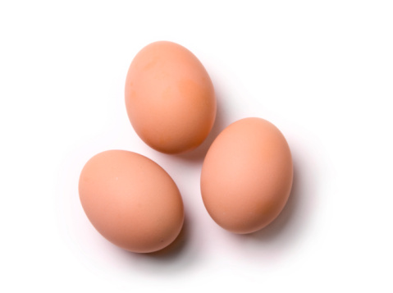
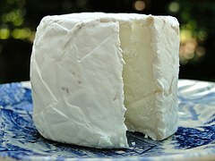
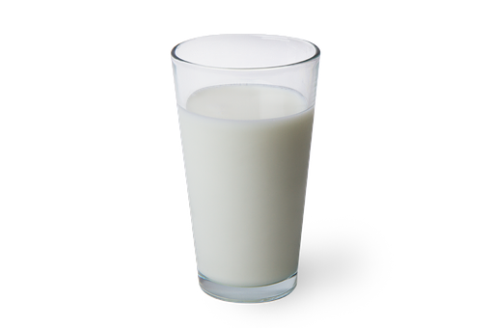
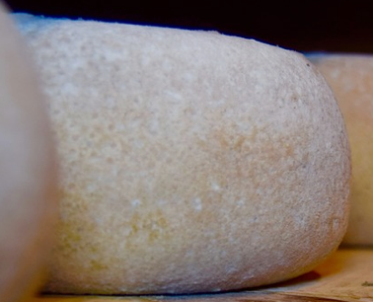
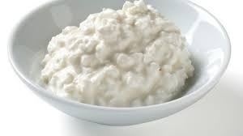
Roman foods: Dairy
caseum
cheese
ova
eggs
lac
milk
lactose
oval
MCR: Roman food

Slide 5
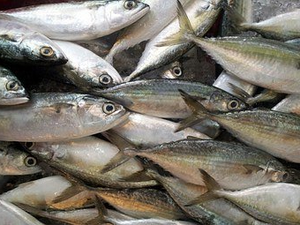
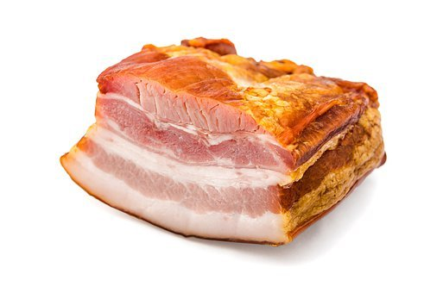
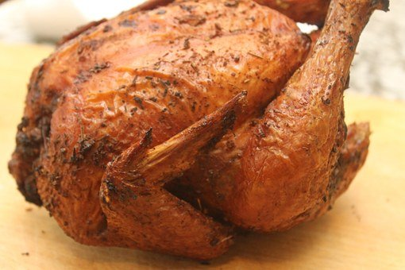
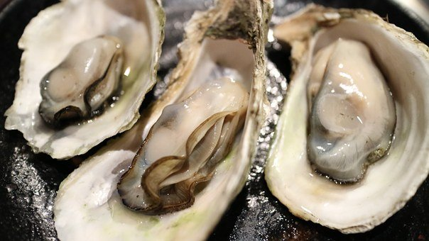
Roman foods: Meat & fish
carnes
meats
pisces
fish
carnivore
Pisces (star sign)
aves
birds
ostrea
oysters
aviation
MCR: Roman food

Slide 6
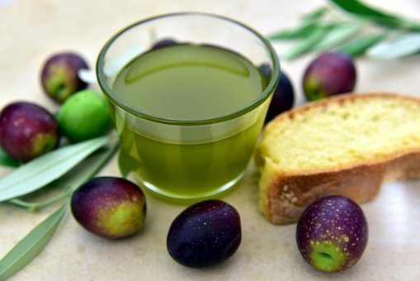
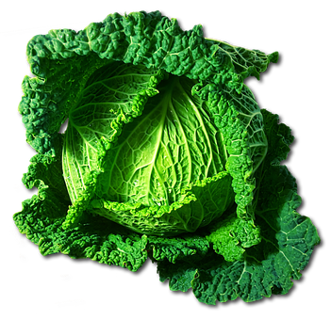
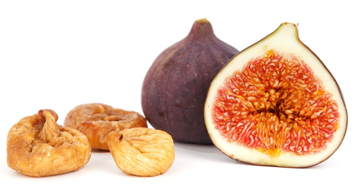
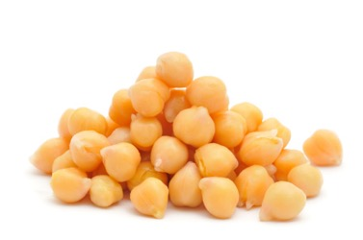
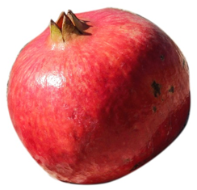
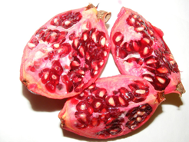
Roman foods: fruit & vegetables
brassica
cabbage
olea
olive
ficus
fig
cicer
chick peas
pomum granatum
pomegranate
MCR: Roman food

Slide 7
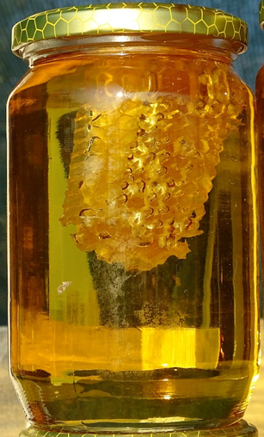
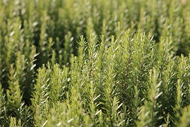
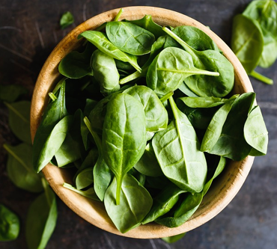
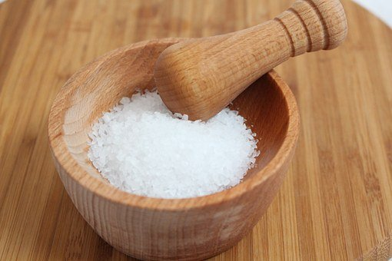
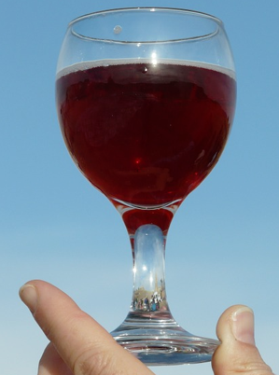
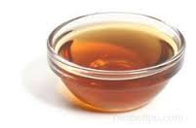
Roman foods: flavourings
herbae
herbs
sal
salt
herbivore
mel
honey
salary
marmelade
liquamen
fermented fish sauce
caroenum
condensed grape juice
MCR: Roman food

Slide 8
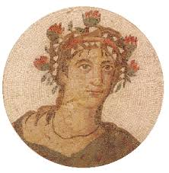
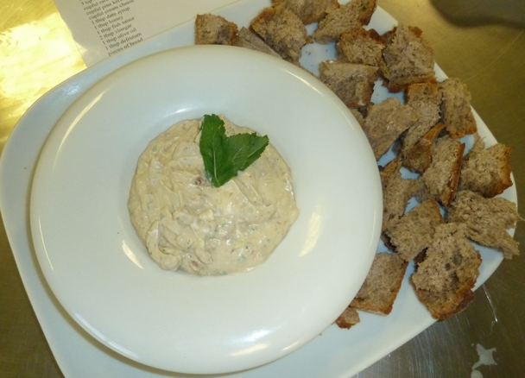
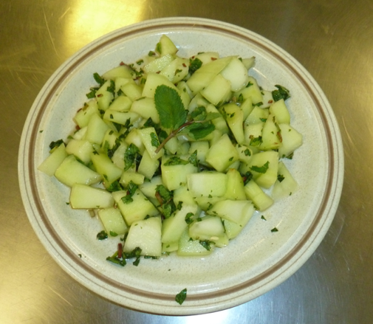
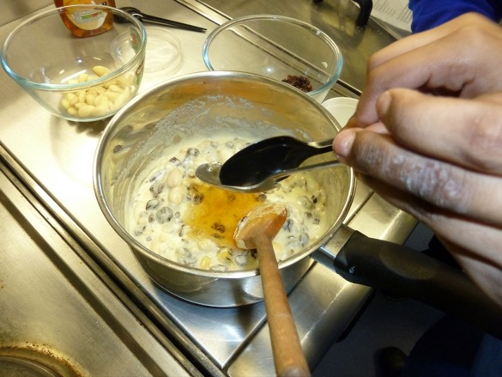
Some Roman recipes
These all come from a cookery book written by a Roman called Apicius.
Hypotrimma
(cheese and herb dip)
Melon in a mint dressing
Almond & semolina pudding
5.03a Roman food

Slide 9
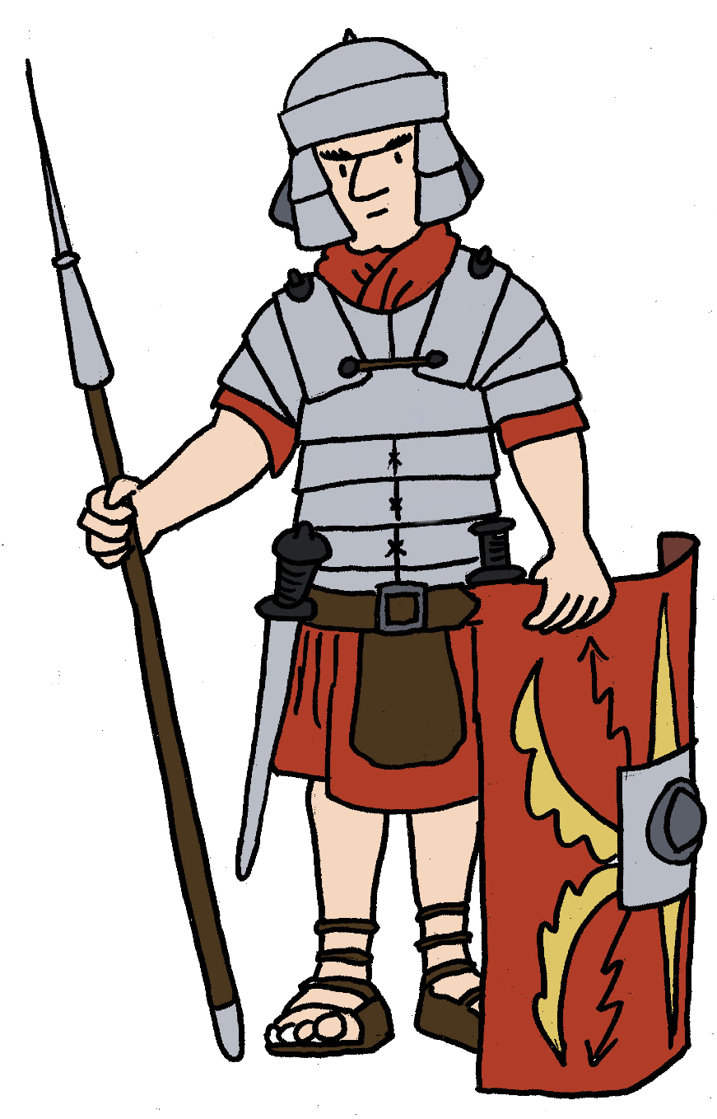
Plenary quiz
Question 1 Name an ingredient that Romans didn’t have.
Question 2 What English shape word comes from the Latin word for ‘egg’?
Question 3 What is liquamen?
MCR: Roman food

