Slide 1
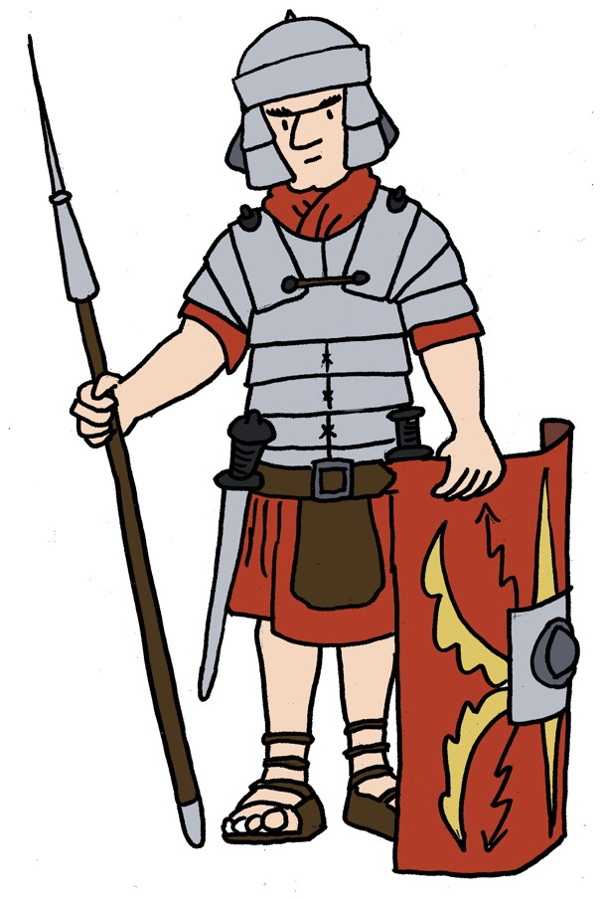
Maximum Civilisation
THE ROMANS
The Roman Army
LO: To discover what made the Roman army so effective and to make a mini onager

Slide 2
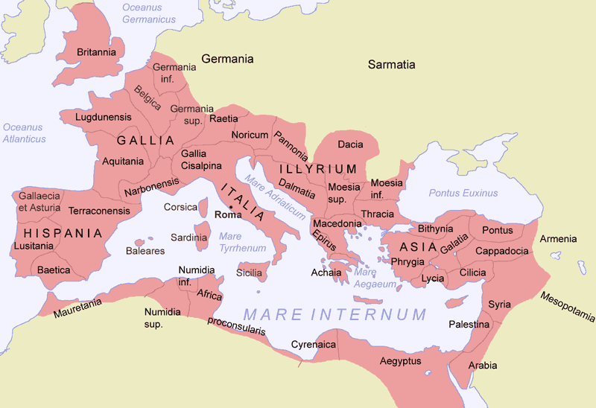
The Roman Empire at its height
about 2,500 miles
about 2,500 miles
MCR: The Roman army

Slide 3
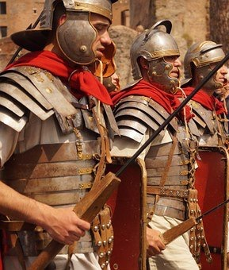
The Roman army’s strengths
1. size
2. organization & discipline
3. advanced armour
& battle tech
around 450,000 soldiers
Roman citizens and non-Romans from the Empire
Cavalry (soldiers on horse)
Infantry (soldiers on foot)
Some soldiers had 20 to 40 years’ experience
Lots of practice at clever manoeuvres (patterns of moving as an armed unit)
MCR: The Roman army

Slide 4
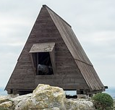
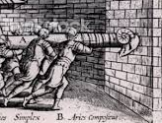
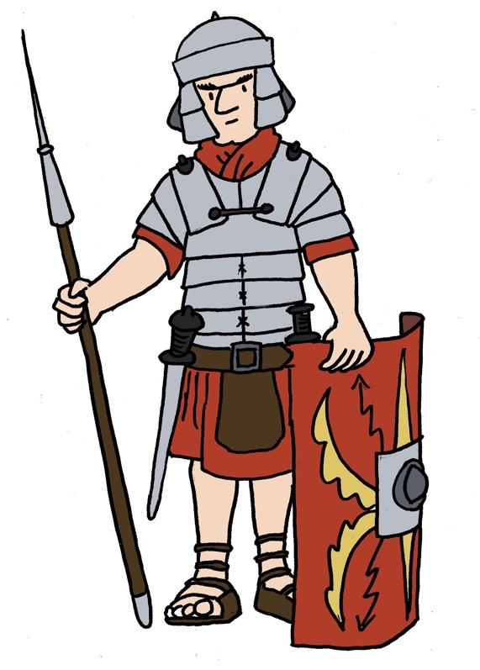
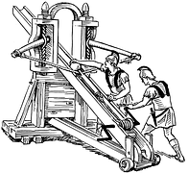
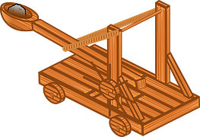
The Roman Army – battle tech
helmet
armour
shield
aries (ram)
javelin
sword
ballista
(trebuchet)
onager
(catapult)
shoes
dagger
MCR: The Roman army

Slide 5
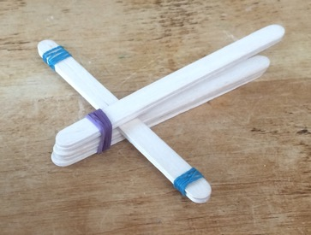
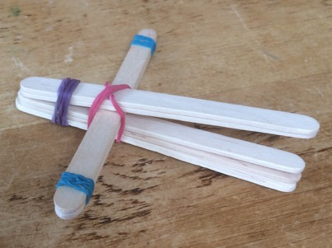
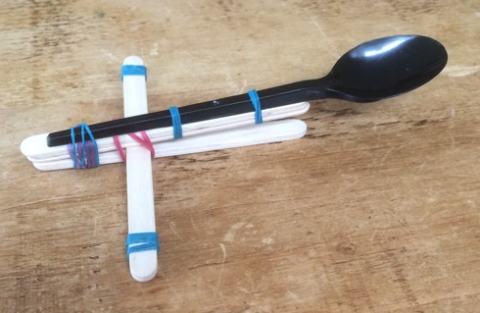
Make a mini onager
1
1. Stack 5 lolly sticks together, and rubber band the bundle at one end. Then stack 2 lolly sticks together, and wrap a rubber band at both ends.
2
2. Place the bundle of 2 lolly sticks in the 5-lolly-stick-stack.
3
3. Wrap a rubber band around all of the lolly sticks to hold the catapult together.
4
4. Attach a spoon with rubber bands to the 2 top lolly sticks to serve as a missile holder. Scrunched-up pieces of paper
make great missiles.
MCR: The Roman army

Slide 6
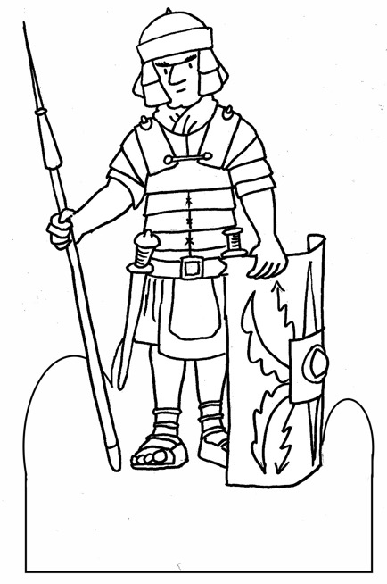
Make some Roman soldiers and their opponents (optional)
1
2
3
4
Create some Roman soldiers (and enemy target practice!) by cutting out these figures from the printed sheets, gluing them onto card and folding them along the dotted line so they stand up.
MCR: The Roman army

Slide 7
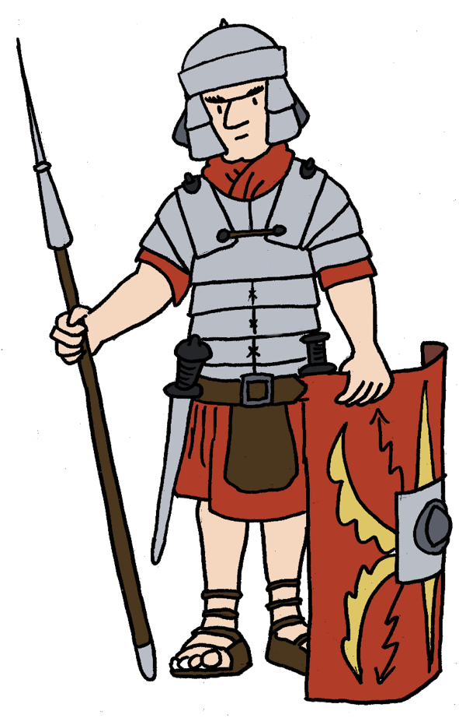
Plenary quiz
Question 1 How many miles would you need to go to journey from the very top to the very bottom of the Roman Empire at its height?
Question 2 Name one element of the Roman soldier’s armour or weapons that made him so deadly.
Question 3 What is the name of the weapon you made today?
MCR: The Roman army

