Slide 1
Maximum Civilisation
THE ROMANS
Curse tablets
LO: To make a replica Latin curse (or blessing) tablet

Slide 2
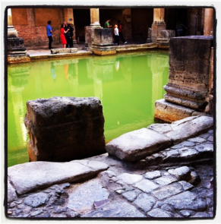
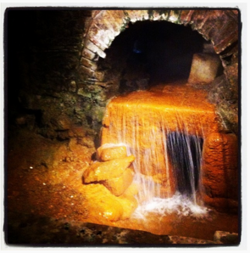
Defixiones
the sacred spring
the baths
Aquae Sulis
Bath
MCR: Curse tablets

Slide 3
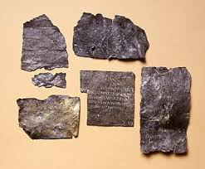
Defixiones
= curse (malediction)
‘If someone knows about it and doesn't speak up, may he be cursed in his blood, and eyes and every limb and even have all his intestines totally eaten away - if he has stolen my ring or been involved in the theft.’
‘May he who took Vilbia from me become liquid as the water.’
MCR: Curse tablets

Slide 4
make your curse (or blessing)
benediction
recipient
adverb
verb
(imperative)
amice - friend (male)
laete - happily
Step 1: Using your worksheet, pick one word from each box to make your Latin curse or blessing, and write out what it means in English underneath.
canta - sing
amica - friend (female)
bene - well
labora - work
inimice - enemy (male)
optime - very well
vive – live/exist
inimica - enemy (female)
male - badly
ama - love
triste - sadly
supera - triumph
pater - father
celeriter - quickly
mater - mother
spera - have hope
irate - angrily
frater - brother
peri - die
facile - easily
soror - sister
lacrima - cry
numquam - never
magister - male teacher
curre - run
fortiter - bravely
patere - suffer
magistra - female teacher
semper - always
Latin
soror
fortiter
spera
English translation
Sister, bravely have hope!
MCR: Curse tablets

Slide 5
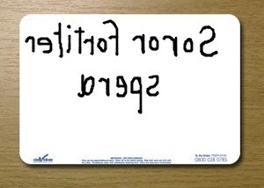
make your curse (or blessing)
Step 2: Once you have your curse/benediction on your piece of paper, practice mirror writing it on your whiteboard
MCR: Curse tablets

Slide 6
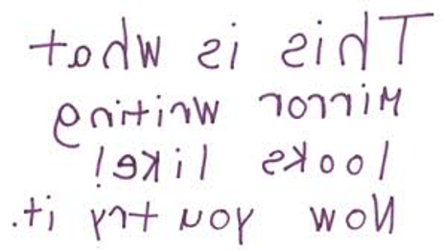
make your curse (or blessing)
MCR: Curse tablets

Slide 7
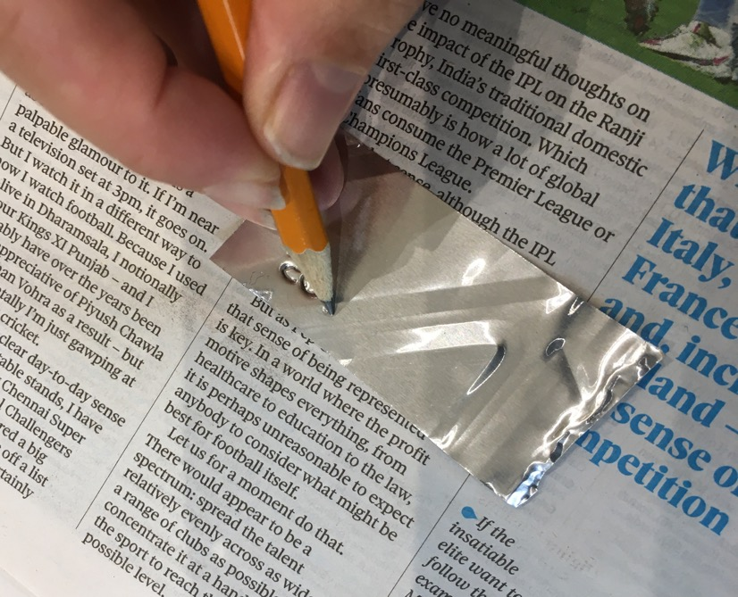
make your curse (or blessing)
Step 3: With your blank curse tablet on top of a magazine or folded newspaper. Using a sharp pencil press firmly and mirror-write your Latin curse/blessing onto your blank metal slip.
MCR: Curse tablets

Slide 8
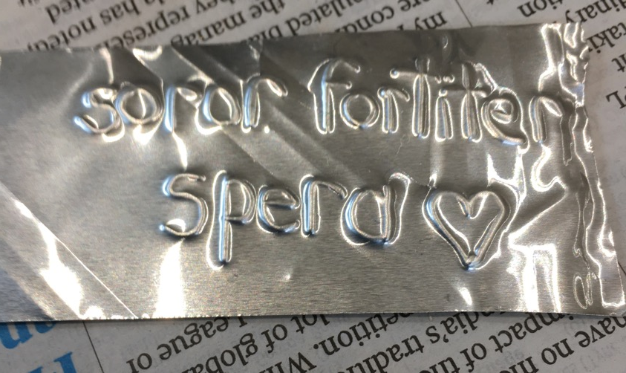
make your curse (or blessing)
Step 4: Turn the metal slip over to read your curse/blessing.
MCR: Curse tablets

Slide 9
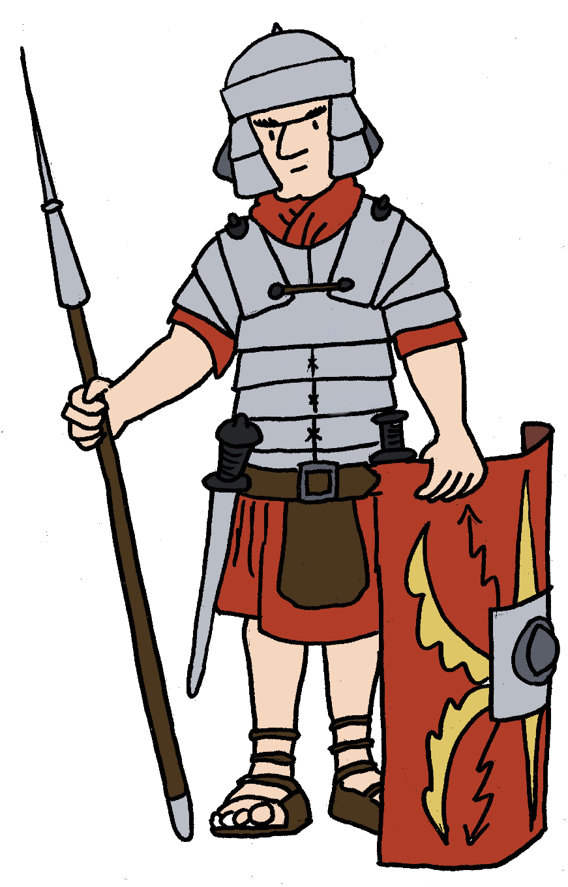
Plenary quiz
Question 1 Can you name an English adverb? What about a Latin one?
Question 2 What’s another English word for a blessing?
Question 3 What did you write on your metal tablet? What does it mean in English? Is it a curse or a blessing?
MCR: Curse tablets

