Slide 1
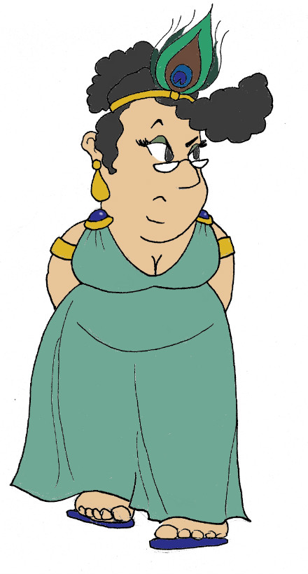
Maximum Civilisation
The Olympics
LO: To discover the similarities and differences between the Modern and Ancient Olympics
MCG: The Olympics

Slide 2
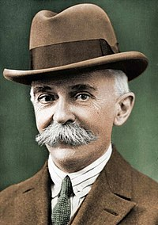
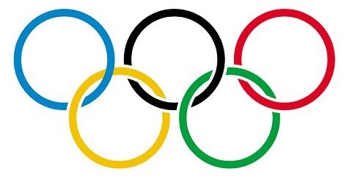
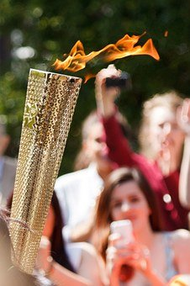
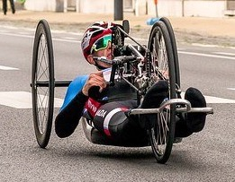
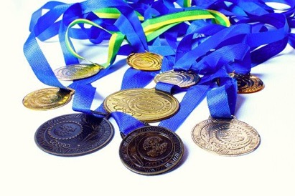
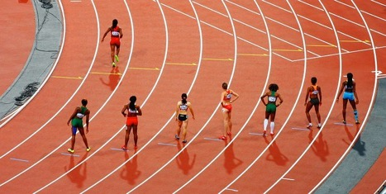
The Modern Olympics
citior altior fortior
Pierre de Coubertin
1896
MCG: The Olympics

Slide 3
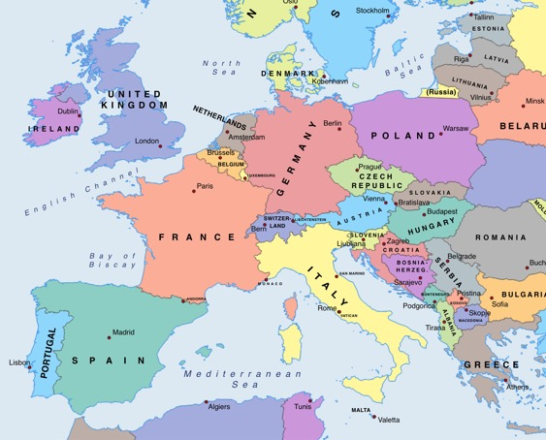
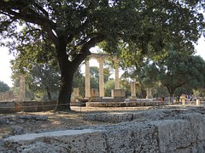
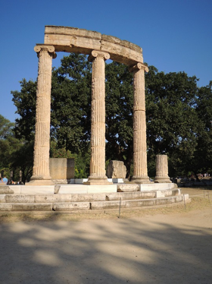
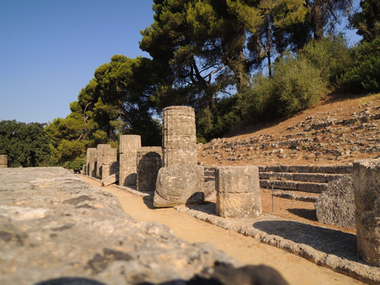
The Ancient Olympics
776 BCE – 393 CE
1169 years!
Athens
Olympia
MCG: The Olympics

Slide 4
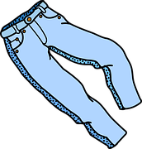
Olympic Lying
Each team will nominate a member to read a paragraph about the Ancient Olympic Games. In each paragraph, there are three things that are untrue. There are two ways to win points in this game:
Spot the three lies concealed in other teams’ statements and write them down on your Olympic Lying sheets. Each lie correctly identified is worth one point. 5 teams = maximum of 4x3 points = 12 points
‘Smuggle’ your own team’s lies by reading them with such authority that everyone will believe you. You may want to choose a reader who is not prone to fits of giggles, or who has a good ‘poker face’! Each lie ‘smuggled’ is worth one point. 3 lies x 1 = 3 points
TOTAL POSSIBLE POINTS = 15 points
MCG: The Olympics

Slide 5
Olympic Lying Scoresheet
Team reading =
Lie 1 =
Lie 2 =
Lie 3 =
Team reading =
Lie 1 =
Lie 2 =
Lie 3 =
points for correctly spotted lies = out of 3
points for correctly spotted lies = out of 3
Team reading =
Lie 1 =
Lie 2 =
Lie 3 =
Our team
Lie 1 = spotted? yes ☐ (0 points) no ☐ (1 point)
Lie 2 = spotted? yes ☐ (0 points) no ☐ (1 point)
Lie 3 = spotted? yes ☐ (0 points) no ☐ (1 point)
points for correctly spotted lies = out of 3
points for unspotted lies = out of 3
Team reading =
Lie 1 =
Lie 2 =
Lie 3 =
Points for correctly spotting lies = out of 12
Points for disguising our lies = out of 3
TOTAL POINTS = out of 15
MCG: The Olympics
points for correctly spotted lies = out of 3

Slide 6
Plenary quiz
Question 1 For roughly how long did the Ancient Greek Olympics run?
Question 2 Name one thing that Ancient and Modern Olympics have in common.
Question 3 Name one way in which the Ancient and Modern Olympics are different.
MCG: Greek gods & goddesses
© C Andrew 2022

