Slide 1
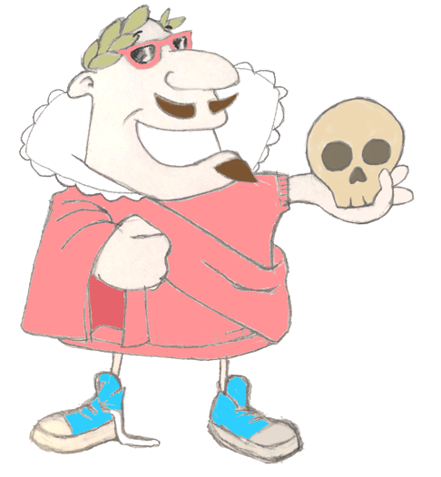
Maximum Civilisation
Shakespeare & The Ancient World
To investigate how ancient literature and languages influenced the writing of William Shakespeare
MCG: Shakespeare & the Ancient World

Slide 2
Shakespeare Words Roots Challenge
solus + loqui
Latin
alone + to speak
Can you match the Shakespeare-related word to its Latin or Ancient Greek ancestor?
similis
Latin
same, alike
pente + metron
Greek
five + measure
prologue
comedy
soliloquy
tragedy
irony
metaphor
simile
epilogue
epi + logos
Greek
after + speech
pentameter
eironia
Greek
pretending not to know
tragos + oide
Greek
goat + song
pro + logos
Greek
before + speech
meta + phorein
Greek
beyond + to carry
komos
Greek
fun, merriment
MCG: Shakespeare & the Ancient World

Slide 3
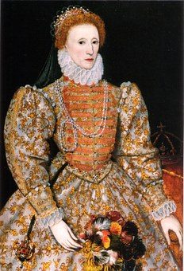
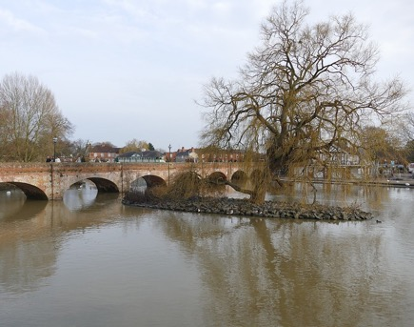
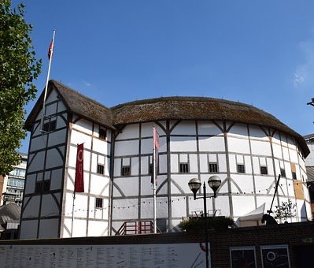
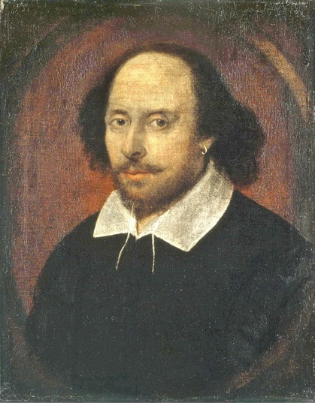
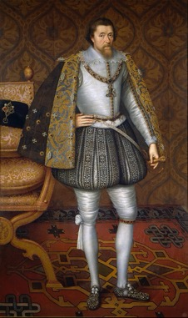
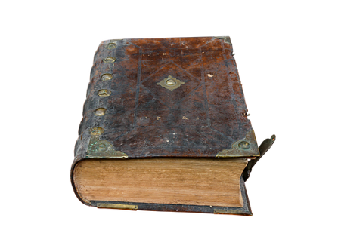
All about Shakespeare
Shakespeare lived & worked during the reigns of Elizabeth I and James II
Stratford-upon-Avon
the reconstructed Rose Theatre
Shakespeare lived in both Stratford-upon-Avon and London, where his plays attracted audiences in venues such as the Rose Theatre
William Shakespeare
At school in Stratford-upon-Avon, Shakespeare learned Latin and read lots of ancient world authors. Shakespeare’s school even encouraged its pupils to speak in Latin! The influence of writers from ancient Rome and Greece is evident in Shakespeare’s writing. Many of his plays are based on Greek myth and Roman history. Shakespeare was also inspired by the way ancient drama was written.
A writer of plays and poetry
Shakespeare was born in 1654 and died 1616
All pictures Wikimedia Commons
MCG: Shakespeare & the Ancient World

Slide 4
Shakespeare’s ancient inspiration
1. Tragedy and comedy formats
In Ancient Greece, plays can be a Comedy (mainly happy) or a Tragedy (mainly sad).
Shakespeare also follows this format, but he also adds History plays as a third category.
Sophocles (5th century BCE)
Oedipus Rex
(Oedipus the King)
Shakespeare
Macbeth
Menander
(4th – 3rd centuries BCE)
Shakespeare
Much Ado
Dyskolos (The Grouch)
About Nothing
Claudio falls in love with Hero but is told a lie about her that makes him doubt her. Beatrice (Hero’s cousin) and Benedict are tricked into believing the other is in love with them. The lie about Hero is finally put straight and Beatrice and Benedict actually fall in love.
A young man, Sostratos, falls in love with a girl, whose father, Knemon, is very bad-tempered and hard to approach. Eventually, after helping to rescue him from a well, he wins Knemon over and gains his permission to marry his daughter.
Oedipus, the king of Thebes, is searching for the killer of Laius, the previous king of Thebes. Oedipus discovers that not only is he the killer, but that Laius was his father. Shamed by guilt, Oedipus blinds himself and goes into exile.
Macbeth and his wife seek to become king and queen of Scotland, and resort to murder to fulfil their ambition. They get what they want but madness and death follow shortly after.
power
greed
death
hope
betrayal
madness
love
marriage
MCG: Shakespeare & the Ancient World

Slide 5
Shakespeare’s ancient inspiration
2. Dramatic conventions
Ancient Greek drama established many conventions (ways of doing things) that Shakespeare also used, for example:
epilogue
a speech at the end of a play, often a comment on the themes or moral lessons of the play
soliloquy
a character speaking to themselves and
in doing so letting the audience know their innermost thoughts
Hamlet: To be, or not to be, that is the question:
Whether 'tis nobler in the mind to suffer
The slings and arrows of outrageous fortune,
Or to take arms against a sea of troubles
And by opposing end them. To die—to sleep,
No more; and by a sleep to say we end
The heart-ache and the thousand natural shocks
That flesh is heir to: 'tis a consummation
Devoutly to be wish'd. To die, to sleep;
To sleep, perchance to dream—ay, there's the rub:
Shakespeare, Hamlet
Prince: A glooming peace this morning with it brings; The sun for sorrow will not show his head.
Go hence to have more talk of these sad things,
Some shall be pardoned, and some punished,
For never was a story of more woe
Than this of Juliet and her Romeo.
Shakespeare, Romeo & Juliet
Chorus: Zeus on Olympus dispenses many things. Gods often contradict our fondest expectations. What we anticipate does not come to pass. What we don’t expect some god finds a way to make it happen. So with this story.
Euripides (5th century BCE), Medea
Antigone:…Abandoned by my friends, not yet dead, I go down. I, whose Fate is dark, am now taken down into the shadowy alleys of the dead, without having trampled on any god’s law.
And why should I put my hope on the gods? Whom shall I call for an ally when, by doing what is just I have been judged unjustly?...
Sophocles (5th century BCE), Antigone
MCG: Shakespeare & the Ancient World

Slide 6
Shakespeare’s ancient inspiration
3. Names with meaning
Shakespeare sometimes named his characters in a way to indicate their back-stories or personalities:
Prospero
from The Tempest
Perdita
Feste
from Twelfth Night
from The Winter’s Tale
Exiled and shipwrecked duke, manages to survive and protect his daughter, Miranda
A character abandoned as a baby
A jester
prosperare (Latin)
= to make something work
perdita (Latin)
= abandoned
festus (Latin)
= merry, jolly
Can you work out anything about these two characters from their names?
Benvolio
Malvolio
clue: ‘bene’ is Latin for ‘well’
clue: ‘malus’ is Latin for bad
MCG: Shakespeare & the Ancient World

Slide 7
Plenary quiz
Question 1 Name two places important in the life of William Shakespeare.
Question 2 What two formats (or genres) of Ancient Greek theatre did Shakespeare use in his work?
Question 3 When Shakespeare names a character ‘Benvolio’, what does he want his audience to think about them?
MCG: Shakespeare & the Ancient World

