Slide 1
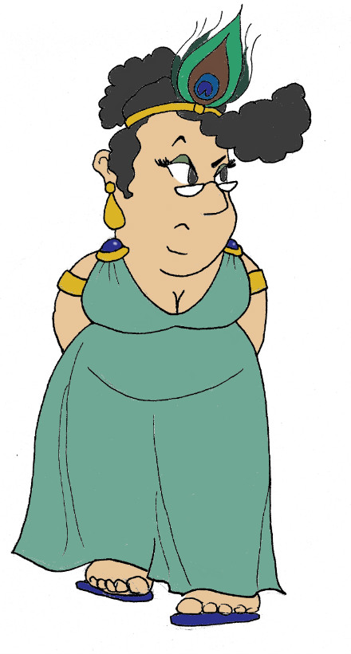
Maximum Civilisation
Plato & morality
LO: To find out about Plato and, using his tale of Gyges, to explore both his and our own thoughts on why humans behave how they do
MCG: Homer & epic poetry

Slide 2
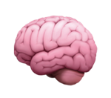
Word Roots Challenge
morality
🧐
philosophy words
autonomy
ύποθεσις (hypothesis)
(Ancient Greek)
a proposal
ratio
Latin
plan, method, reasoning
mores (Latin)
customs, habits
sequi
Latin
to follow
δια (dia) through
λογος (logos) word
(Ancient Greek)
hypothesis
αὐτος (autos) self
νομος (nomos) rule
(Ancient Greek)
iudicare
(Latin)
to decide
dialogue
judgement
consequence
rational
MCG: Plato & morality

Slide 3
What is philosophy?
φιλειν
σοφος
philein (Ancient Greek)
to love
sophos (Ancient Greek)
wise
philosophy
= love of wisdom
MCG: Plato & morality

Slide 4
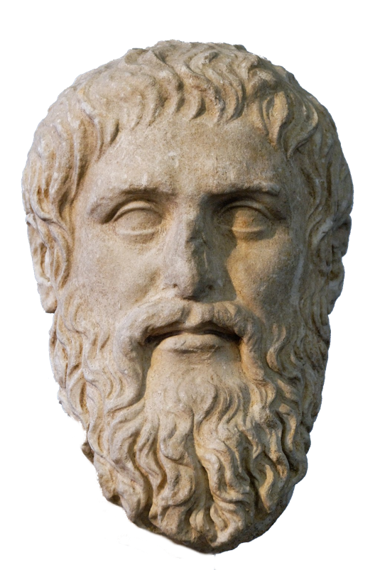
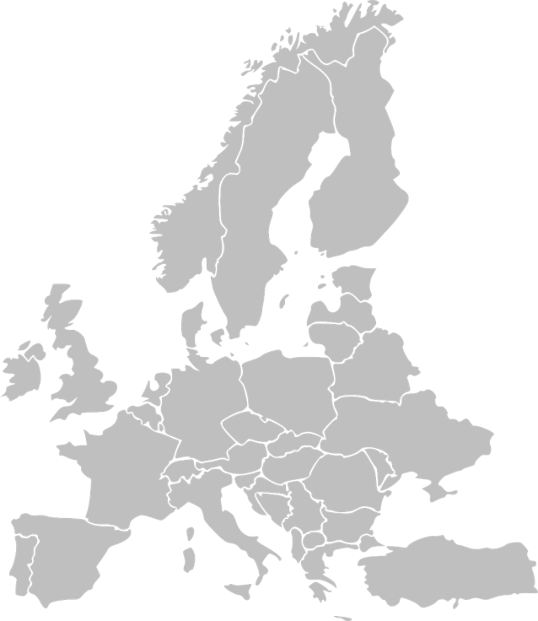
Plato the philosopher
lived 427 BCE - 347 BCE (roughly)…
…in Athens, Greece
wrote down dialogues with his teacher, Socrates, and other people to explore philosophical questions such as:
Roman sculpture of how Plato may have looked
What’s the best way to rule? A king? Let the people decide?
Do humans have souls? Do souls live forever?
How do we know what’s real?
MCG: Plato & morality

Slide 5
Plato & morality
What makes people behave how they do? Let’s explore it through a story…
🐏 ⛈💥🕳
There was a shepherd called Gyges who worked for the king of Lydia; there was a great storm, and an earthquake made an opening in the earth at the place where he was feeding his flock.
⬇️🕳😮💰💀💍💰🔝
Amazed at the sight, he descended into the opening. Inside, amongst piles of treasure, he saw a dead body wearing a gold ring; this he took and went back above ground to his flock.
🐏💍❗️ 💬 ❗️💍😮
Later, at a meeting of the shepherds, Gyges was fiddling with the ring on his finger. As he turned it, instantly he became invisible to everyone, and they all began to speak of him as if he were no longer there. He was astonished at this, tried turning the ring again, and reappeared.
💍 💰💰🔑🗡💀🗡👑
Over time, Gyges used his power of invisibility to act secretly to make his life better, stealing and breaking into people’s houses. He eventually killed the king and took over the kingdom.
MCG: Plato & morality

Slide 6
Plato & morality
This story tells us that a person is good, not because they want to or because they think that being good is any use to them personally.
They are good because they have to be –
other people are watching!
If anyone thinks they’ll be able to get away with something, they’ll do it.
Do you agree?
MCG: Plato & morality

Slide 7
Plenary quiz
Question 1 The Greek word ‘sophos’ means ‘wise’: true or false?
Question 2 What Ancient Greek philosopher came up with the tale of Gyges and the Ring of Invisibility?
Question 3 What was the name of the shepherd who found the ring of invisibility?
MCG: Plato & morality

