Slide 1
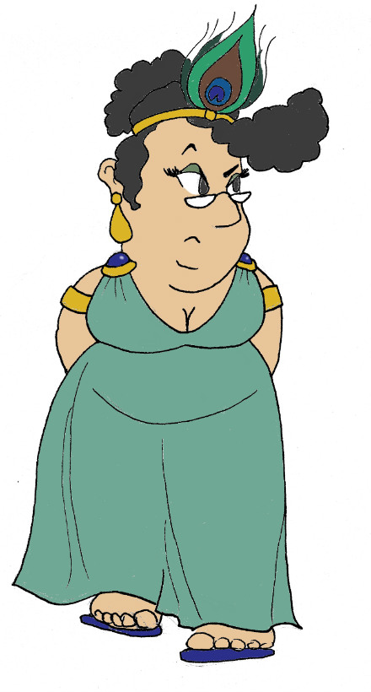
Maximum Civilisation
The Meanings of Myth
LO: To learn about different ways of interpreting mythology and to write our own myth
MCG: The Meanings of Myth

Slide 2
Examples of Greek myths
Achilles
Achilles was the mightiest warrior of the Trojan War. His mother dipped him in the River Styx as a baby to make him immortal. He fought many a battle and always triumphed. Unfortunately, the one spot where his mother held him when she dipped him – his heel – stayed mortal, and when his was injured there, he died.
Persephone
Persephone was the daughter of the goddess of the harvest, Demeter. Hades, ruler of the Underworld, tricked Persephone into becoming his wife. Demeter was so upset with the loss of her daughter that she made a bargain: for six months of the year, Persephone could live in the Underworld with her husband, but for the six glorious months of spring and summer, she was allowed to live above ground with her mother.
Midas
After showing great hospitality to a stranger, King Midas was granted a wish. He wished for all he touched to turn to gold. Of course, he became the richest man alive, but when he went to hug his daughter, he realized that he had in fact cursed himself through his own greed.
Do you know any more?
Which is your favourite? What adjectives would you use to describe these stories?
MCG: The Meanings of Myth

Slide 3
Reasons for myths
Myths exist in all cultures and don’t just tell strange or exciting stories. Myths can:
teach a moral message or life lesson
explain a natural phenomenon
fulfil something we wish humans could do but can’t
Persephone
Achilles
Midas
MCG: The Meanings of Myth

Slide 4
Match the myth to the reason
teach a moral lesson
explain a natural phenomenon
fulfil a superhuman wish
Perseus was a demi-god and a slayer of monsters that no other mortal could defeat, such as the gorgon Medusa. He flew around on winged sandals.
fulfil a superhuman wish
explain a natural phenomenon
It is rumoured that a half-man, half-bull monster called the Minotaur lives in a labyrinth under the island of Crete (which is a place very susceptible to earthquakes). From time to time he is enraged and bellows loudly.
Arachne was a skilled weaver but overstepped the mark when she challenged the goddess Athena to a weaving competition. For insulting the gods, an angry Athena turns Arachne into a spider.
teach a moral lesson
MCG: The Meanings of Myth

Slide 5
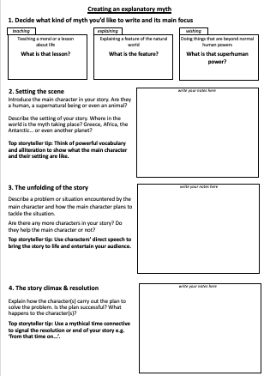
Create your own myth
Decide on what type of myth you’d like to write
Use the worksheet to record and refine your ideas
Tell the story to your classmates
teaching
explaining
wishing
MCG: The Meanings of Myth

Slide 6
Plenary quiz
Question 1 Name three possible reasons why cultures create myths.
Question 2 Can you think of a Greek myth that teaches a moral lesson?
Question 3 Can you name a hero from Greek myth who has superhuman powers?
MCG: Greek gods & goddesses
© C Andrew 2022

