Slide 1
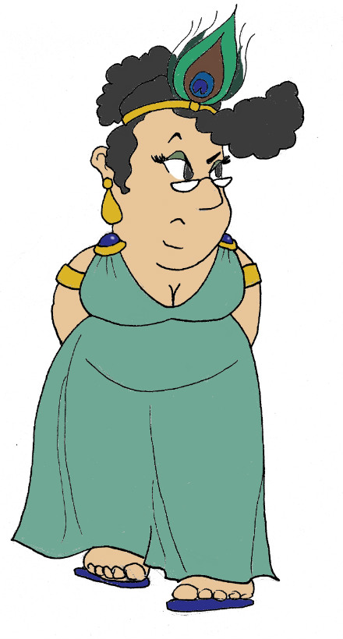
Maximum Civilisation
Homer & his epic poetry
LO: To encounter stories from Homer’s Iliad and Odyssey and to make a card game based on the characters in these stories
MCG: Homer & epic poetry

Slide 2
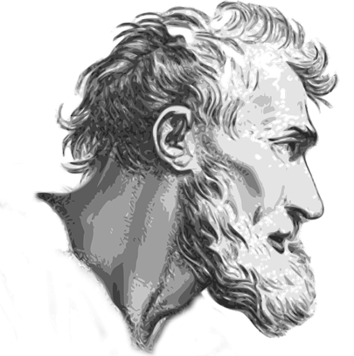
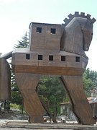
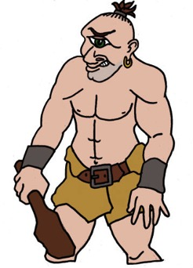
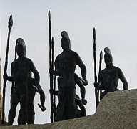
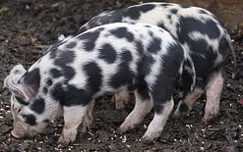
Homer & his epics
12th century BCE?
8th century BCE?
People turned into animals by witches
The Trojan War
The Cyclops
The Trojan Horse
MCG: Homer & epic poetry

Slide 3
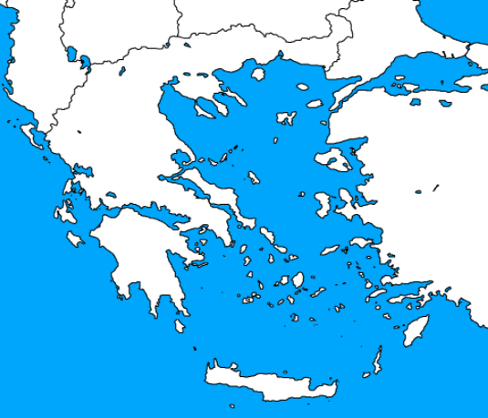
One war, two epics
modern countries
kingdoms in Homer’s work
The Iliad
The ten-year Greek siege of Troy
Gods interfere
Men often act badly
Lots of battles!
Bulgaria
Macedonia
Albania
Troy/‘Ilium’
Greece
Turkey
Ithaka
The Odyssey
Greek warrior Odysseus sails home to his kingdom of Ithaka after the siege is ended
Gods interfere
Lots of monsters!
Greece/‘Achaia’
Crete
MCG: Homer & epic poetry

Slide 4
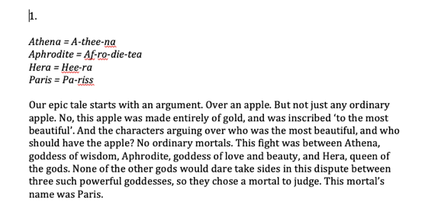
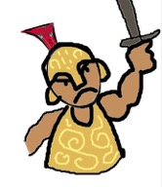
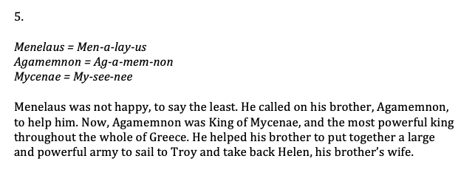
Epic Trumps
3. Play
1. Read
2. Make
Achilles
almost-immortal Greek warrior
45
Intelligence
82
Power
100
Bravery
85
Beauty
MCG: Homer & epic poetry

Slide 5
Plenary quiz
Question 1 What started the Trojan War?
Question 2 How did the siege of Troy end?
Question 3 What did Odysseus and his men do to the Cyclops Polyphemus?
MCG: Homer & epic poetry

