Slide 1
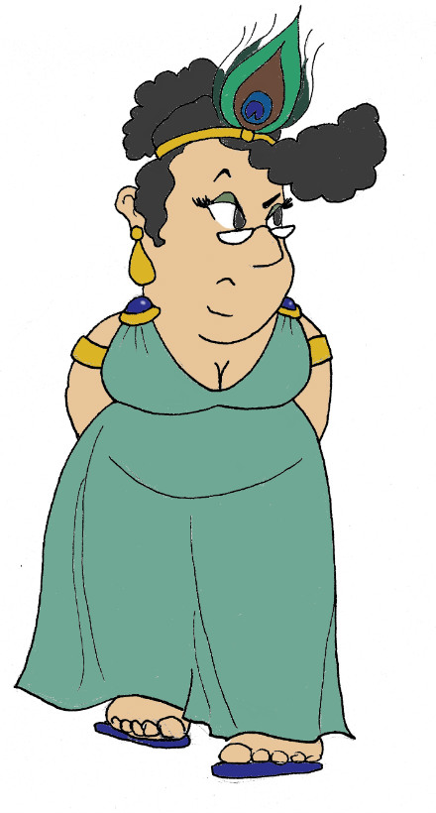
Maximum Civilisation
Gods & goddesses
LO: To learn about the Greek gods
and their associated symbols and specialist areas
MCG: Greek gods & goddesses

Slide 2
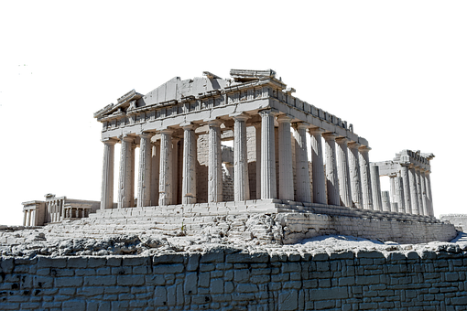
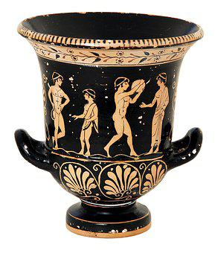
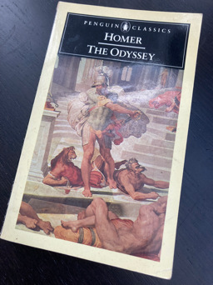
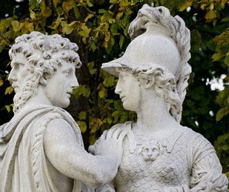
The Gods of Greece
The Ancient Greeks (5th-2nd Centuries BCE) lived in societies that worshipped many gods. This is known as polytheism
poly = many
theos = god
We have evidence of these gods from sources that survive into modern times, such as
temples & religious buildings
physical artefacts
myths, stories & poems
MCG: Greek gods & goddesses
© C Andrew 2022

Slide 3
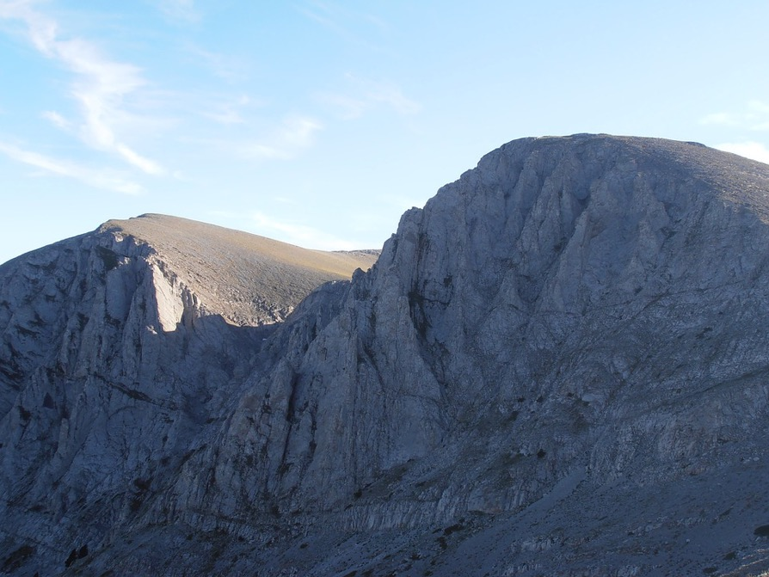
The Gods of Greece
The most important gods were known as the Olympians, as they were believed to live on Mount Olympus in Greece.
The Greeks and Romans shared the same gods, but often gave them different names.
Each Olympian god or goddess had special aspects of the world that they looked after
Each god or goddess often had one of more special objects of symbols associated with them
MCG: Greek gods & goddesses
Mount Olympus in Greece
© C Andrew 2022

Slide 4
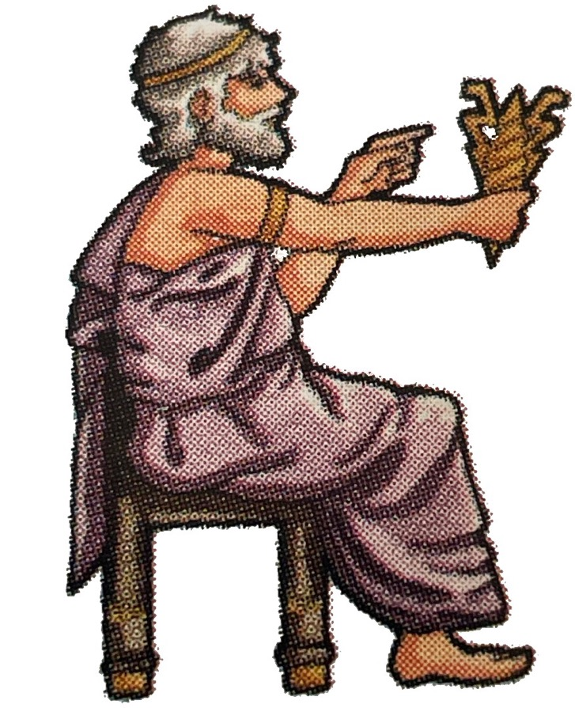
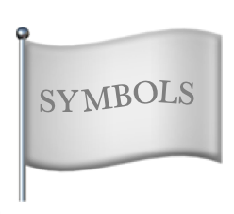
Greek gods & goddesses quiz
Can you identify these Greek gods and goddesses from their pictures and other clues?
Take notes to fill in any gaps in your knowledge and to help you with this lesson’s creative task.
King of the gods, thunder
lightning bolt, eagle
Zeus
MCG: Greek gods & goddesses
© C Andrew 2022

Slide 5
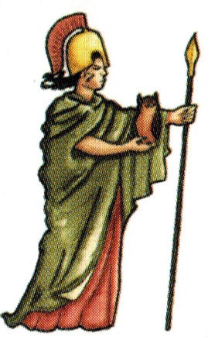
Greek gods & goddesses quiz
Wisdom, war
Owl, aegis (armour showing head of Medusa)
Athena
or Athene
MCG: Greek gods & goddesses
© C Andrew 2022

Slide 6
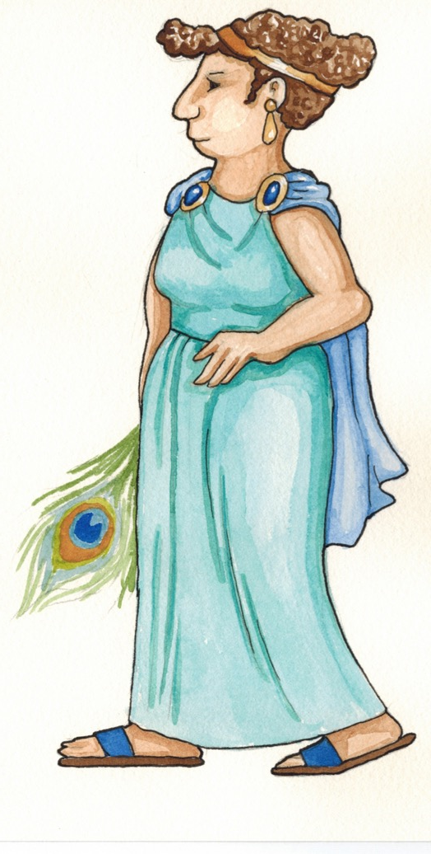
Greek gods & goddesses quiz
Queen of the gods
Peacock
Hera
MCG: Greek gods & goddesses
© C Andrew 2022

Slide 7
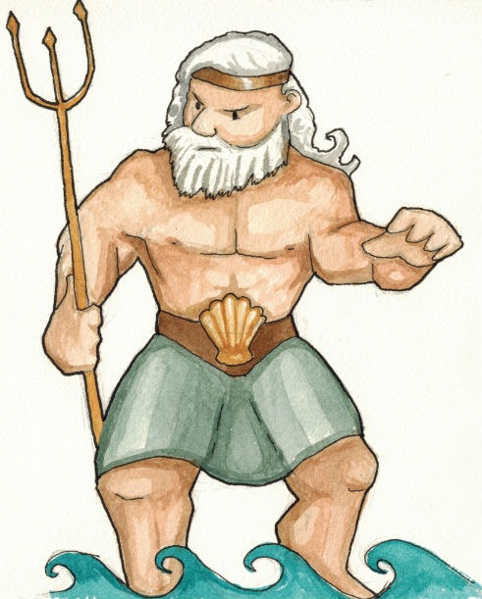
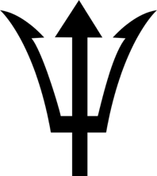
Greek gods & goddesses quiz
Ruler of the seas,
earthquakes
Trident
Poseidon
MCG: Greek gods & goddesses
© C Andrew 2022

Slide 8
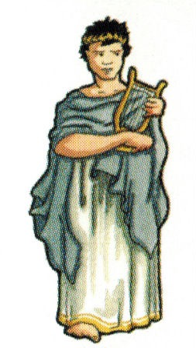
Greek gods & goddesses quiz
Medicine, music
Sun, lyre (like a harp)
Apollo
MCG: Greek gods & goddesses
© C Andrew 2022

Slide 9
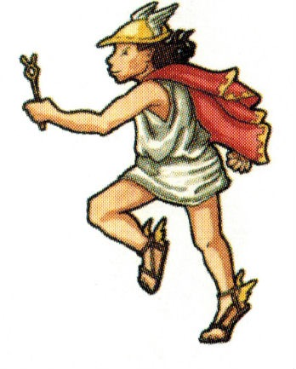
Greek gods & goddesses quiz
Messenger god
Winged sandals, staff
Hermes
MCG: Greek gods & goddesses
© C Andrew 2022

Slide 10
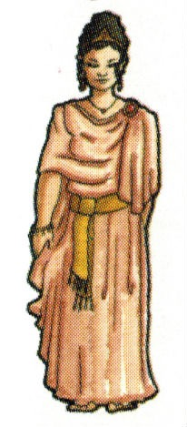
Greek gods & goddesses quiz
Love, beauty
Swan, dove, mirror
Aphrodite
MCG: Greek gods & goddesses
© C Andrew 2022

Slide 11
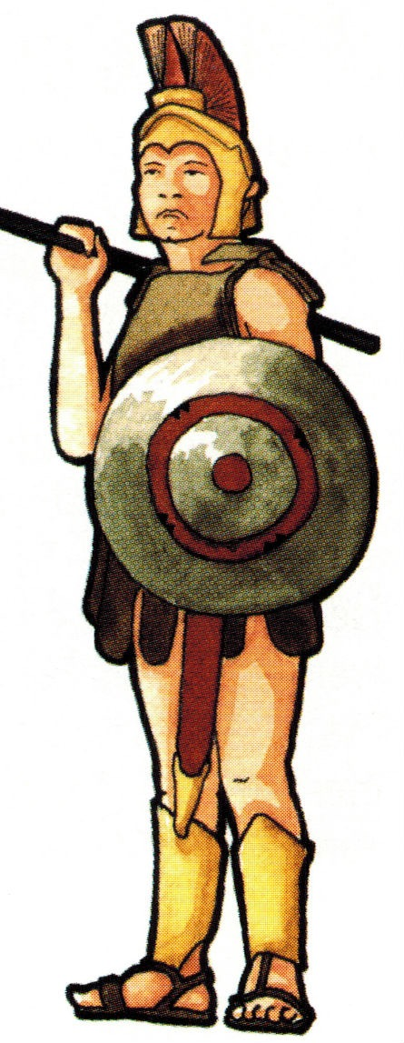
Greek gods & goddesses quiz
War, fighting
Spear & shield
Ares
MCG: Greek gods & goddesses
© C Andrew 2022

Slide 12
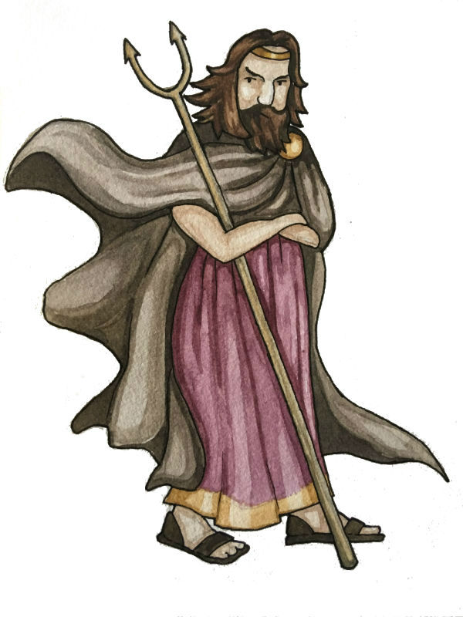
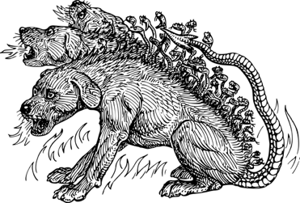
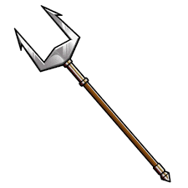
Greek gods & goddesses quiz
Ruler of the underworld
Cerberus
Bident
Hades
MCG: Greek gods & goddesses
© C Andrew 2022

Slide 13
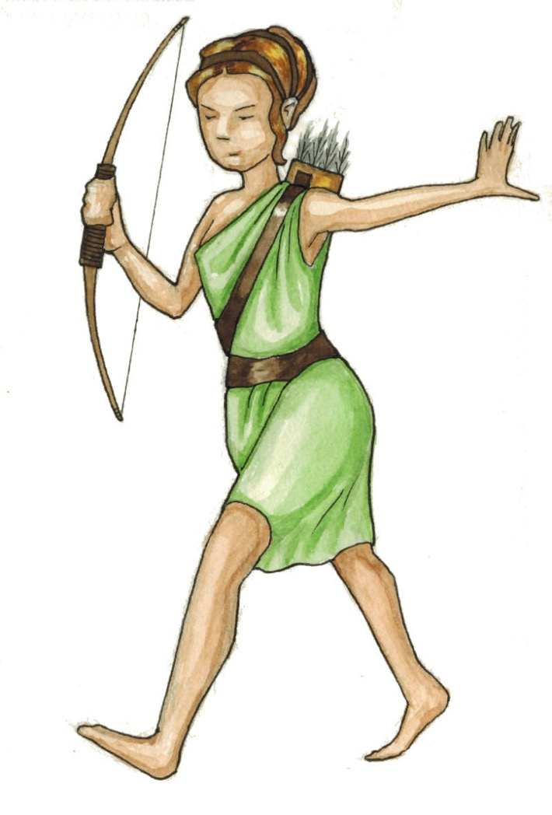
Greek gods & goddesses quiz
Hunting
Moon
Artemis
MCG: Greek gods & goddesses
© C Andrew 2022

Slide 14
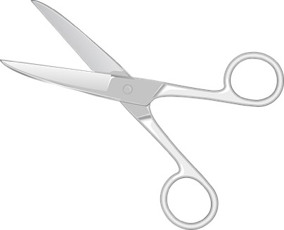
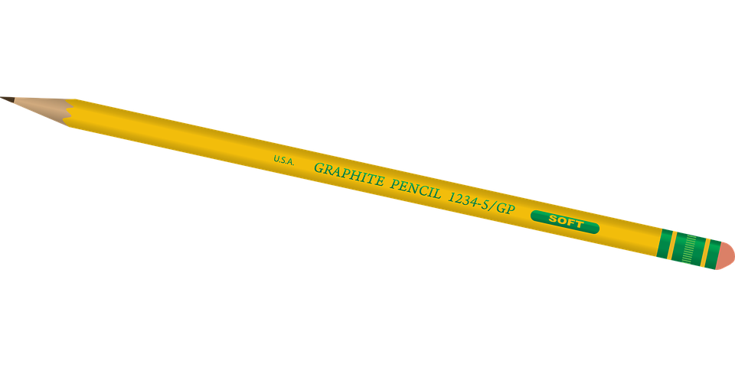
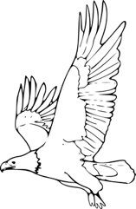
Greek gods & goddesses quiz
Using the information from the quiz, illustrate and cut out the cards on your worksheet…
Zeus
Zeus
symbols =
thunderbolt & eagle
king of the gods
…and use them to play a game of Greek Gods Match-Up.
MCG: Greek gods & goddesses
© C Andrew 2022

Slide 15
Plenary quiz
Question 1 The goddess Athena is in charge of wisdom, but what is her animal symbol?
Question 2 If an ancient Greek heard a thunderstorm, which god might he think is unhappy?
Question 3 Who is your favourite god or goddess and why?
MCG: Greek gods & goddesses
© C Andrew 2022

