Slide 1
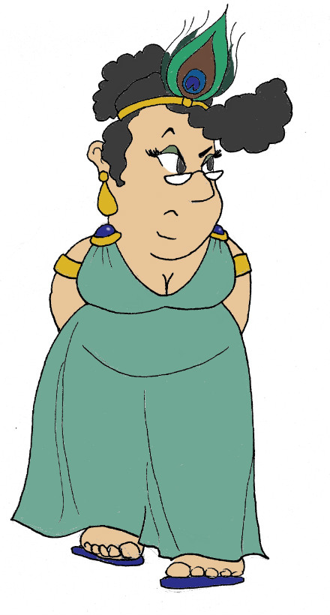
Maximum Civilisation
The Greek Alphabet
LO: To learn about the Ancient Greek alphabet and to write our names using it
MCG: Greek alphabet

Slide 2
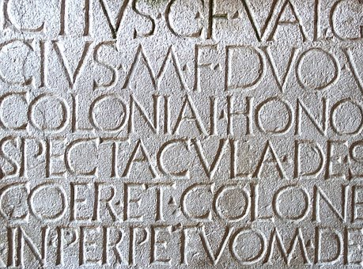
Where do our letters come from?
We get the alphabet that we use today from the Romans.
Can you find these words in the Roman inscription to the right?
ET
and
DVO
two
SPECTACVLA
spectacles/shows
This looks like a V but is the way that U was inscribed
MCG: Greek alphabet

Slide 3
Where do our letters come from?
The Romans’ letters evolved from an earlier alphabet – Greek.
This is where we get the English word ‘alphabet’ from.
α
β
alpha
first letter of the Greek alphabet
beta
second letter of the Greek alphabet
MCG: Greek alphabet

Slide 4
Similar and different letters
Greek letters make language sounds that are mostly familiar to us.
α
κ
a
k
Some of the letters even look pretty similar:
ρ
r
R
is actually an
Some letters, though, are a bit confusing:
but think of it as a capital R that’s lost a leg!
χ
ψ
Some letters make sounds we need more than one letter for in English:
ch
ps
MCG: Greek alphabet

Slide 5
The Greek alphabet
Here are all the Greek letters. Capitals are in red and lower case in blue, along with their letter name and the sound they make.
Α α | alpha | a |  | Ν ν | nu | n
Β β | beta | b |  | Ξ ξ | xi | x
Γ γ | gamma | g |  | Ο ο | omicron | short o
Δ δ | delta | d |  | Π π | pi | p
Ε ε | epsilon | short e |  | Ρ ρ | rho | r
Ζ ζ | zeta | z |  | Σ σ ς (at end of word) | sigma | s
Η η | eta | long e |  | Τ τ | tau | t
Θ θ | theta | th |  | Υ υ | upsilon | u
Ι ι | iota | i |  | Φ φ | phi | ph/f
Κ κ | kappa | k |  | Χ χ | chi | ch
Λ λ | lambda | l |  | Ψ ψ | psi | ps
Μ μ | mu | m |  | Ω ω | omega | long o
h = ‘
(six-shaped inverted comma) before vowel at start of word
Show there’s no h before a vowel at start of word by using ’ (nine-shaped inverted comma)
Can you spot the ones that are similar and not-so-similar to the English letters you’re used to?
MCG: Greek alphabet

Slide 6
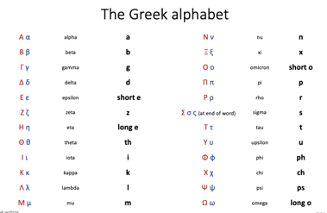
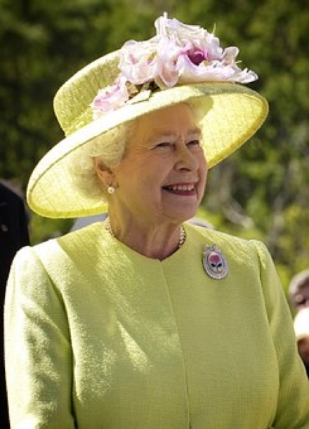
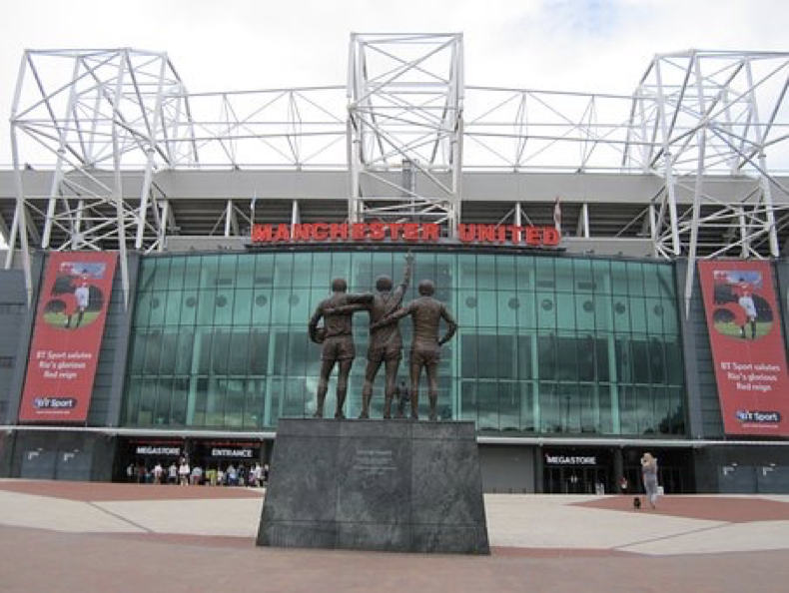
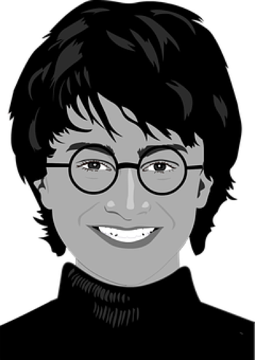
Guess who?
Use your Greek alphabet sheets to…
’Ελιζαβεθ
‘Αρρυ Ποττερ
Μανχεστερ ’Υνιτεδ
MCG: Greek alphabet

Slide 7
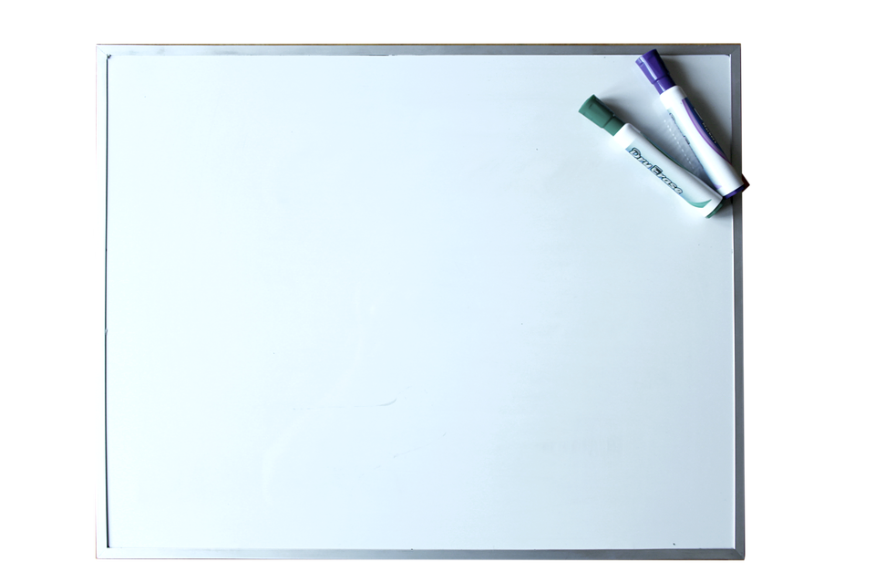
Write your name & make a name badge
HELLO, MY NAME IS
Αβδυλ
Abdul
Α β δ υ λ
MCG: Greek alphabet

Slide 8
Plenary quiz
Question 1 We use the same letters today as which ancient culture? Where did they get their alphabet from?
Question 2 What sound does the Greek letter make?
Question 3 There are two versions of the letter ‘o’ in the Greek alphabet. Can you write both of them? What’s the difference between how they sound?
MCG: Greek alphabet

