Slide 1
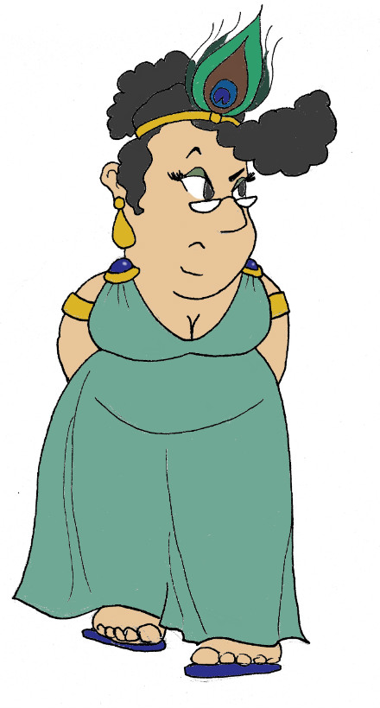
Maximum Civilisation
ROME
&
Music in the Ancient World
LO: To discover how music was made in the Ancient World
and to make a replica syrinx

Slide 2
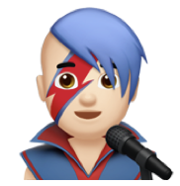
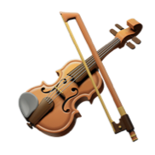
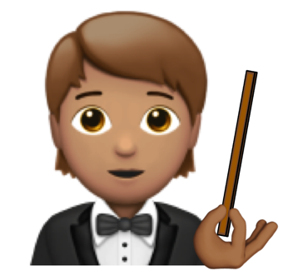
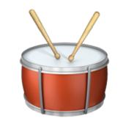
Word Roots Challenge
chorus
instrument
ῥυθμoς (rhuthmos)
(Ancient Greek)
a measured flow or beat
χορος (khoros) (Ancient Greek)
A group of people in a play who comment on the action in between scenes
φονος (phonos)
(Ancient Greek)
a sound
instruere
(Latin)
To build or put together
ἁρμόζειν (harmozein)
(Ancient Greek)
to join
audire
(Latin)
to hear
audio
symphony
rhythm
harmony
MC: Music in the Ancient World

Slide 3
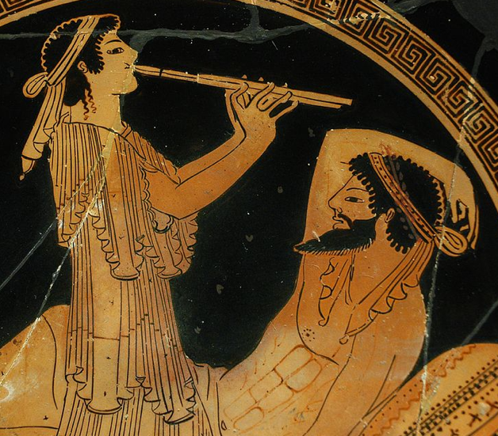
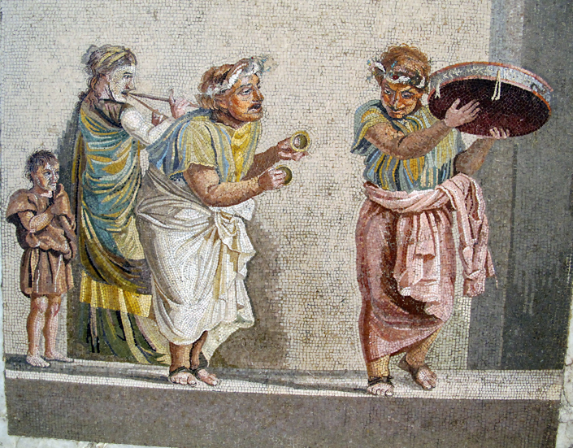
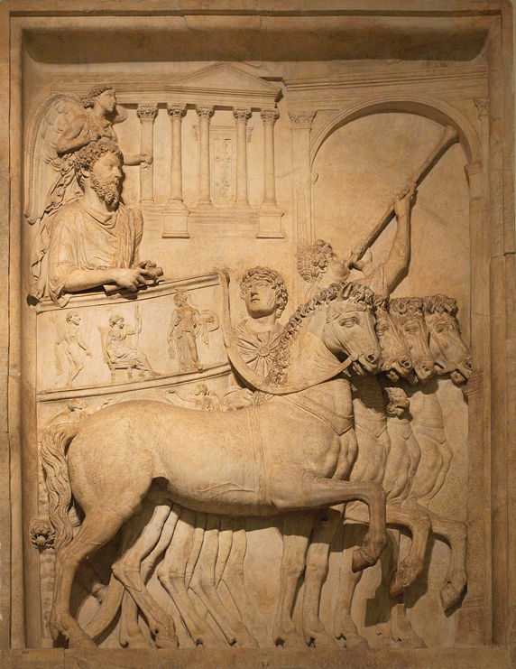
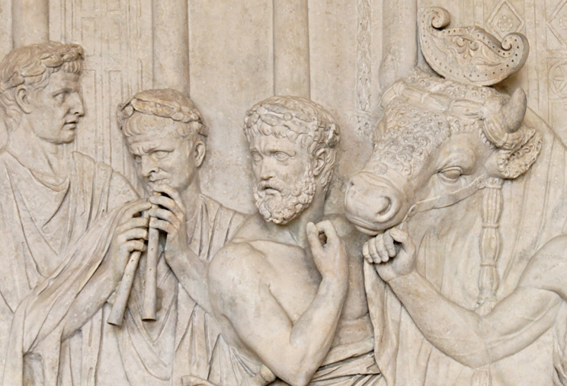
Music in the Ancient World
Just like in modern times, the Ancient Greeks and Romans made and listened to music.
theatre performances & shows
army communications
Wikimedia Commons
hymns & religious occasions
Sailko via ikimedia Commons
parties
MatthiasKabel via ikimedia Commons
Wikimedia Commons
MC: Music in the Ancient World

Slide 4
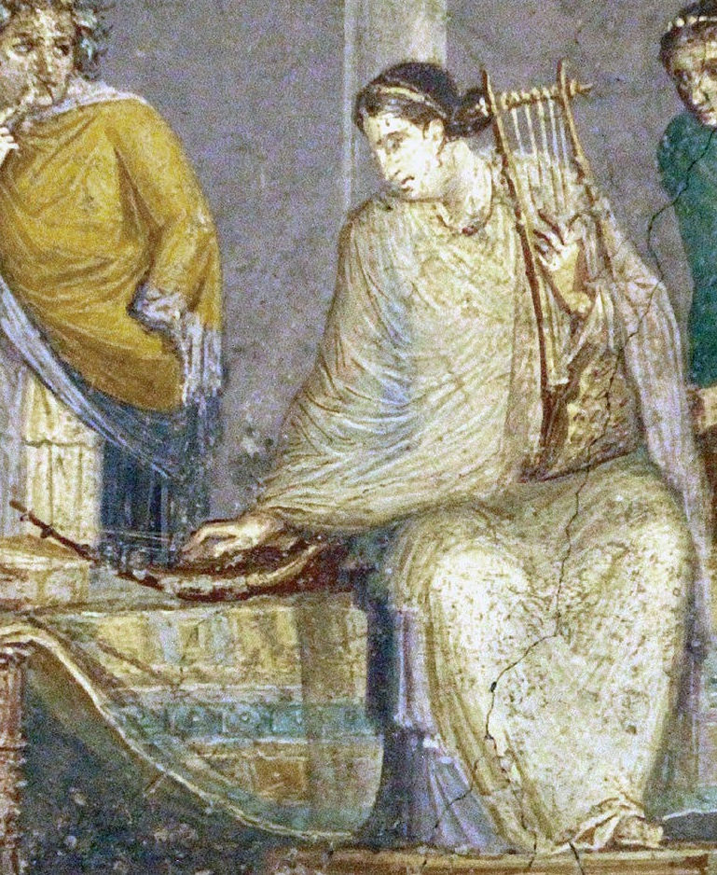
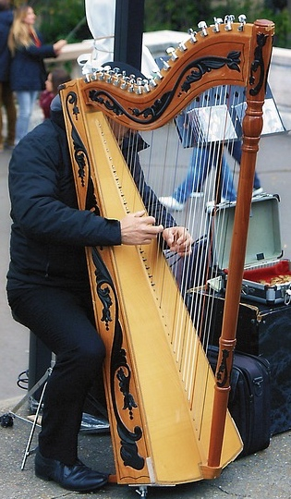
Ancient instruments
Lyra (lyre)
How does it work?
The player plucks strings to make a sound.
What does it sound like?
click to listen
What modern instrument is most like it?
Wikimedia Commons
harp
wall painting from Pompeii, 1st Century CE
MC: Music in the Ancient World

Slide 5
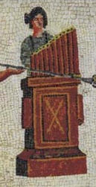
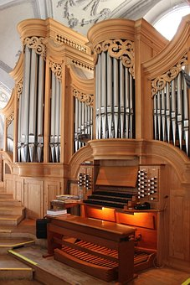
Ancient instruments
Hydraulis (Water Organ)
How does it work?
Water forces air through pipes of different lengths.
What does it sound like?
click to listen
Nacéra Benseddik via Wikimedia Commons
What modern instrument is most like it?
mosaic from Libya, 2nd Century CE
organ
MC: Music in the Ancient World

Slide 6
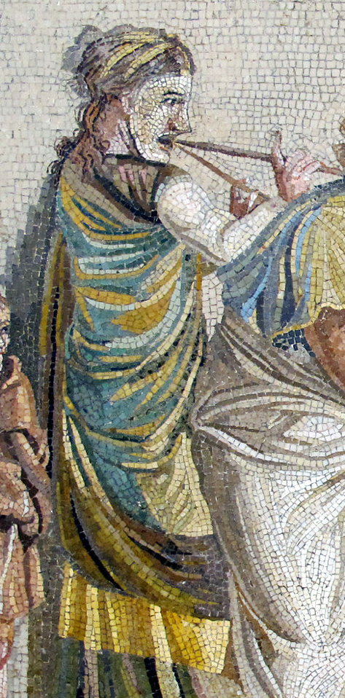
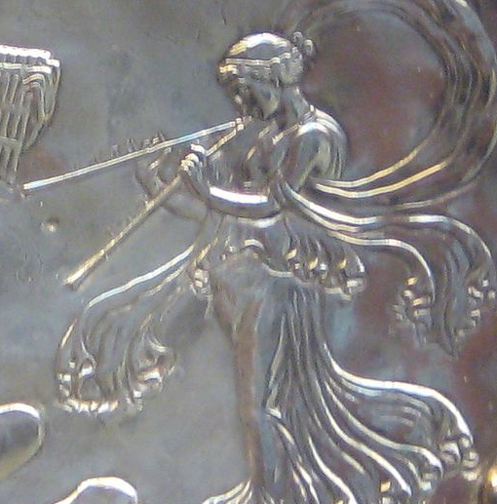
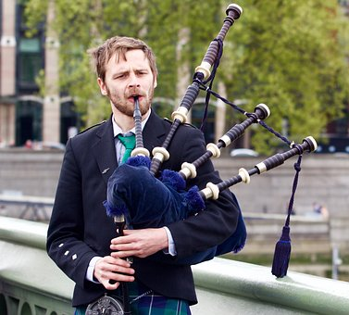
Ancient instruments
Aulos (double pipe)
mosaic from Pompeii, 1st Century CE
How does it work?
Players create a sound wave by blowing across a reed at the top of the pipes. They then change the notes made by covering holes with their fingers.
What does it sound like?
click to listen
Sailko via ikimedia Commons
What modern instrument is most like it?
British Museum via Wikimedia Commons
silver dish from Britain, 4th Century CE
bagpipes
MC: Music in the Ancient World

Slide 7
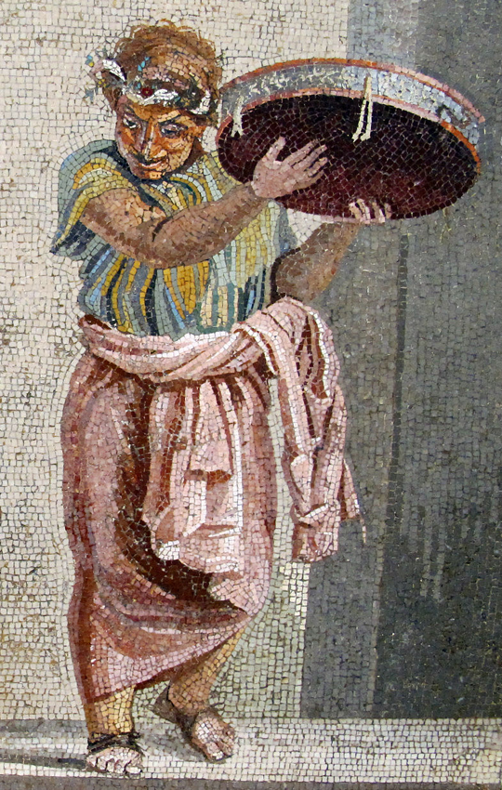
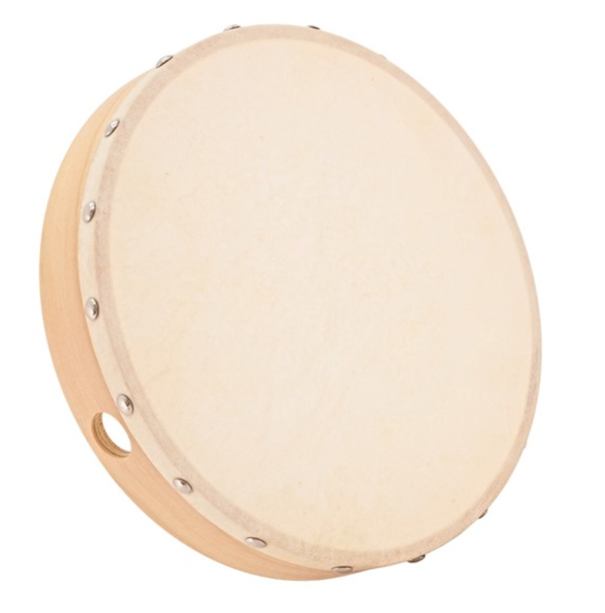
Ancient instruments
Tympanum (drum)
How does it work?
Hit it!
What does it sound like?
click to listen
Sailko via ikimedia Commons
What modern instrument is most like it?
hand drum
mosaic from Pompeii, 1st Century CE
MC: Music in the Ancient World

Slide 8
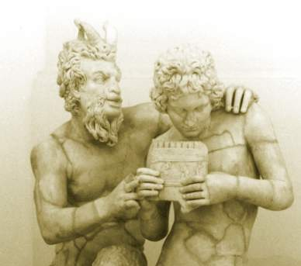
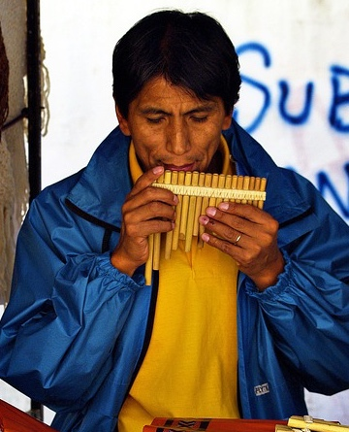
Ancient instruments
Syrinx (pan pipe)
How does it work?
The player blows across the pipes. Blowing through longer pipes creates lower notes. Blowing through shorter pipes create higher notes.
What does it sound like?
click to listen
What modern instrument is most like it?
statue of Pan and Daphnis from Pompeii, 1st Century CE
pan pipes are still used today
MC: Music in the Ancient World

Slide 9
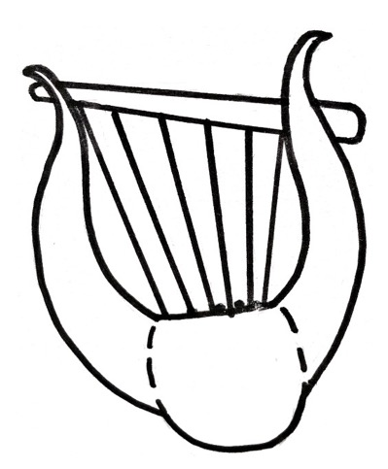
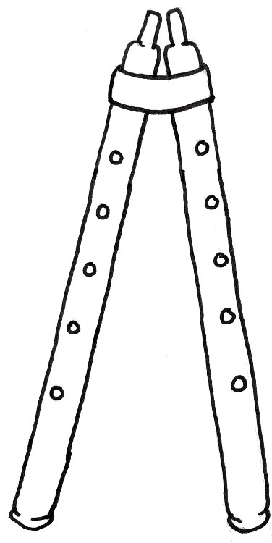
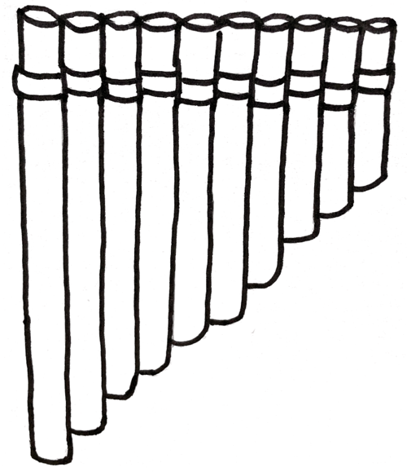
How musical instruments work
Musical instruments create notes of different pitches by altering the length of soundwaves produced
Aulos
Players create a sound wave by blowing across a reed at the top of the pipe. They then change the pipes’ length by covering holes with their fingers. Blowing through longer pipes creates longer soundwaves and this makes lower notes. Blowing through shorter pipes create shorter soundwaves and this makes higher notes.
Lyre
Longer strings are plucked to create longer soundwaves and this makes lower notes. Shorter strings create shorter soundwaves and this makes higher notes.
Syrinx
Blowing through longer pipes creates longer soundwaves and this makes lower notes. Blowing through shorter pipes create shorter soundwaves and this makes higher notes.
MC: Music in the Ancient World

Slide 10
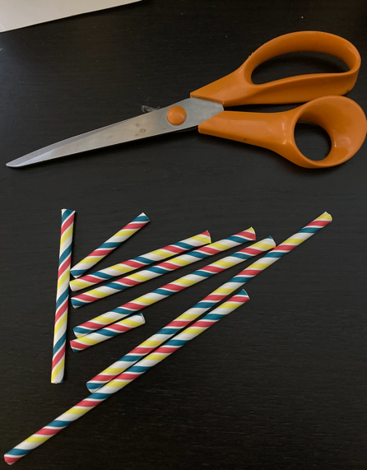
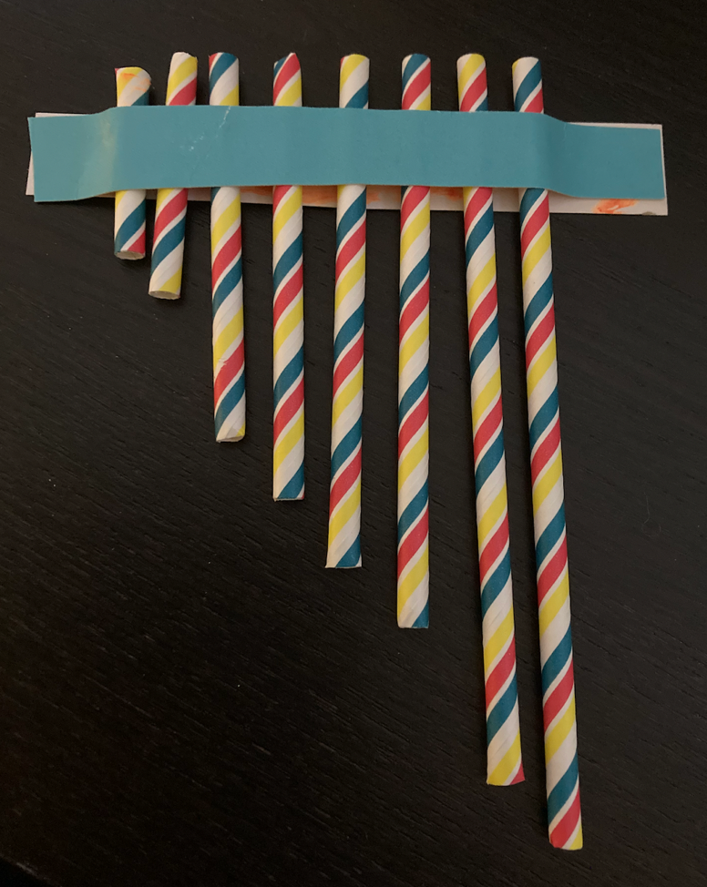
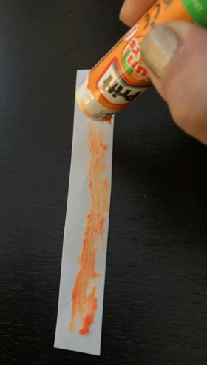
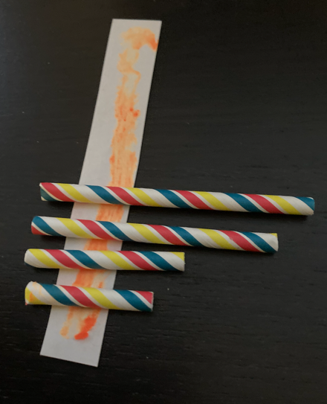
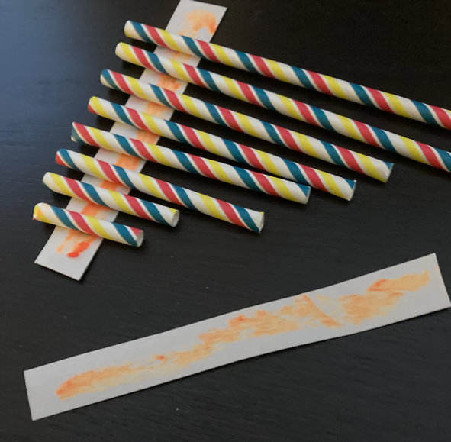
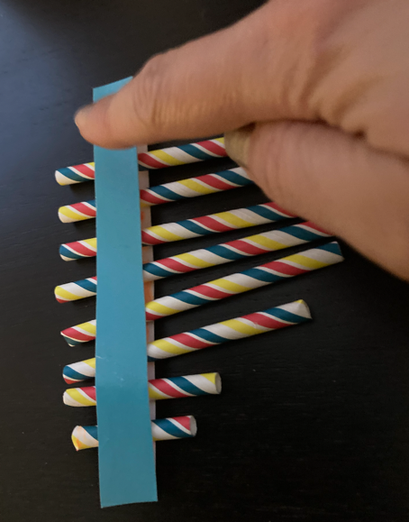
How to make a syrinx
3. Place the straws in order of their length on the gluey card strip, leaving a little space at the edges. Make sure the tops of the straws line up.
1. Take four paper straws and cut them to different lengths.
2. Spread glue along a 2cm x 10cm strip of card.
6. Once the glue is dry, pick up your syrinx by the ends of the cardboard strip and blow gently across the ends of each straw. Listen carefully to how the pitch of the note produced changes depending on the length of the straw.
4. When you have stuck down all the straws, spread glue on another 2cm x 10cm strip of card.
5. Press this strip gluey side down over the row of straws. Press the ends of the strip together.
MC: Music in the Ancient World

Slide 11
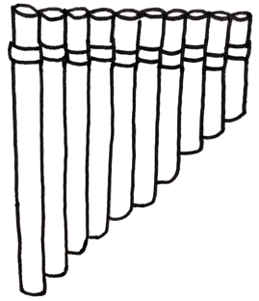
Plenary quiz
Question 1
Can you name an occasion on which you might hear music in the ancient world?
Question 2
What creates a high note, a long sound wave or a short sound wave?
Question 3
What is this instrument called?
MC: Music in the Ancient World

