Slide 1
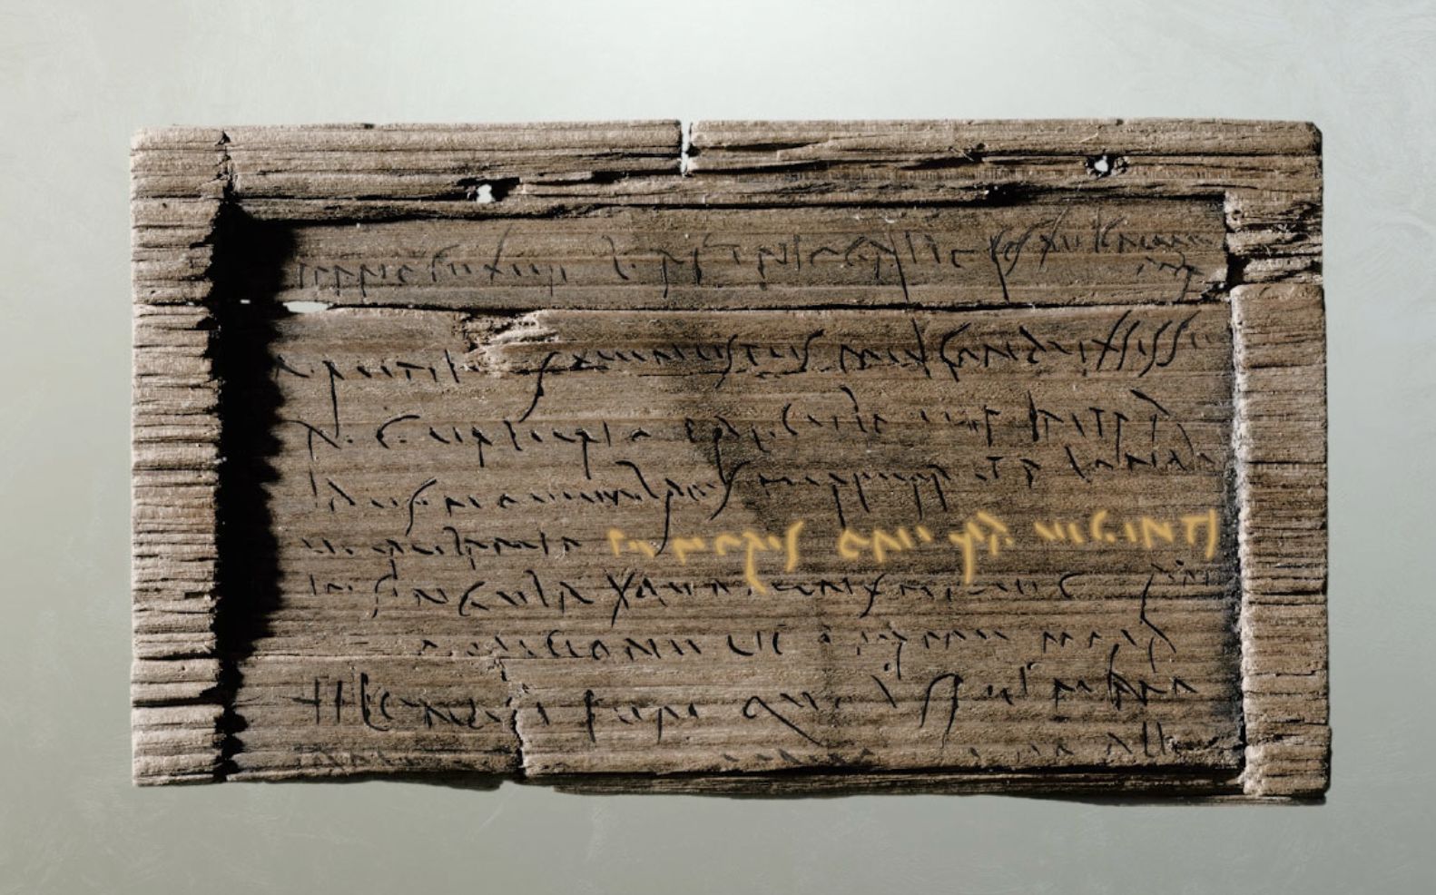
Messages from the Past
Exploring the Bloomberg Tablets

Slide 2
Stages and L.O.s of this micro-course
Introducing the tablets
Students are able to make connections between the tablets and modern forms of communication
Exploring cursive handwriting
Students are able to recognize similarities and differences between cursive and modern fonts, and are able to reproduce the cursive style
Reading an inscription
Students can extrapolate an imagined ‘back story’ from the stimulus of tablets WT30
Making deductions
Students can interrogate the BTs as artefactual sources to formulate claims about life in Roman Londinium and can deduce facts about tablets WT31, WT 24 and WT79

Slide 3
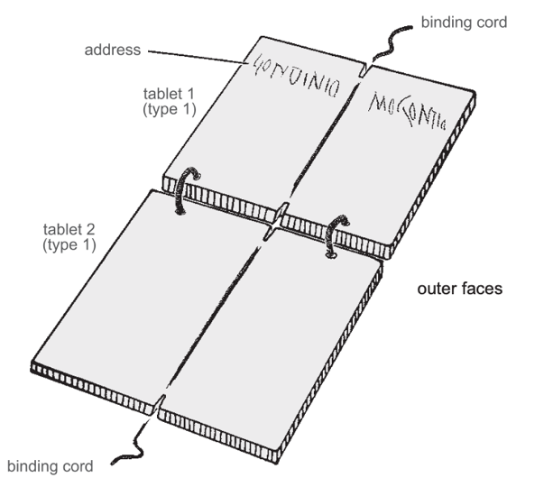
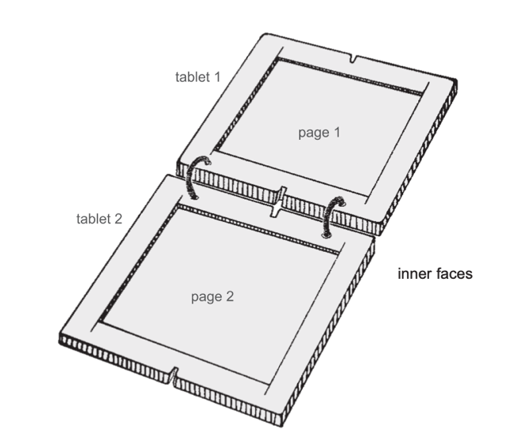
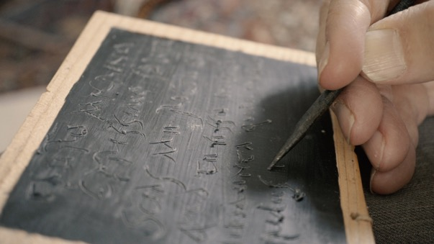
1. Introducing the tablets
What are wax tablets? What materials were used to make them?
Wax tablets were used across the ancient world.
name and address
shallow recess for wax
pointed metal stylus scrapes letters into dark coloured wax, showing the lighter coloured wood beneath
pictures © MoLA

Slide 4
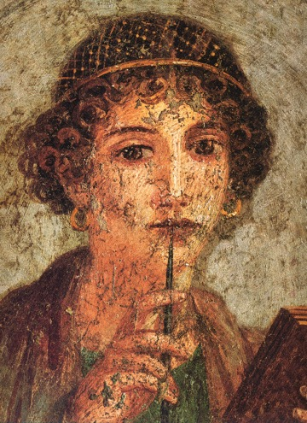
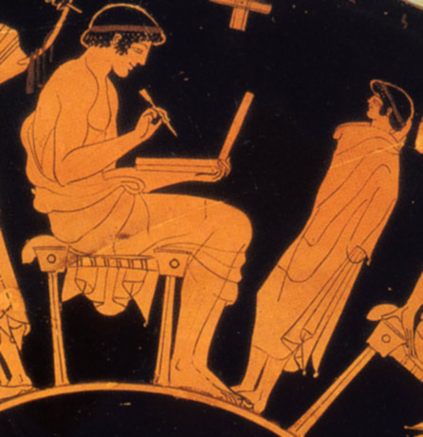
1. Introducing the tablets
Here are two primary sources (pieces of evidence) for the use of wax tablets in the ancient world:
Can you point out the wax tablets and styluses?

Slide 5
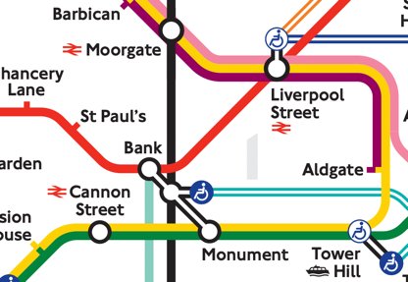
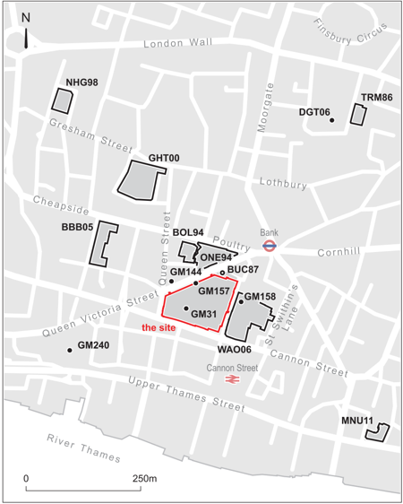
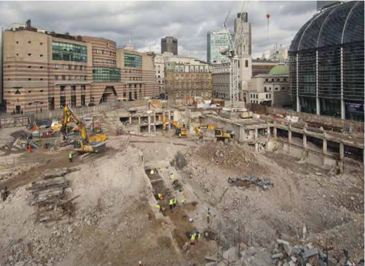
1. Introducing the tablets
A total of Roman 405 writing tablets were dug up between 2010 and 2014 when a location in the City of London was being prepared for new building work.
Water-logged conditions in the ground helped preserve the wooden tablets which date to the 1st Century CE.
The wax had disappeared but some scratched shapes of letters remained in the wood, where the writer had pressed hard with their stylus and gone right through the layer of wax.
pictures © MoLA

Slide 6
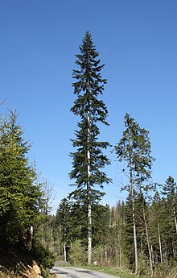
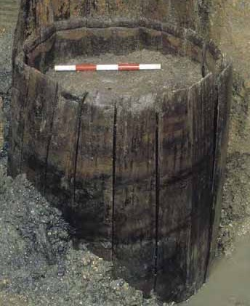
1. Introducing the tablets
a silver fir tree
Specialists identified that most of the tablets were made out of silver fir wood which is good for making wax tablets
BUT silver fir trees are native to Europe and didn’t grow in Britain in Roman times.
picture © MoLA
Can you explain how the tablets were made out of non-native wood?
CLUE: Many casks and barrels, used for importing goods, were excavated near to where the tablets were found.

Slide 7
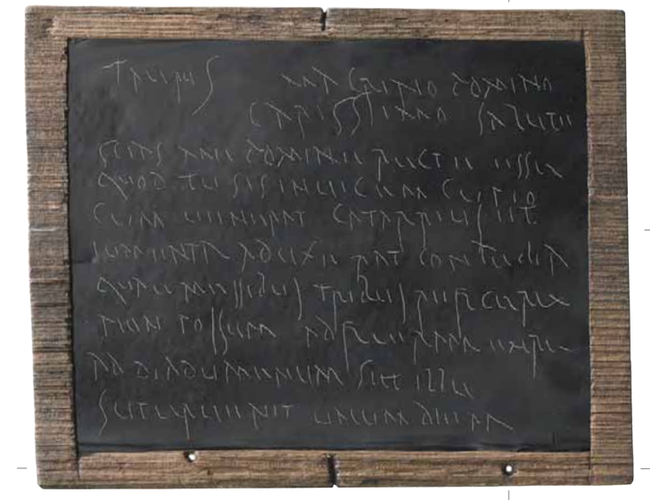
1. Introducing the tablets
Tablets were used for record-keeping and everyday writing, including letters. The beeswax, which is dyed black using soot, can be scraped off, melted and poured back into the wooden tablet frame, and the whole wax tablet reused.
picture © MoLA
What are some modern equivalents of Roman wax tablets? What might we use these for?

Slide 8
2. Exploring cursive writing
The everyday writing style used by people throughout the Roman Empire was known as cursive. This is the style we see on the Bloomberg Tablets. Cursive is the ancestor of the alphabet letters we still use today. Sometimes words written in cursive writing can look very similar to the word in modern letters:
Londinio – ‘in Londinium (London)’
pictures © MoLA

Slide 9
2. Exploring cursive writing
Sometimes the style of cursive writing can make words look very different:
Flori – ‘to Florus’ (a man)
pictures © MoLA

Slide 10
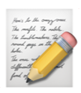
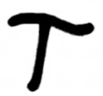
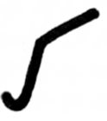
2. Exploring cursive writing
worksheet 1 write in the cursive style
Here’s what the cursive alphabet looks like. It gets its name from the Latin ‘currere’ (‘to run’) because it’s a quick and efficient style of writing when using a stylus on wax or ink on wood.
a | b | c/k | d | e | f | g | h | i/j | l | m
n | o | p | q | r | s/z | t | u/v/y | w (write letter u twice) | x (write as ‘cs’)
Which letters are similar to modern ones? Which are different?

Slide 11
3. Reading the inscriptions
We’ve seen this inscription before but did you notice there was another word?
What do you think is the purpose of this writing (clue: it’s on the outside of the tablet)
pictures © MoLA
Londinio Mogontio – ‘To Mogontius in Londinium (London)’

Slide 12
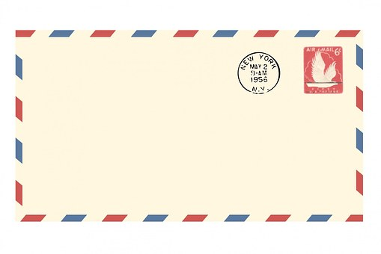
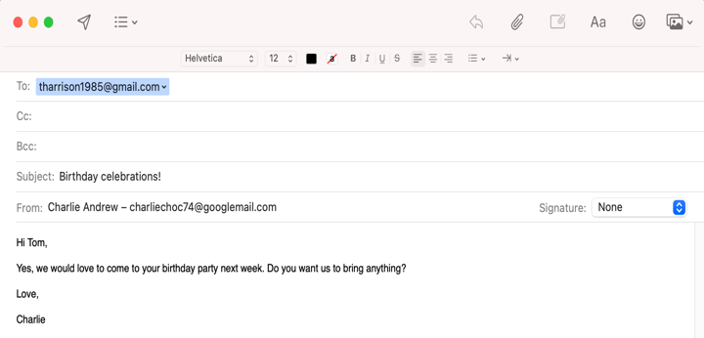
3. Reading the inscriptions
How do we make sure letters and messages get to their destinations today? What is the same and what is different?
picture © MoLA
What clues can this give us about life in the Roman world?
T. Harris
15, Rowland Street,
Weston Favell,
Northampton,
NN3 3PB,
ENGLAND

Slide 13
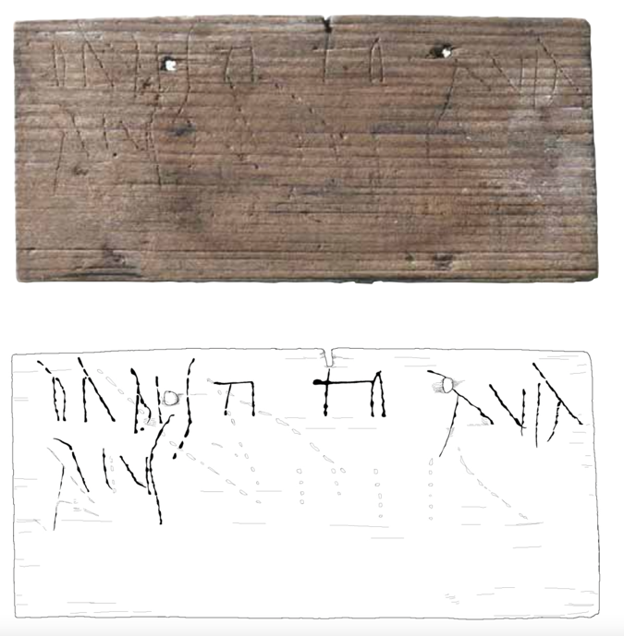
3. Reading the inscriptions
Here’s another address written on the outside of a tablet (WT30).
Can you use your knowledge of the cursive style of handwriting to decode the letters of this Latin address?
Tito
dabis
You will give (this)
to Titus
aviarius
the bird-keeper
pictures © MoLA

Slide 14
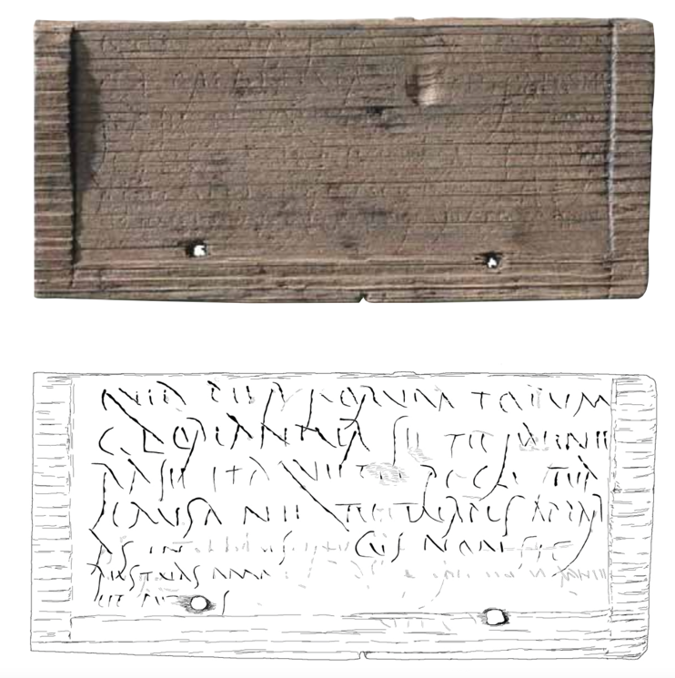
3. Reading the inscriptions
And here’s the inside of the tablet, where we can still see quite a big chunk of the writing.
Here is what it says in Latin, with an English translation:
…quia per forum totum gloriantur se te faenerasse itaque te rogo tua causa ne tu turpis appareas in ...cus non sic res tuas amabis et putas…
... because they are boasting through the whole market that you have lent them money. Therefore I ask you in your own interest not to appear shabby ... you will not do yourself any favours like this...
pictures © MoLA

Slide 15
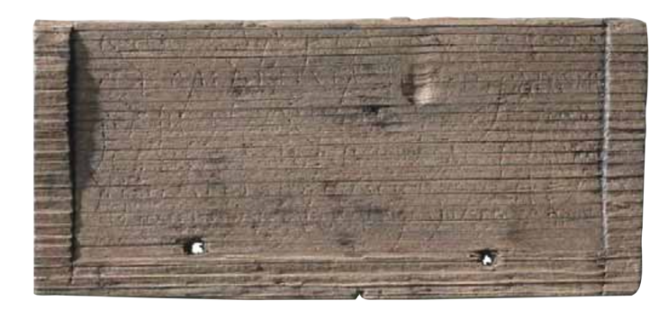
3. Reading the inscriptions
worksheet 2 creative writing
... because they are boasting through the whole market that you have lent them money. Therefore I ask you in your own interest not to appear shabby ... you will not do yourself any favours like this...
pictures © MoLA
What in the name of archaeology is going on here?!

Slide 16
4. Making deductions
With many ancient artefacts, we can search for clues and made deductions (good guesses based on the evidence we have) about the lives of the people making and using them. We can do this, too, with the Bloomberg tablets and help build up a picture of life in Roman Londinium.
Using question words can help in the process of investigating the inscriptions, for example:
who?
when?
where?
what?
Can we find any evidence for a date?
Where was the inscription found?
Who wrote the text?
If a letter, who sent it?
how?
why?
What is the item made from? Is it a common material for everyday use?
What materials or tools were used to make the inscription?
What’s the purpose of the inscription?

Slide 17
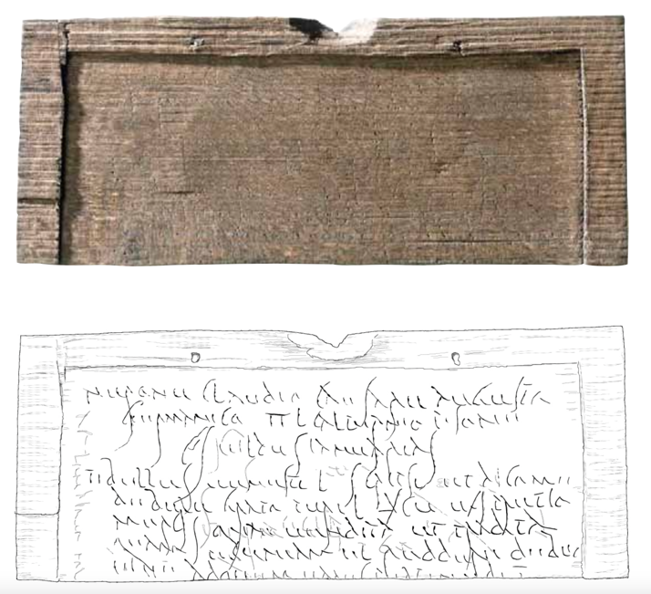
4. Making deductions
Let’s use these question words to help make some deductions about this tablet (WT 44).
Nerone Claudio Caesare Augusto Germanico ii L(ucio) Calpurnio Pisone co(n)s(ulibus) u. i. Idus Ianuarias … Tibullus Venusti l(ibertus) scripsi et dico me debere Grato (S)puri l(iberto) (denarios) cu ex pretio mercis quae uendita et tradita (est) quam pecuniam ei reddere debeo eiue ad quem ea res pertinebit
In the consulship of Nero Claudius Caesar Augustus Germanicus for the second time and of Lucius Calpurnius Piso, on the 6th day before the Ides of January. I, Tibullus the freedman of Venustus, have written and say that I owe Gratus the freedman of Spurius 105 denarii from the price of the merchandise which has been sold and delivered. This money I am due to repay him or the person looking after the matter.
pictures © MoLA

Slide 18
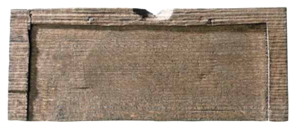
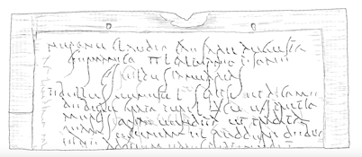
4. Making deductions
(8 January AD 57).
pictures © MoLA
Nerone Claudio Caesare Augusto Germanico ii L(ucio) Calpurnio Pisone co(n)s(ulibus) u. i. Idus Ianuarias … Tibullus Venusti l(ibertus) scripsi et dico me debere Grato (S)puri l(iberto) (denarios) cu ex pretio mercis quae uendita et tradita (est) quam pecuniam ei reddere debeo eiue ad quem ea res pertinebit
In the consulship of Nero Claudius Caesar Augustus Germanicus for the second time and of Lucius Calpurnius Piso, on the 6th day before the Ides of January. I, Tibullus the freedman of Venustus, have written and say that I owe Gratus the freedman of Spurius 105 denarii from the price of the merchandise which has been sold and delivered. This money I am due to repay him or the person looking after the matter.
See if you can find some answers in the text of WT 44 for these questions:
what is the artefact?
who made it?
cursive scratch marks on wood = wax tablet
where was it found?
Tibullus, freedman of Venustus
City of London, Roman Londinium
why was it made?
when was it made?
to record a debt to Gratus, freedman of Spurius
“In the consulship of Nero Claudius Caesar Augustus Germanicus for the second time and of Lucius Calpurnius Piso, on the 6th day before the Ides of January”
= 8 January AD 57

Slide 19
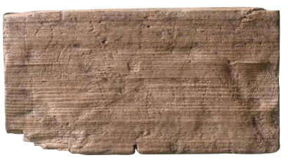
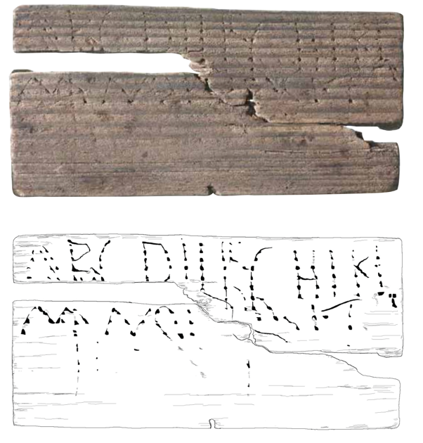
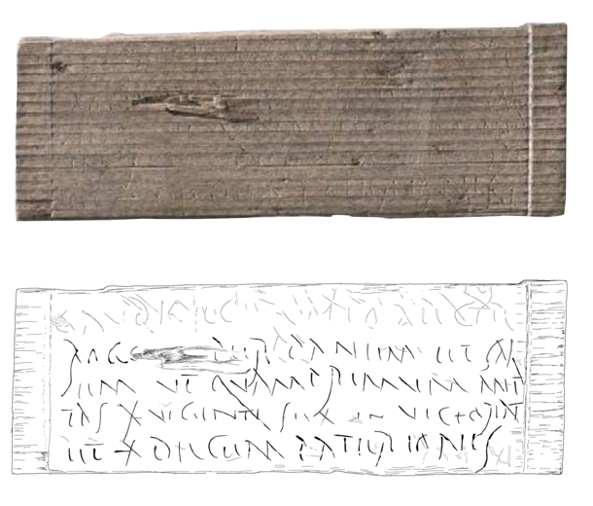
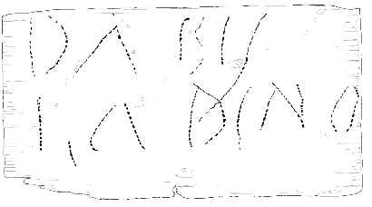
4. Making deductions
worksheet 3
making deductions from inscriptions
Using question words, try to deduce as much as you can about these three tablets and their inscriptions on your worksheet
pictures © MoLA
WT31
WT24
WT79

Slide 20
4. Making deductions
What is it & where was it found?
Wooden fragment of wax tablet containing scratched letters in the cursive style. Found in the City of London, Roman Londinium
When was it made/written?
1st Century CE
Who made/wrote it?
No name, but perhaps he is a business partner of the recipient?
Why was it made?
Asking the recipient for money.
Is there anything else interesting?
The victoriatus was a Roman silver coin made in the 2nd century BC for trade with the Greek world. The denarius was another type of Roman coin.
Let’s see what you deduced about WT 31.
WT31
pictures © MoLA
“... I ask you for our friendship’s sake that you send as soon as possible the 26 denarii in victoriati and the 10 denarii of Paterio…”

Slide 21
4. Making deductions
What is it & where was it found?
Wooden fragment of wax tablet containing an address in scratched cursive letters. Found in the City of London, Roman Londinium
When was it made/written?
1st Century CE
Who made/wrote it?
We will never know! The recipient’s name is also sadly missing.
Why was it made?
It is the outside of a wax tablet giving the name and address of the recipient.
Is there anything else interesting?
The sender has spelled ‘Londinio’ incorrectly, but the message still got delivered to the right place!
Let’s see what you deduced about WT 24.
pictures © MoLA
WT24
“You will give this to <name missing> in Londinium”

Slide 22
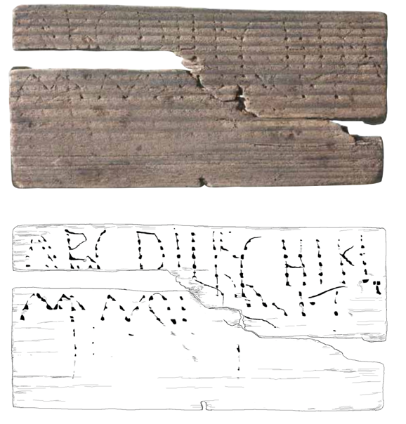
4. Making deductions
What is it & where was it found?
Wooden fragment of wax tablet containing a scratched capital letters that read like the alphabet. Found in the City of London, Roman Londinium
When was it made/written?
1st Century CE
Why was it made?
We can’t be entirely sure, but many historians think this may be someone practicing writing the letters of the alphabet on the tablet.
Who made/wrote it?
Perhaps a child doing their lessons?
Is there anything else interesting?
There’s no J in Latin so that’s why it’s missing. The inside of this tablet also contains letters that look like writing practice.
Let’s see what you deduced about WT 79.
WT79
pictures © MoLA
“A B C D I I F G H I K L M N O P Q R S T ”

