Slide 1
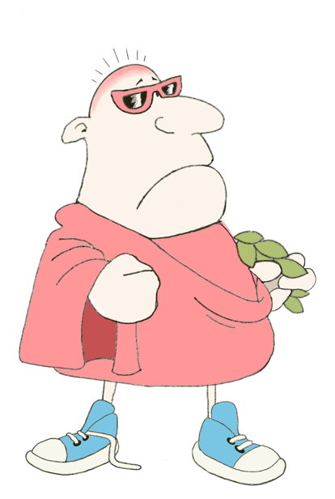
eheu! Iucundus aeger est! quid sibi dolet…
salvete!
salve!
…cor
aut
cerebrum?
Maximum Classics
……………… sibi dolet!
Unit 16, Session 4
Useful to know: Animals
LO: To explore the roots of modern animal-related words, to investigate the roles of animals in the ancient world, and to make a clay owl, symbol of Athena/Minerva

Slide 2
Animal Words Roots Challenge
canis
Latin
dog
Can you match the animal-related word to its Latin or Ancient Greek ancestor?
pilosus
Latin
hairy
equus
Latin
horse
canine
bovine
cygnet
rodent
arachnophobia
arctic
caterpillar
squirrel
equestrian
skiouros
Greek
with a shady tail
arachne
Greek
spider
cygnus
Latin
swan
arktos
Greek
bear
(or The Great Bear constellation)
boves
Latin
cattle
rodere
Latin
to gnaw, to chew
16.04 UTK: Animals

Slide 3
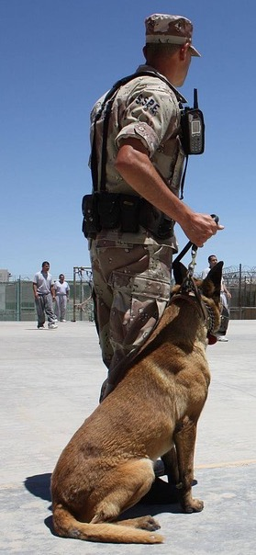
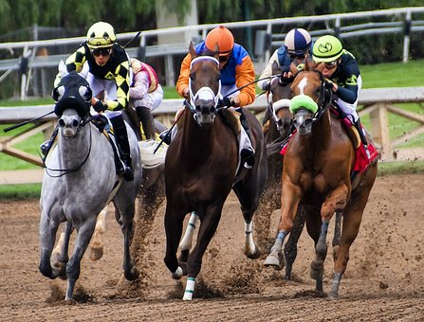
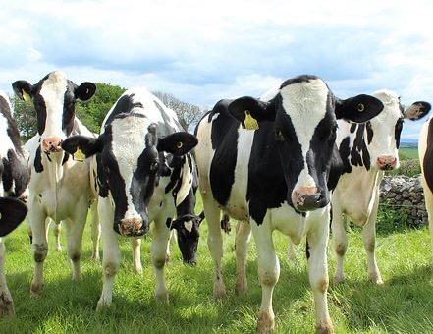
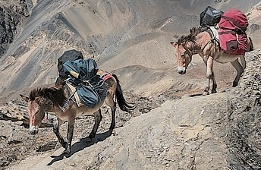
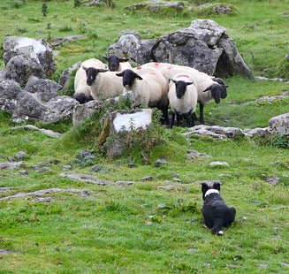
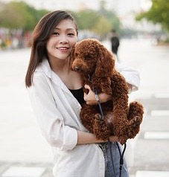
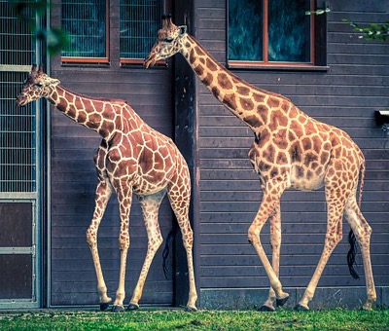
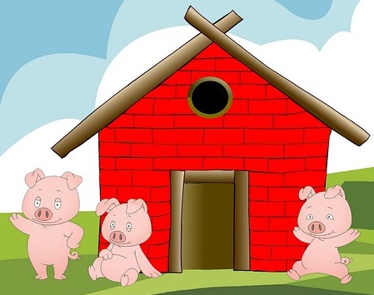
The role of animals
What roles do animals play in today’s world?
16.04 UTK: Animals

Slide 4
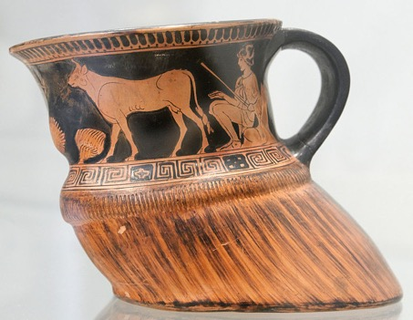
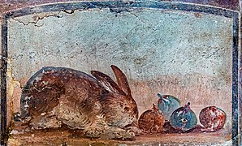
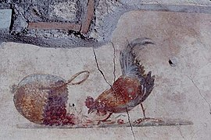
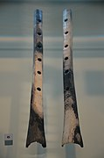
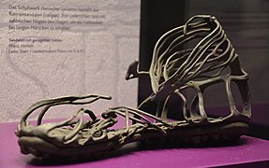
The role of animals in the ancient world
for meat (wild & farmed)
to provide dairy products
Greek cup decorated with a cowherd and cow, in the shape of a cow hoof, 470-460 BCE
Wikimedia Commons
Wikimedia Commons
Wikimedia Commons
Wall paintings of a rabbit and a chicken from Pompeii, 1st century BCE
to make everyday objects
to provide clothes & shoes
Roman soldier’s leather sandal, 1st century CE
Wikimedia Commons
Wikimedia Commons
Wikimedia Commons
Wikimedia Commons
Roman ivory (elephant tusk) sewing needle from 2nd-3rd century CE
Roman bone flutes
16.04 UTK: Animals

Slide 5
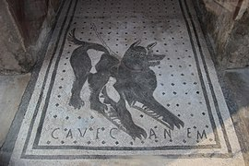
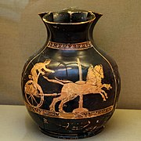
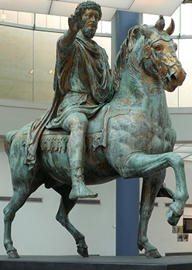
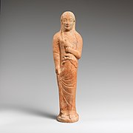
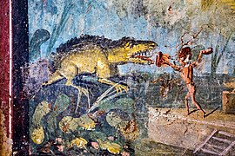
The role of animals in the ancient world
fighting & guarding
transport & pulling vehicles (e.g. chariots, ploughs, carts)
bronze statue showing Emperor Marcus Aurelius on horseback, 173-176 CE
Greek wine jug showing a chariot race,
400-420 BCE
Wikimedia Commons
mosaic of a guard dog
(‘cave canem’= ‘beware of the dog’), Pompeii 1st century BCE
Wikimedia Commons
pets
currency/status
hunting
“…for the winner a large tripod … valued at the price of twelve oxen … and for the loser he stood up a woman… skilled in many tasks, who was priced in four oxen.”
Homer, The Iliad (Book 23)
wall painting of a crocodile hunt, Pompeii,
1st century BCE
Wikimedia Commons
Wikimedia Commons
Greek terracotta statuette of a woman holding a bird, 6th century BCE
16.04 UTK: Animals

Slide 6
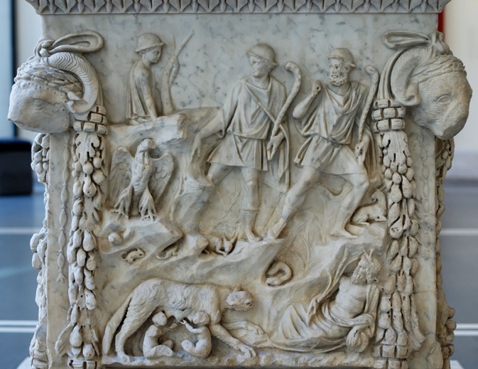
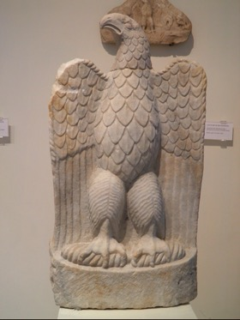
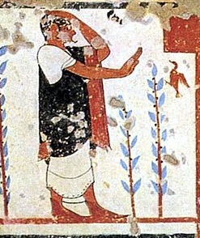
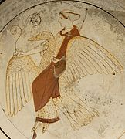
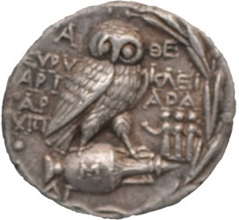
The role of animals in the ancient world
in mythology
as symbols of the gods
in religion
A marble eagle from a Greek temple of Zeus
© Creative Commons
Wikimedia Commons
Wikimedia Commons
A picture of Aphrodite and a swan on a Greek cup, 460 BCE
Wikimedia Commons
Creative Commons
Carving on a Roman altar showing the mythological founders of Rome, Romulus and Remus, being looked after as babies by a wolf,
1st-2nd centuries CE
A wall painting showing an augur (a priest who specialized in interpreting meaning from the actions of birds),
6th century BCE
A coin from Athens showing Athena’s (and the city’s) owl symbol, from 200 BCE
Wikimedia Commons
16.04 UTK: Animals

Slide 7
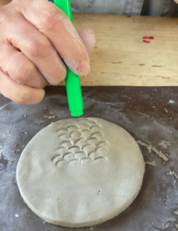
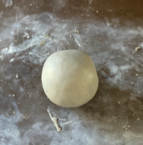
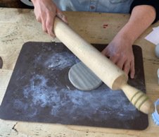
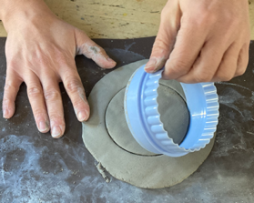
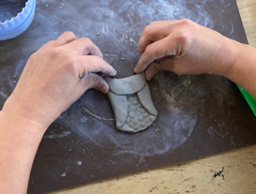
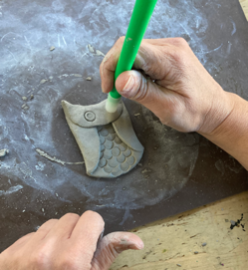
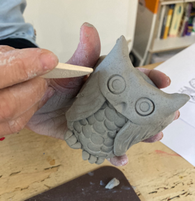
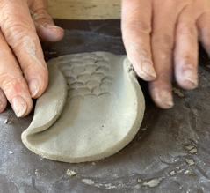
Make a clay owl (animal symbol of Athena/Minerva)
4
1
2
3
Cut out a circle from the clay.
Use the end of a pen to make feather shapes on the bottom half of the circle.
Roll a ball of clay about the size of a small orange.
Flatten it until it is the same depth as two pennies.
6
If you want, you can add more detail such as feet, a beak or more feathers.
Leave the owl to dry (air drying clay takes about a week). Once dry, you can paint your owl, if you like.
7
8
5
Fold in the two outside edges of the circle to make wings
Fold over the top bit of the circle and pinch to make the owl’s ears.
Use the end of a pen lid to give the owl some eyes.
16.04 UTK: Animals

Slide 8
Plenary quiz
valete!
Question 1 Which creature gets its name from the Latin word ‘pilosus’, meaning ‘hairy’?
Question 2 Name two uses of animals in the ancient world.
vale!
vale!
Question 3 Can you recall any Greek/Roman gods and the animal symbols associated with them?
vale!
16.04 UTK: Animals

