Slide 1
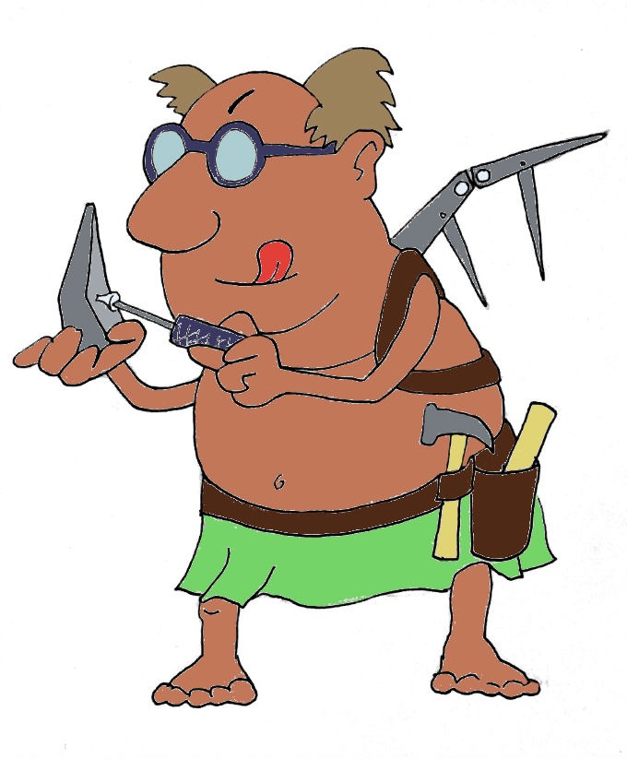
Χαιρετε!
Khairete!
Your guide for today…
Daedalus
Mega Greek
8: inventions
© C. Andrew 2017

Slide 2
word roots challenge
τηλε
φως
tele, far away
phos, light
θερμος
thermos, hot
’ελεκτρον
κινημα
elektron, amber (fossilised tree sap)
kinema, movement
© C. Andrew 2017

Slide 3
ancient greek verbs
I
we
ω
ομεν
o
omen
you
you/y’all
εις
ετε
eis
ete
he,she,it
ει
they
ουσι
ei
ousi
© C. Andrew 2017

Slide 4
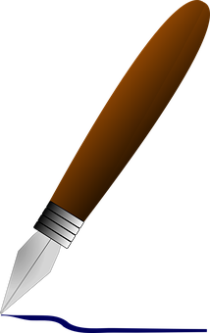
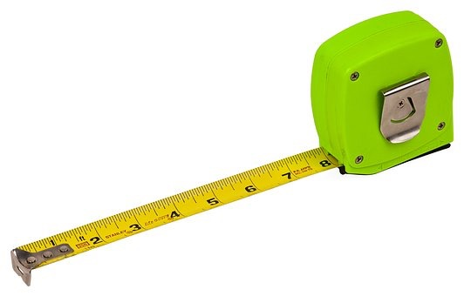
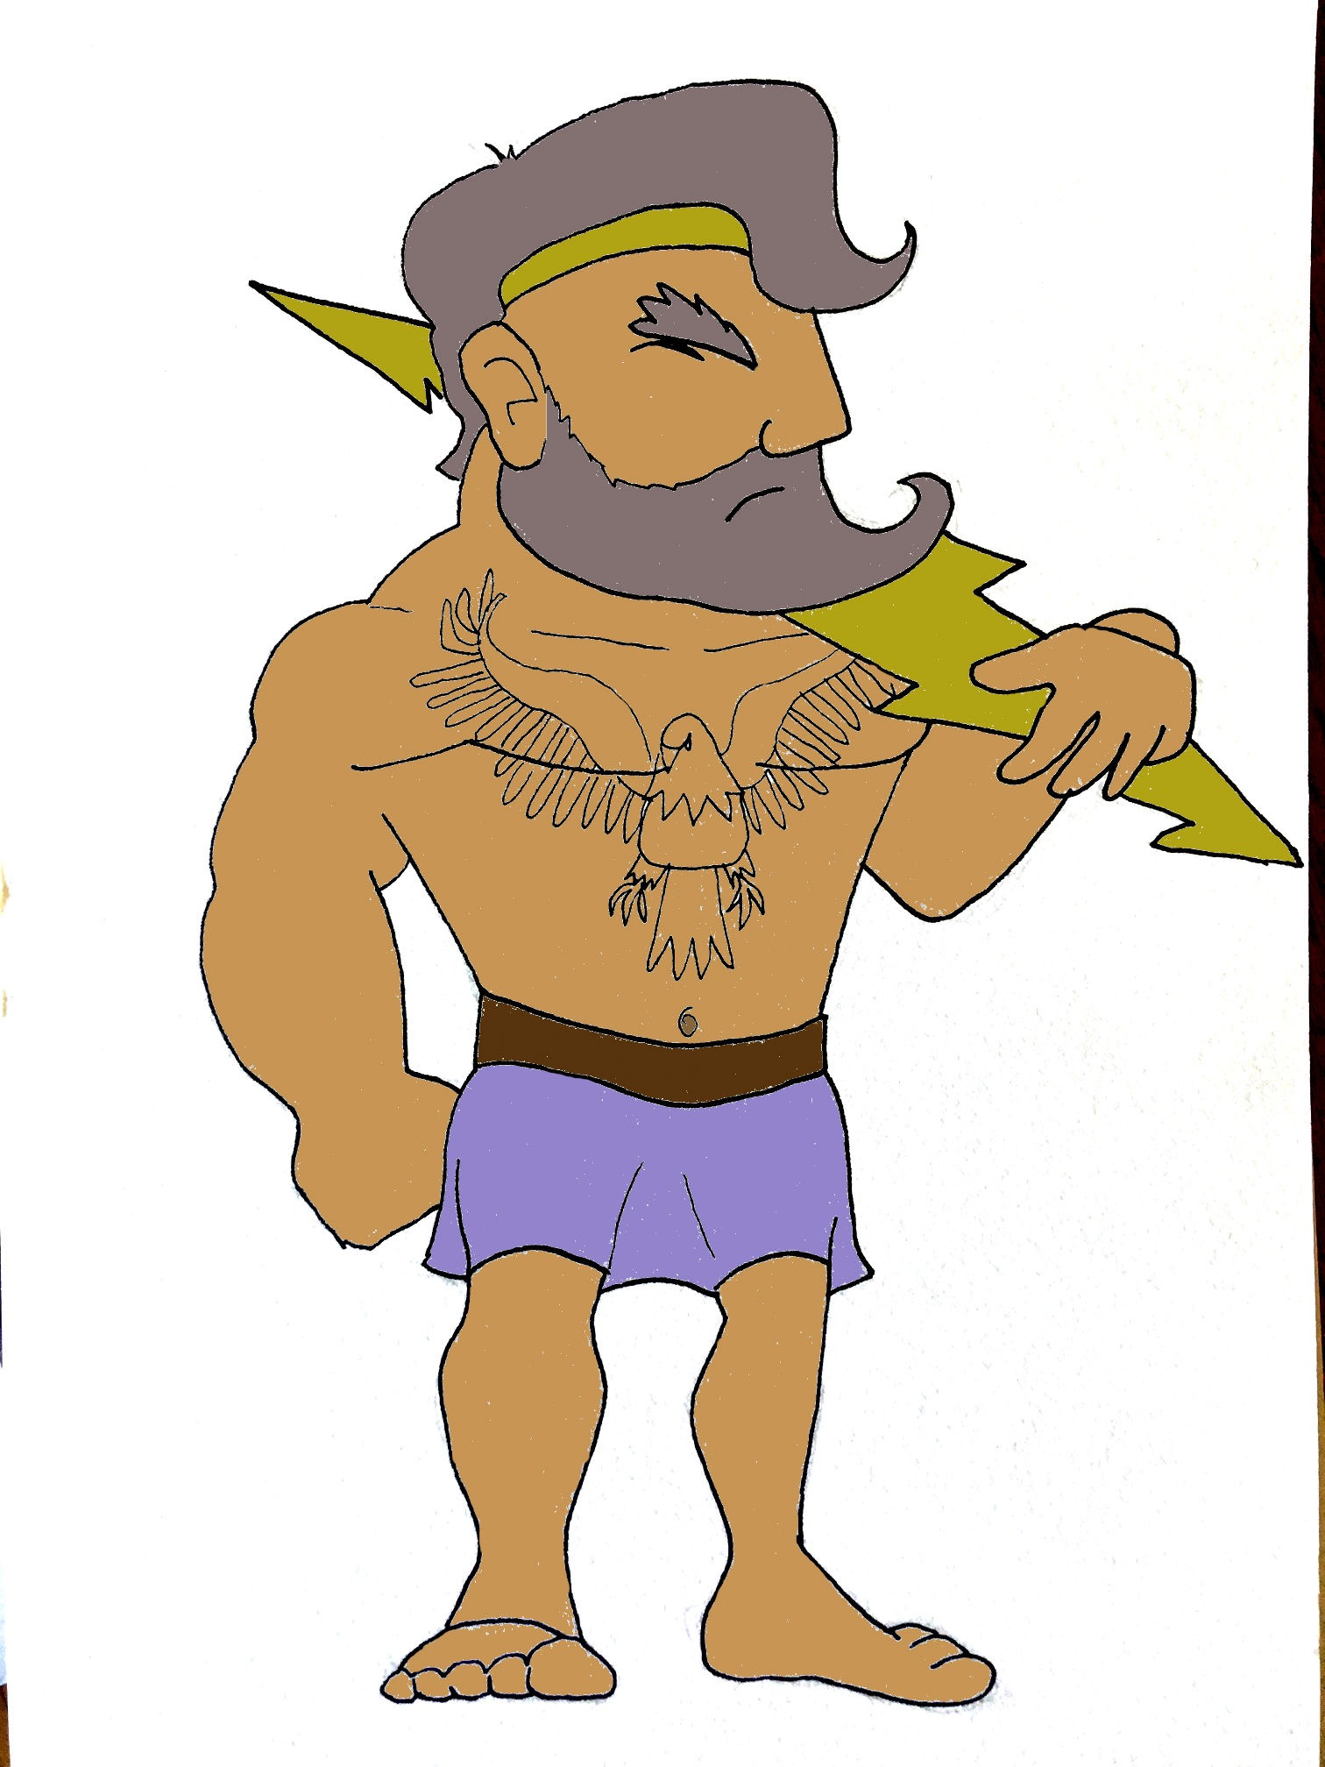
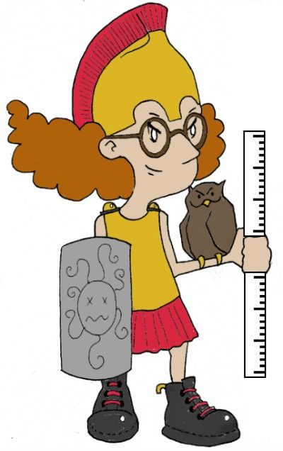
quick-fire Verbs
γραφειν, graphein
μετρειν, metrein
φιλειν, philein
μετρω
φιλομεν
γραφεις
μετρετε
φιλουσι
’Αθηνα μετρει
Ζευς φιλει
© C. Andrew 2017

Slide 5
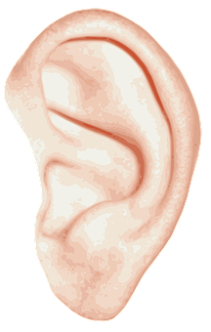
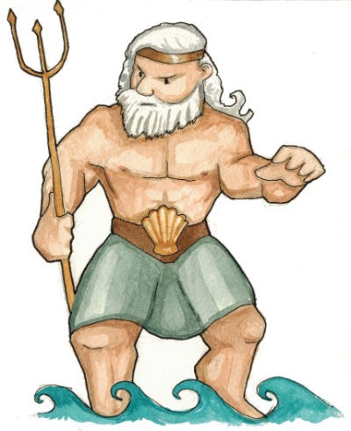
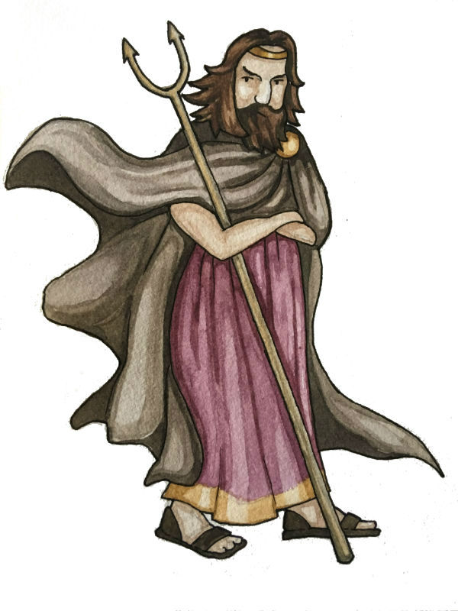
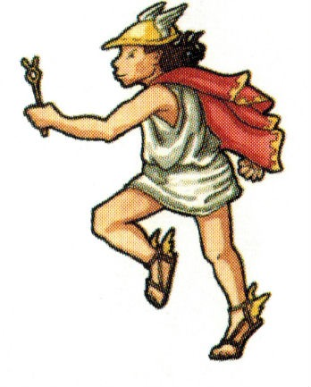
singulars & plurals
’ακουειν, akouein
‘Αδες ’ακουει
‘ο θεος ’ακουει
‘Αδες και Ποσειδων και ‘Ερμης ’ακουουσι
‘οι θεοι ’ακουουσι
© C. Andrew 2017

Slide 6
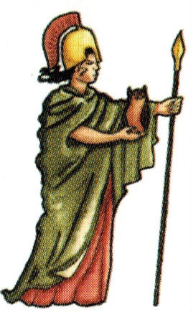
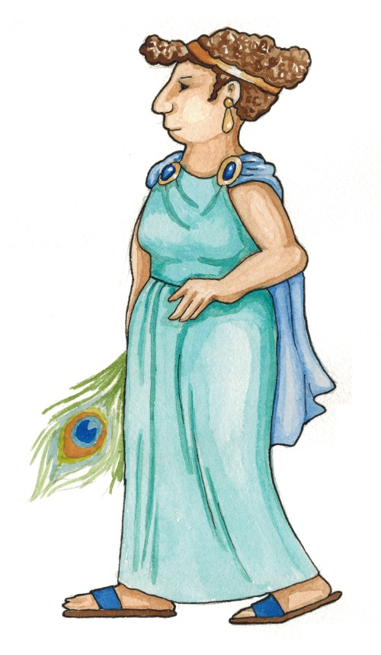
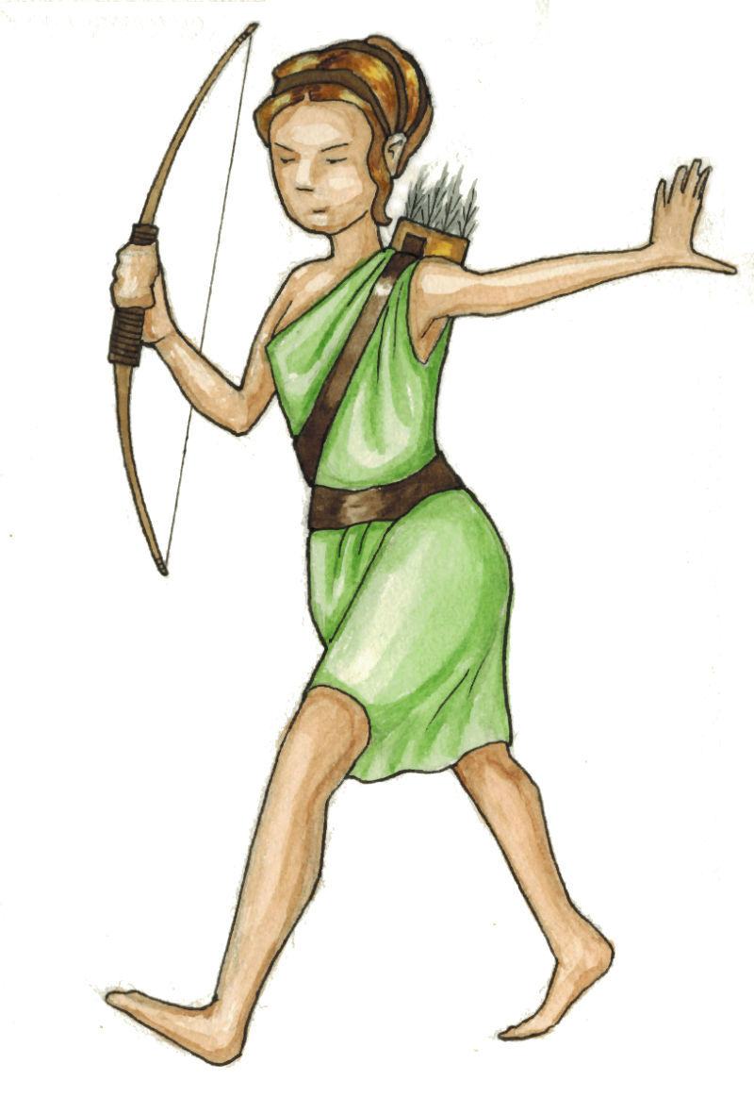
singulars & plurals
’ακουειν, akouein
’Αθηνα ’ακουει
‘η θεα ’ακουει
’Αθηνα και ‘Ηρα και ’Αρτεμις ’ακουουσι
‘αι θεαι ’ακουουσι
© C. Andrew 2017

Slide 7
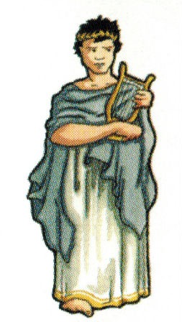
singulars & plurals
‘ο θεος
‘οι θεοι
‘η θεα
‘αι θεαι
© C. Andrew 2017

Slide 8
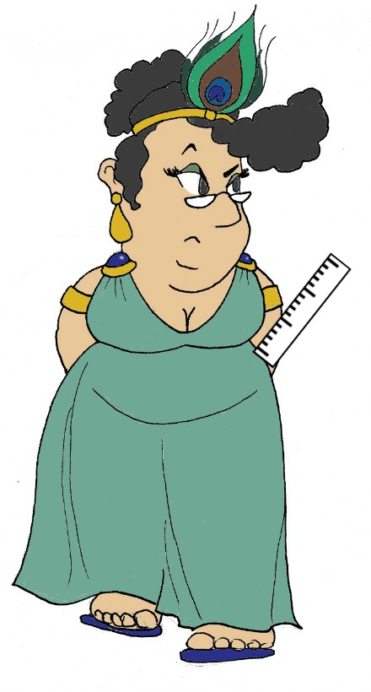
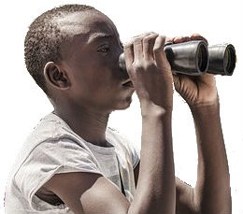
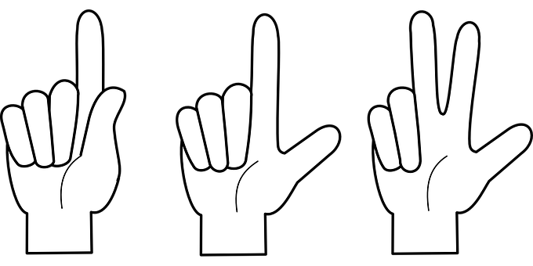
Plural Nouns & Verbs
What are the gods and goddesses doing? Translate the sentence and add an illustration. The first one has been done to show you how.
’Αθηνα και ‘Ηρα μετρουσι
Ζευσ και ’Απολλων γραφουσι
‘αι θεαι ’ακουουσι
‘οι θεοι σκοπουσι
Athena and Hera measure.
Zeus and Apollo write.
The goddesses listen.
The gods watch.
Handy Hints!
γραφειν, graphein
σκοπειν, skopein
’αριθμειν, arithmein
’Αρτεμις και ’Αθηνα και Περσεφονη σκοπουσι
‘οι θεοι ’ακουουσι
μετρειν, metrein
‘Ερμης και ‘Αδες αριθμουσι
Hermes and Hades count.
Artemis and Hera and Persephone watch.
The gods listen.
’ακουειν, akouein
© C. Andrew 2017

Slide 9
The myth of icarus
Let me tell you one of the most famous Greek myths, a cautionary tale about listening to instructions…
Once upon a time, my son, Icarus and I lived on the island of Crete. King Minos kept us prisoners there, as he prized my skills as the world’s greatest inventor.
But Icarus and I wanted to escape, so I came up with a cunning plan. Using all my skills as an inventor, I made each of us a set of wings so we could fly off the island to freedom.
The day came for our escape. “Icarus,” I warned my son, “Don’t fly too close to the sea or too near to the sun. If you do, the heat will melt the wax holding the feathers on your wings.” He promised he wouldn’t.
But, oh dear, he was so enthralled with his new-found abililty to fly that he got carried away. Up, up he soared toward the sun… and then down, down he plummeted as his wings melted. He fell into the sea, never to be seen again.
© C. Andrew 2017

Slide 10
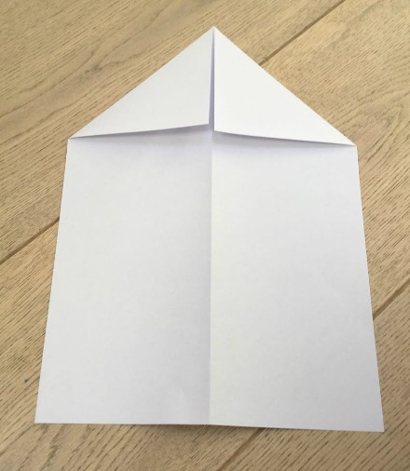
make an icarus flyer
1. Fold a piece of A4 size paper in half lengthwise, and then unfold.
2. Fold the top two corners down so they meet the centre crease.
© C. Andrew 2017

Slide 11
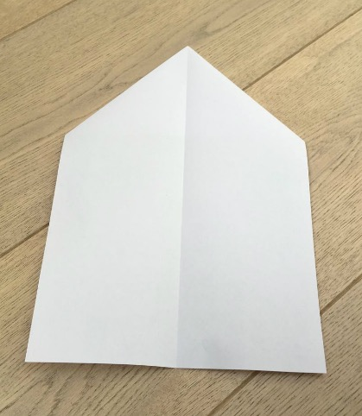
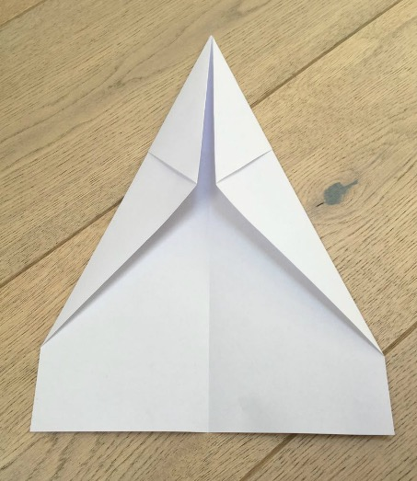
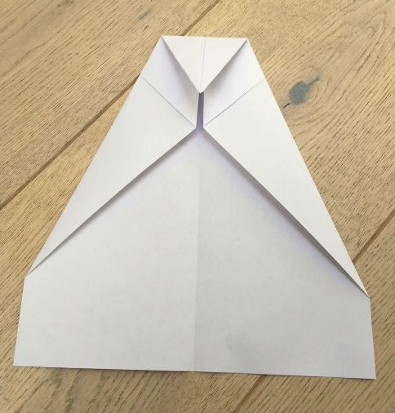
make an icarus flyer
3. Turn the flyer over.
4. Fold the corners in again to the centre crease. You want the diagonal line coming off the top of the flyer (on the left side) to be lined up with the middle (like on the right side).
5. Fold the top point down so that the tip meets the bottom of where the previous folds come together.
© C. Andrew 2017

Slide 12
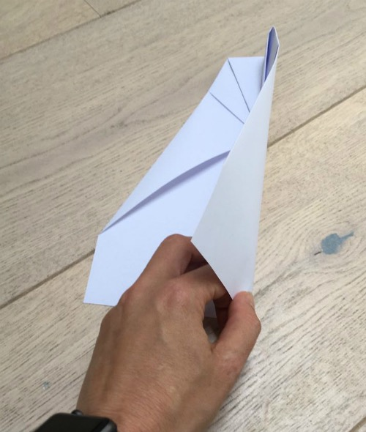
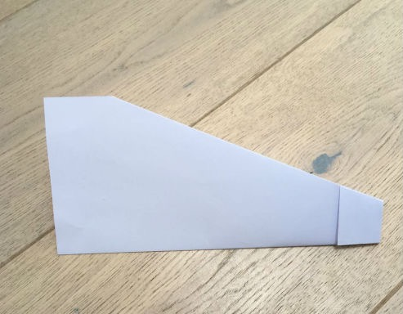
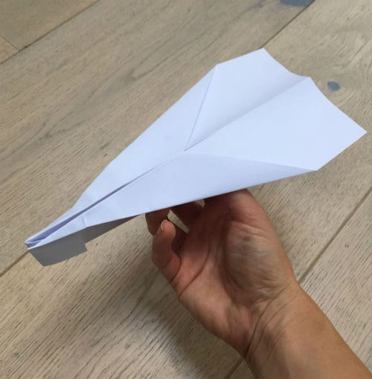
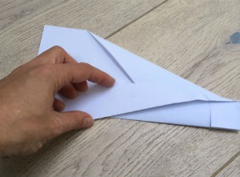
make an icarus flyer
6. Fold the entire flyer in half, in on itself.
7. Fold the wings down so that you’re making a straight line across from the top of the snub nose. Repeat on the other side.
© C. Andrew 2017

Slide 13
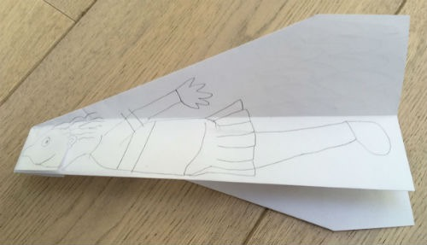
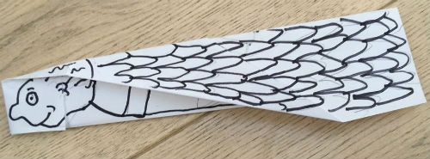
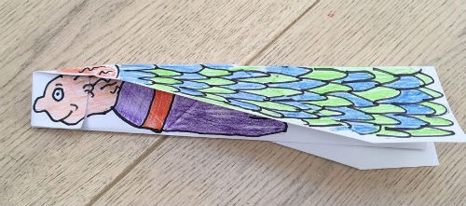
make an icarus flyer
8. Decorate with the figure of Icarus underneath, and his wings above.
© C. Andrew 2017

Slide 14
plenary
What modern inventions have τηλε, meaning ‘far away’, in their names?
What was the name of my son, and what did I tell him not to do?
© C. Andrew 2017

