Slide 1
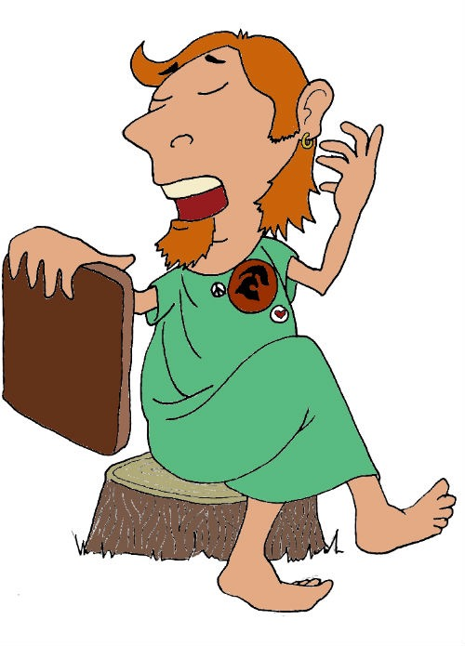
Χαιρετε!
Khairete!
Your guide for today…
Homer
Mega Greek
7: entertainment
© C. Andrew 2017

Slide 2
word roots challenge
μυθος
μελος
muthos, story
melos, song
κριτης
krites, a judge
ποιημα
μιμος
poiema, something made or written
mimos, actor
θεατρον
theatron, a place for seeing things
© C. Andrew 2017

Slide 3
ancient greek verbs
I
we
😱
ω
ομεν
o
omen
you
you/y’all
εις
ετε
eis
ete
he,she,it
ει
they
ουσι
ei
ousi
© C. Andrew 2017

Slide 4
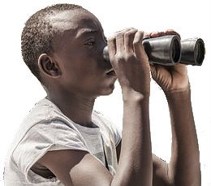
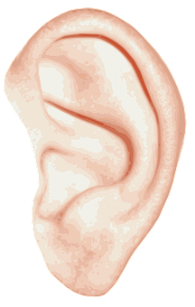
quick-fire verbs
© C. Andrew 2017
σκοπειν, skopein
φιλειν, philein
’ακουειν, akouein
σκοπουσι
’ακουομεν
φιλει
φιλεις
φιλετε
’ακουω
σκοπω
φιλουσι
’ακουετε
I
you
he,she,it
we
you/y’all
they
ω
εις
ει
ομεν
ετε
ουσι
o
eis
ei
omen
ete
ousi

Slide 5
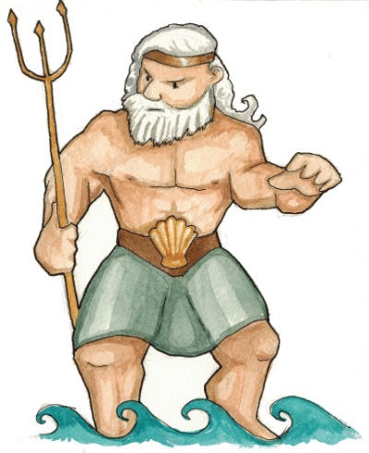
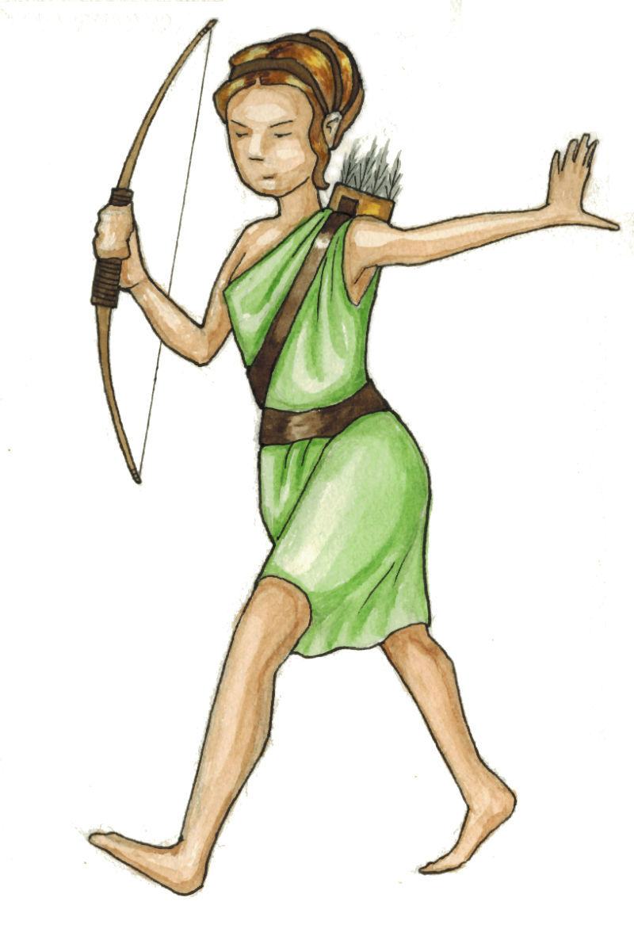
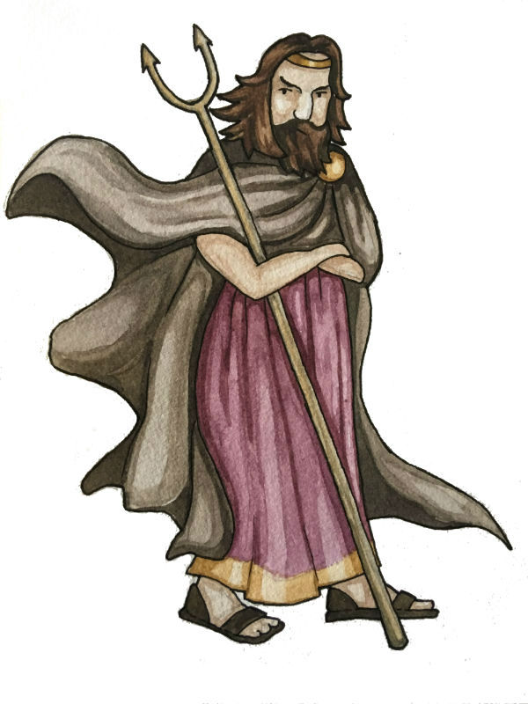
goodbye pronouns,
hello nouns
!
Ποσειδων
’ακουει
Poseidon
he/she/it
hears
’Αρτεμις
σκοπει
he/she/it
Artemis
looks at
‘Αδες
φιλει
he/she/it
Hades
loves
© C. Andrew 2017

Slide 6
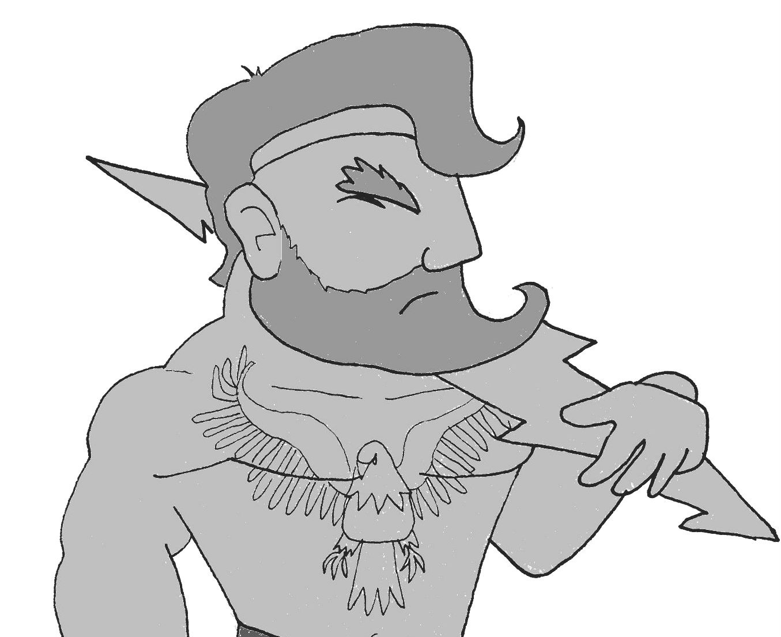
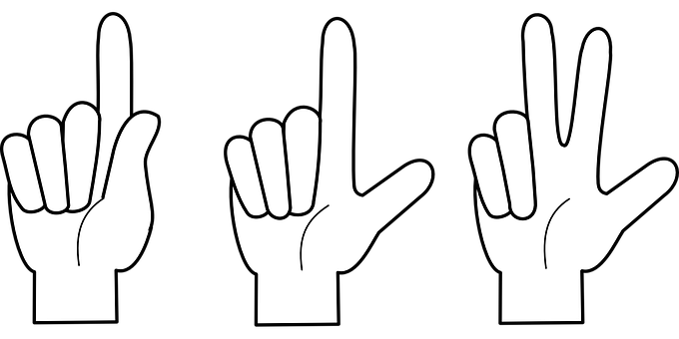
Nouns & Verbs together
What are the gods and goddesses doing? Translate the sentence and add an illustration. The first one has been done to show you how.
Ζευς ’ακουει
’Αθηνα γραφει
‘Ηρα φιλει
‘Αδες ’αριθμει
Zeus hears
Athena writes
Hera loves
Hades counts
Handy Hints!
γραφειν, graphein
σκοπειν, skopein
’αριθμειν, arithmein
Ποσειδων σκοπει
’Αρτεμις ’ακουει
‘Ερμης γραφει
φιλειν, philein
Poseidon looks
Artemis hears
Hermes writes
’ακουειν, akouein
© C. Andrew 2017

Slide 7
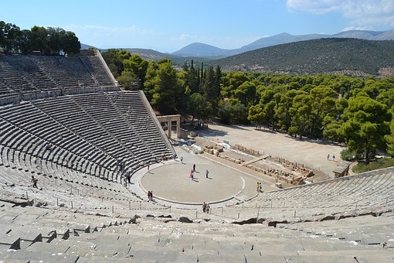
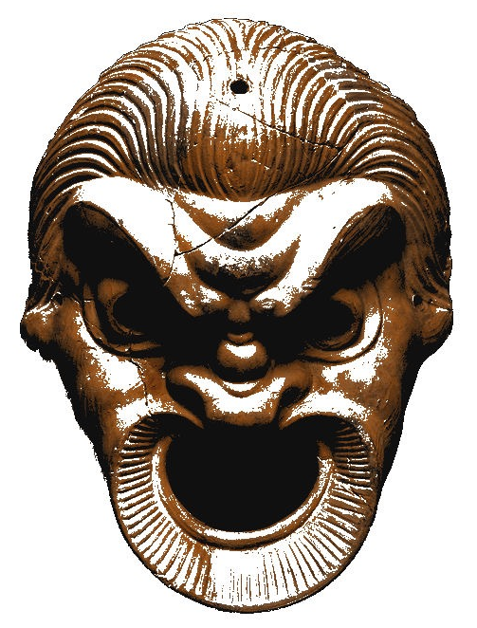
entertainment in Ancient greece
ποιητης
poet
θεατρον
theatre
ποιημα
μιμος
poem
actor
’Ιλιας
χορος
Ilias/The Iliad
chorus
’Οδυσσεια
προσωπον
Odusseia/The Odyssey
mask
© C. Andrew 2017

Slide 8
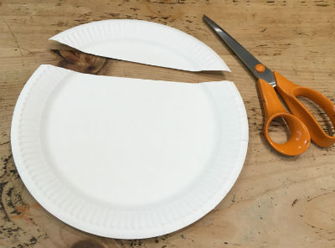
make a greek theatre mask
1. Cut the top off a paper plate.
© C. Andrew 2017

Slide 9
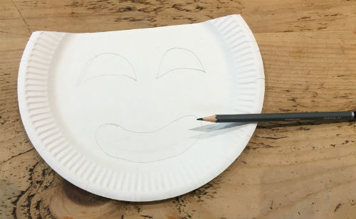
make a greek theatre mask
2. On the plate, sketch out the mask’s eyes and a mouth. You’ll need to decide between…
…a tragic character
(sad face)
…a comic character
(happy face)
© C. Andrew 2017

Slide 10
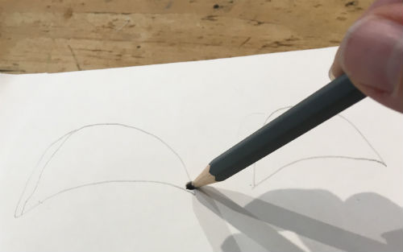
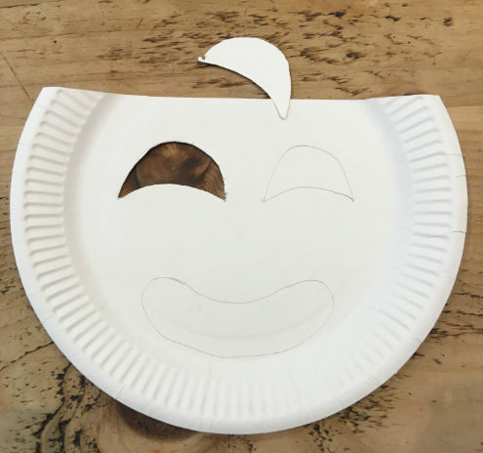
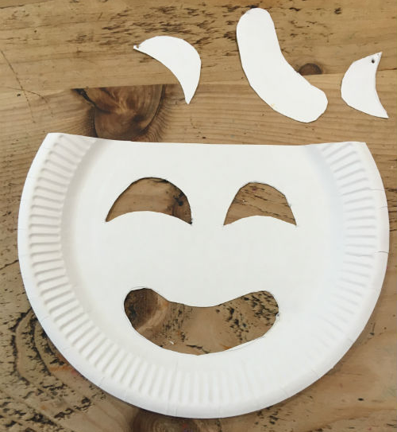
make a greek theatre mask
3. Cut out the eyes and the mouth. To start off, push a pencil (with an eraser underneath) through the paper plate, so you have a starting point for your scissors.
© C. Andrew 2017

Slide 11
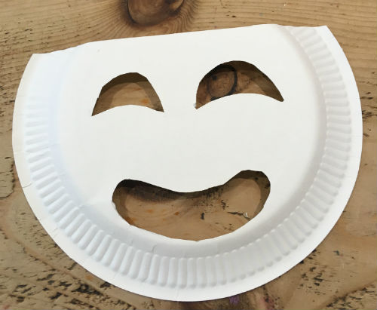
make a greek theatre mask
4. Turn the plate over, so you’re working on the bottom.
Before you start to decorate, you have to decide on your character. Male or female? Old or young? Rich or poor? Angry or afraid?
‘Worry lines’ for an old character
A flower in the hair of a girl
Eyebrows can show fear or anger
© C. Andrew 2017

Slide 12
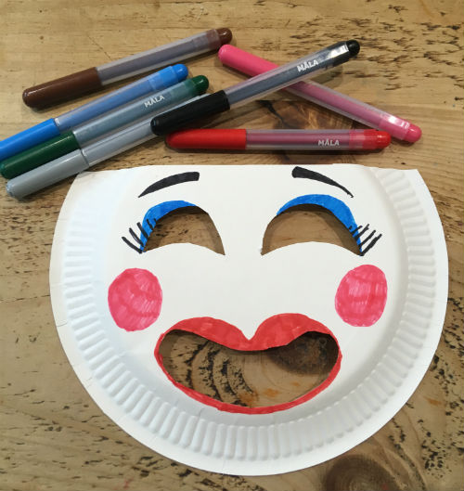
make a greek theatre mask
5. Using felt-tip pens, coloured pencils or paint, decorate your character to bring it to life.
Exaggerated eyes, cheeks and lips characterise a beautiful woman
© C. Andrew 2017

Slide 13
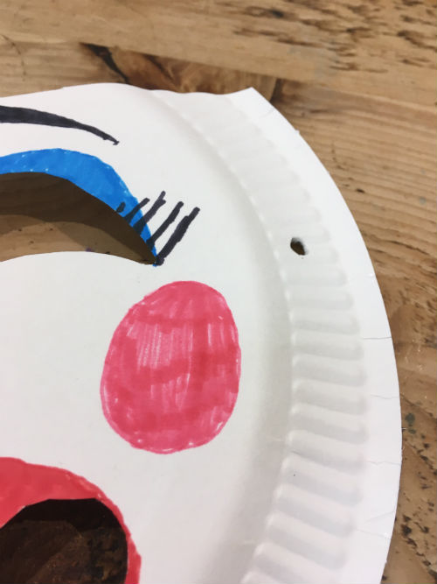
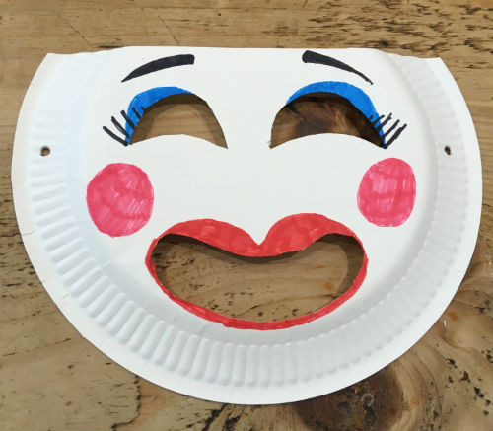
make a greek theatre mask
6. Make holes for string (to hold the mask in place) by pushing a pencil through the plate and into an eraser underneath. Do this on both sides of the mask.
© C. Andrew 2017

Slide 14
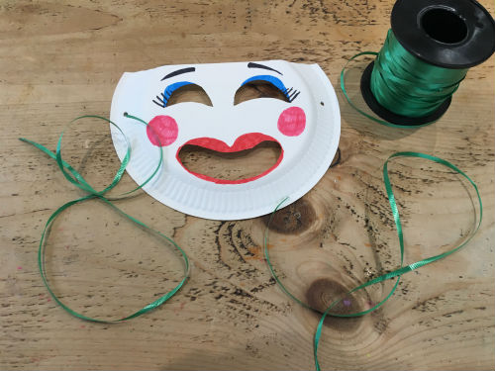
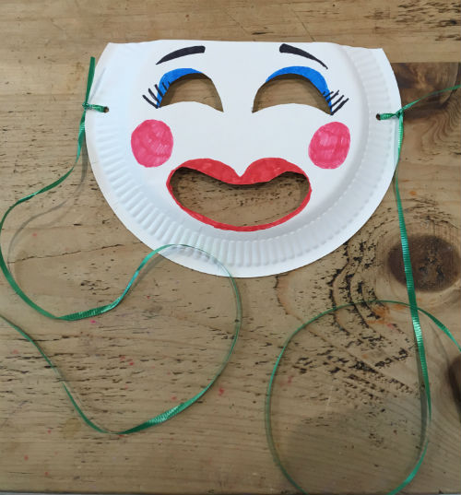
make a greek theatre mask
7. Tie a 30cm length of string, elastic or ribbon through each of the holes.
© C. Andrew 2017

Slide 15
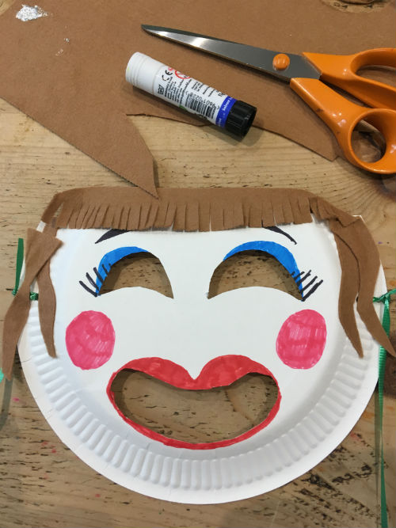
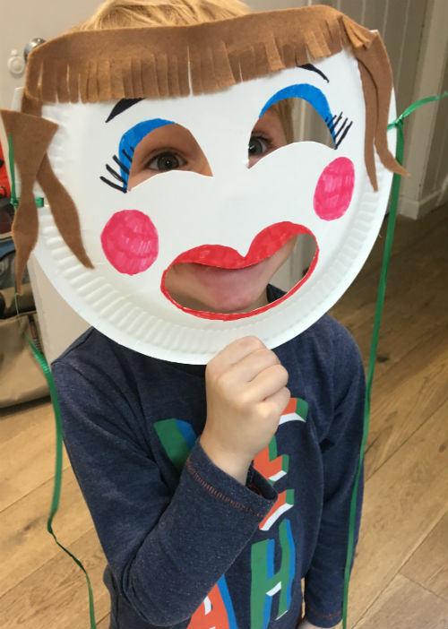
make a greek theatre mask
8. Using felt, wool, coloured paper or fabric, give your mask a hairstyle that fits its character.
Your mask is now finished and ready for you to wear!
© C. Andrew 2017

Slide 16
plenary
’ακουετε ?
What English word comes from μιμος, meaning ‘actor’?
© C. Andrew 2017

