Slide 1
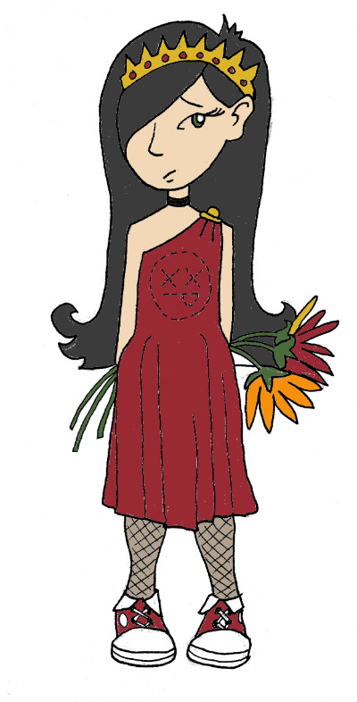
Χαιρετε!
Khairete!
Your guide for today…
Persephone
Mega Greek
6: nature
© C. Andrew 2017

Slide 2
word roots challenge
βιος
ζωον
bios, life
zoon, creature
‘υδωρ
hydor/hudor, water
‘ιπ πος
’αμφι
hippos, horse
amphi, both

Slide 3
ancient greek verbs
I
we
😱
ω
ομεν
o
omen
you
you/y’all
εις
ετε
eis
ete
he,she,it
ει
they
ουσι
ei
ousi

Slide 4
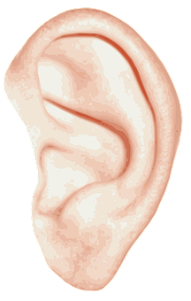
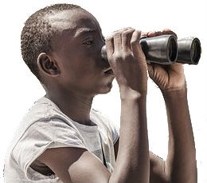
quick-fire verbs
γραφειν, graphein
’ακουειν, akouein
σκοπειν, skopein
σκοπομεν
γραφουσι
’ακουει
γραφεις
γραφετε
’ακουω
γραφω
σκοπουσι
’ακουετε
I
you
he,she,it
we
you/y’all
they
ω
εις
ει
ομεν
ετε
ουσι
o
eis
ei
omen
ete
ousi

Slide 5
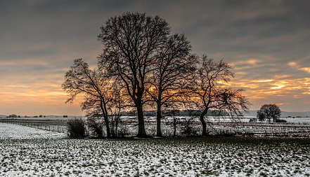
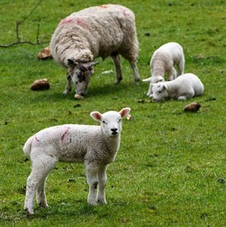
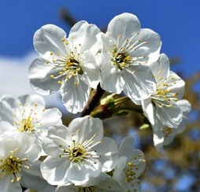
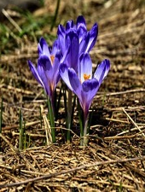
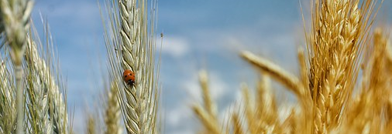
The myth of persephone
Περσεϕονη
Persephone
Δεμητερ
Demeter
‘Αδης
Hades

Slide 6
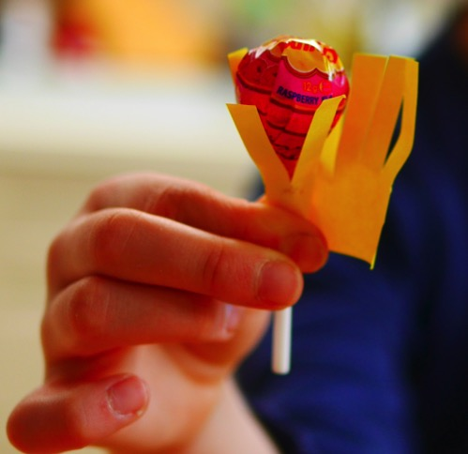
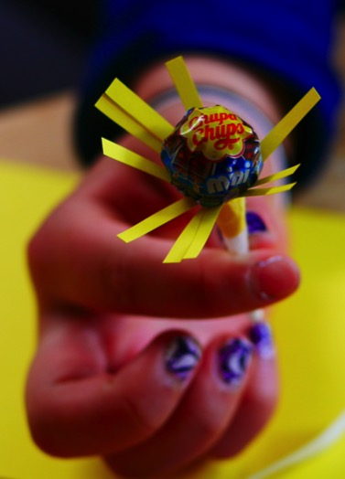
persephone’s flowers
Step 1: Cut a piece of coloured paper about 5cm x 10cm. Snip the top half at regular intervals to make a ‘fringe’ effect.
Step 2: Wrap the coloured paper, ‘fringe’-side up, around the base of a lollipop. Secure in place with sellotape.
This create the effect of stamens around the centre of your lollipop flower.

Slide 7
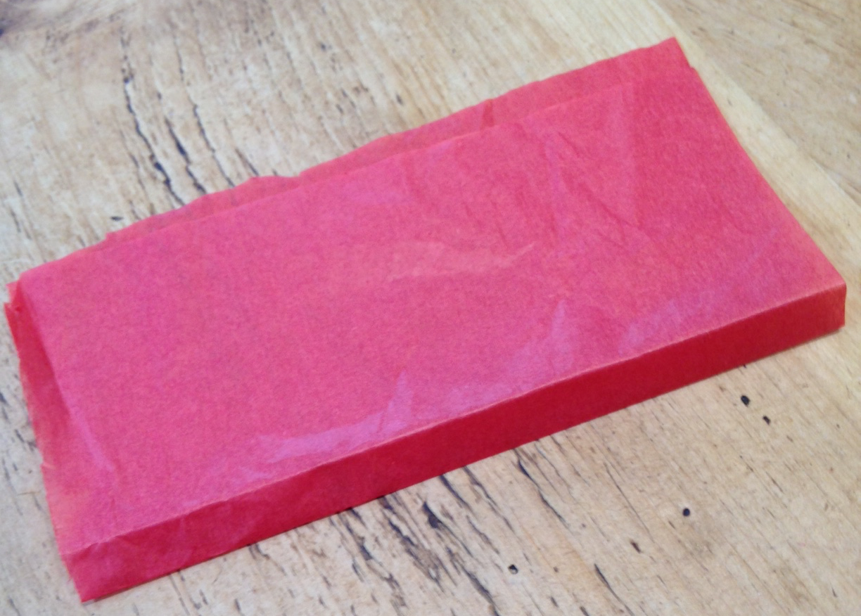
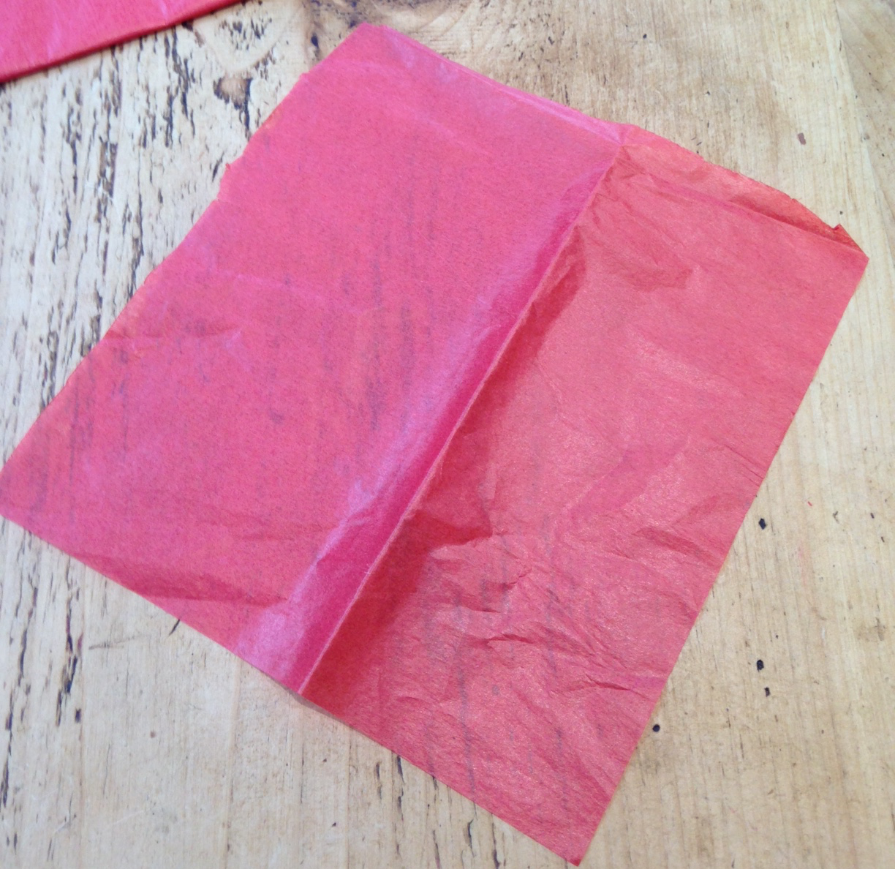
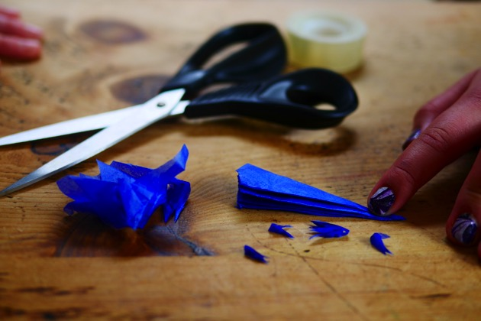
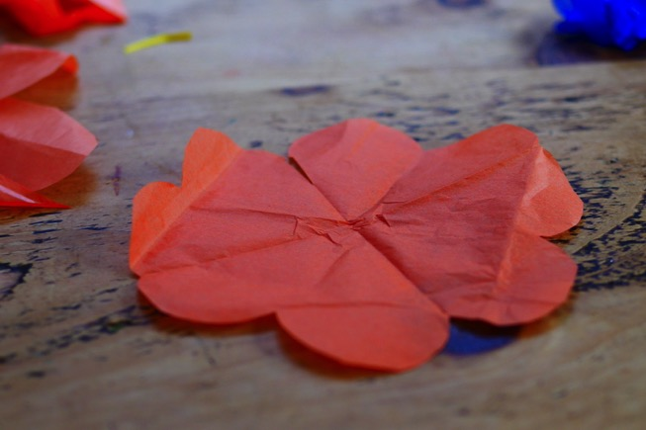
Step 3: Cut a square of tissue paper about 10cm x 10cm (you can change the size to make a bigger or smaller flower).
Step 4: Fold the square in half, then in half again. Then fold along the diagonal twice. If you’ve ever made paper snowflakes, it’s the same idea.
Step 5: Cut a rounded ‘petal’ shape on the outside edge of your folded tissue paper.
Step 6: Unfold your tissue paper. You should have a flower shape.

Slide 8
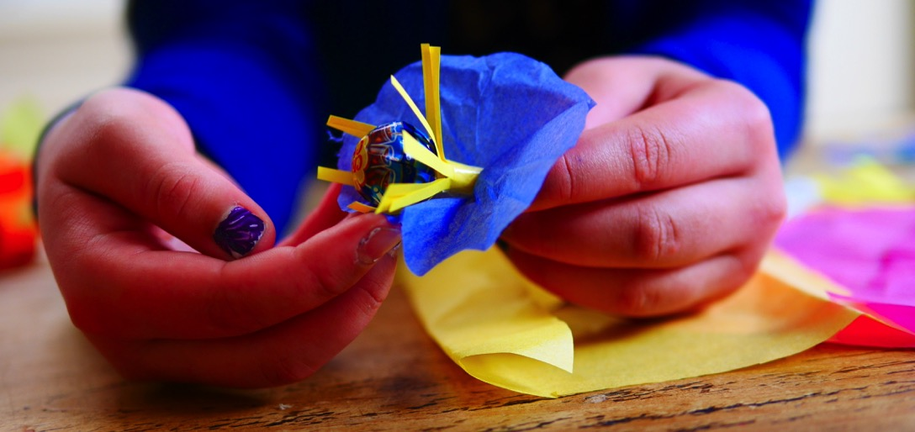
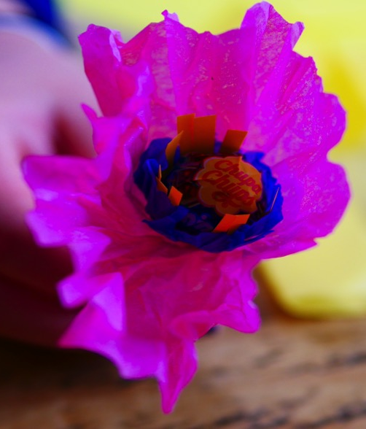
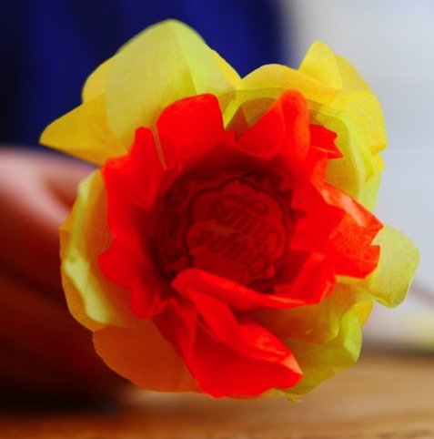
Step 7: Make a small hole in the centre of your tissue paper flower shape, and push the lollipop through it.
This makes your first set of ‘petals’.
Step 8: Repeat steps 3 to 7 with a different-coloured tissue paper so that you have two sets of contrasting petals.

Slide 9
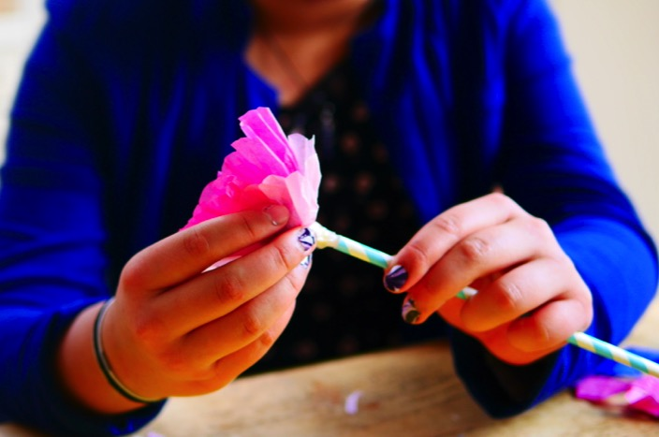
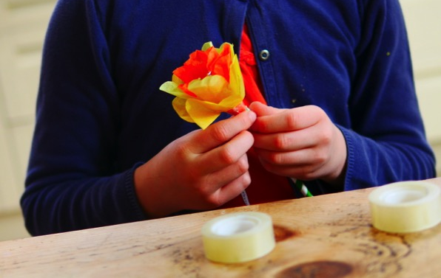
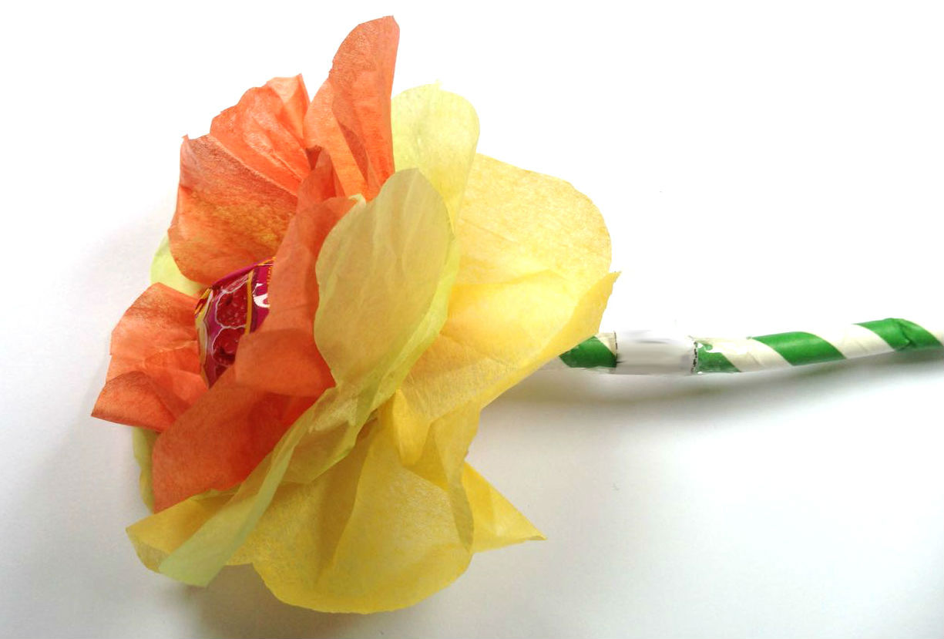
Step 9: Take the lollipop ‘flower’ and push its stick into a drinking straw.
Step 10: Secure the straw and the lollipop together with sellotape.
Done! Why not give the flower as a gift to a friend or family member?

Slide 10
plenary
If I tell you “’ακουει,” who is listening?
What does the myth of Persephone try to explain about the world?
© C. Andrew 2017

