Slide 1
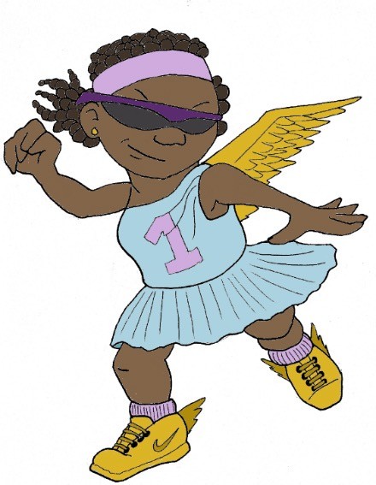
Χαιρετε!
Khairete!
Your guide for today…
Nike
Mega Greek
5: sport
© C. Andrew 2017

Slide 2
word roots challenge
τεχνη
κυκλος
techne, skill
kuklos/kyklos, circle
φυσικος
phusikos, natural
σφαιρα
’αθλητης
sphaira, ball
athletes

Slide 3
ancient greek verbs
I
we
😱
ω
ομεν
o
omen
you
you/y’all
εις
ετε
eis
ete
he,she,it
ει
they
ουσι
ei
ousi

Slide 4
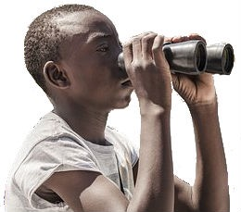
quick-fire verbs
γραφειν, graphein
σκοπειν, skopein
σκοπεις
γραφει
γραφουσι
σκοπω
σκοπετε
γραφομεν
I
you
he,she,it
we
you/y’all
they
ω
εις
ει
ομεν
ετε
ουσι
o
eis
ei
omen
ete
ousi

Slide 5
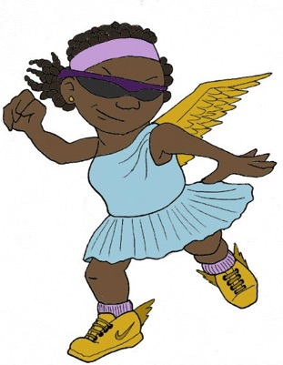
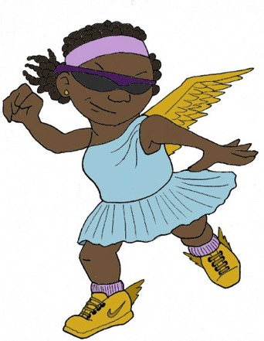
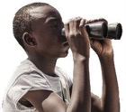
Sort & Translate
You can tell who is doing a Greek verb by looking at the endings.
Sort these verbs by their ending by writing them into the ovals below.
The first one has been done to show you how.
ω - I | ομεν - we
εις - you | ετε - you/y’all
ει - he/she/it | ουσι - they
ω - I
γραφουσι
ομεν - we
σκοπω
σκοπομεν
’αριθμω
’αριθμετε
γραφεις
γραφομεν
σκοπω
σκοπεις
εις - you
γραφει
ετε - you/y’all
γραφεις
’αριθμουσι
σκοπετε
σκοπεις
σκοπετε
’αριθμετε
’αριθμει
σκοπομεν
ει - he/she/it
γραφομεν
ουσι - they
γραφει
’αριθμω
γραφουσι
’αριθμει
’αριθμουσι
Now try to translate the verbs. Remember, the beginning of the word tells you what’s happening, and the end tells you who’s doing it. The first one has been done to show you how.
’αριθμουσι
they count
σκοπετε
y’all look at
Handy Hints!
σκοπω
I look at
γραφουσι
they write
γραφειν, graphein
γραφομεν
we write
σκοπομεν
we look at
σκοπειν, skopein
’αριθμει
he/she/it counts
’αριθμω
I count
σκοπεις
you look at
γραφεις
you write
’αριθμειν, arithmein
γραφει
he/she/it writes
’αριθμετε
y’all count

Slide 6
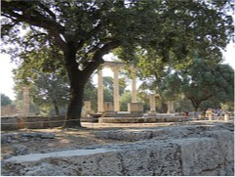
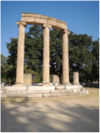
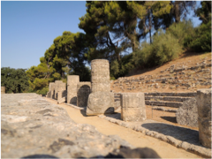
the olympics
776 B.C.E. – 393 C.E.
For how many years did the Ancient Greek Olympics run?
1169 years!

Slide 7
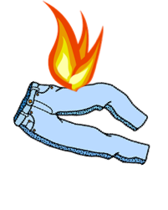
olympic lying
Get into five teams of 5-6 members. Each team will be given a paragraph to read out loud, and a record sheet.
Each team will nominate a Reader and a Record Keeper. In each paragraph, there are three things that are untrue. There are two ways to win points in this game:
1. Spot the three lies concealed in other teams’ statements - the Record Keeper writes them down on your team’s Olympic Lying sheet. Each lie correctly identified is worth one point.
5 teams = maximum of 4x3 points = 12 points
2. ’Smuggle’ your own team’s lies by the Reader reading them with such authority that everyone will believe them. You may want to choose a reader who is not prone to fits of giggles, or who has a good ‘poker face’! Each lie ‘smuggled’ is worth one point.
3 lies x 1 = 3 points
TOTAL POSSIBLE POINTS = 15 points

Slide 8
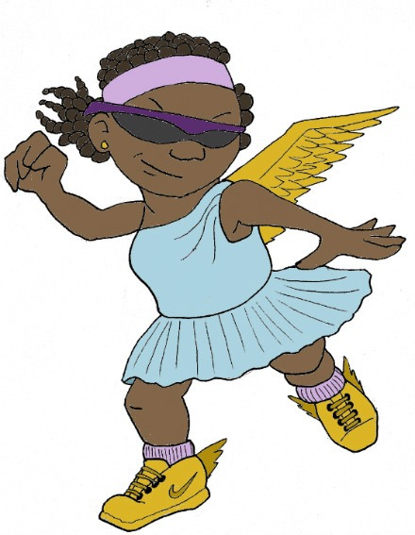
plenary
If I tell you “’αριθμουσι,” who is counting?
To which god were the Ancient Olympic Games dedicated?
© C. Andrew 2017

