Slide 1
Χαιρετε!
Khairete!
Your guide for today…
Hephaistos
Mega Greek
4: Art & Architecture
© C. Andrew 2017

Slide 2
word roots challenge
μετρειν
’αριθμειν
metrein, to measure
arithmein, to count
’ακουειν
akouein, to hear
σκοπειν
γραφειν
skopein, to look at
graphein, to write
Word class?
Verbs

Slide 3
spot the verbs
terrible
a dog
yesterday
we can see
he sings
an ice-cream van
yellow
London
I am
they don’t like it
some children
happiness
Spiderman
you have been
she counted
quickly
it is waking up

Slide 4
ancient greek verbs
graphein - to write
γραφ
ειν
he,
she,it
I
you
we
you/y’all
they
ω
εις
ει
ομεν
ετε
ουσι
o
eis
ei
omen
ete
ousi

Slide 5
ancient greek verbs
I
we
😱
ω
ομεν
o
omen
you
you/y’all
εις
ετε
eis
ete
he,she,it
ει
they
ουσι
ei
ousi

Slide 6
ancient greek verbs
’αριθμειν
arithmein - to count
’αριθμομεν
’αριθμουσι
’αριθμεις
’αριθμετε
’αριθμει
’αριθμω
I
you
he,she,it
we
you/y’all
they
ω
εις
ει
ομεν
ετε
ουσι
o
eis
ei
omen
ete
ousi

Slide 7
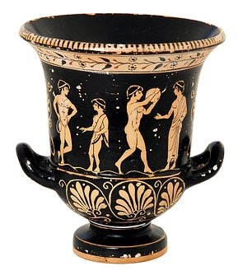
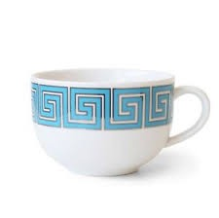
ancient greek art & architecture
krater (bowl for mixing wine)
coffee cup

Slide 8
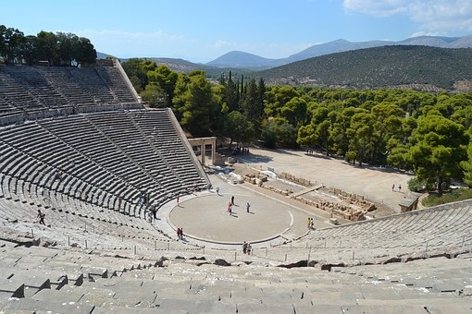
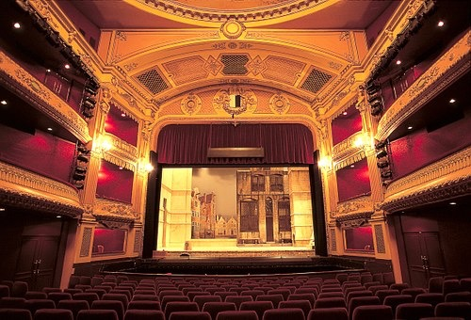
ancient greek art & architecture
Amphitheatre at Epidaurus
modern theatre

Slide 9
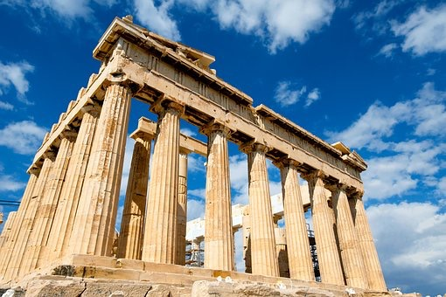
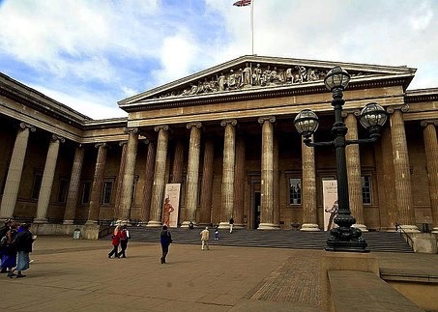
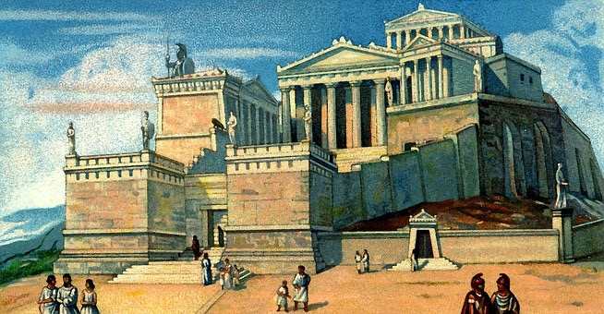
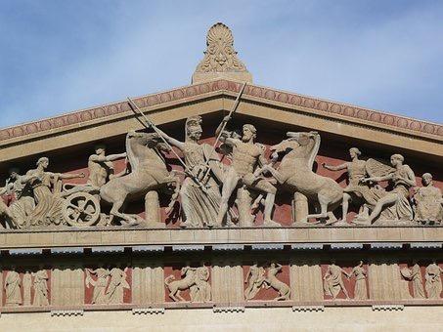
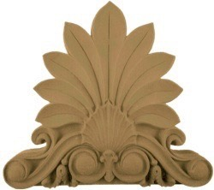
ancient greek art & architecture
Parthenon (Temple of Athena)
British Museum
acroterion

Slide 10
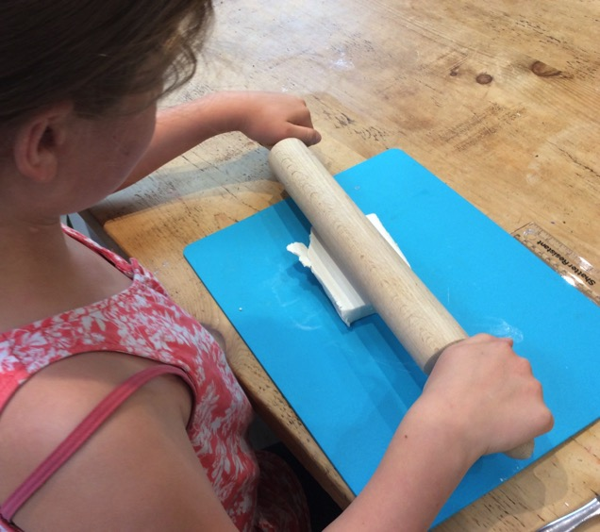
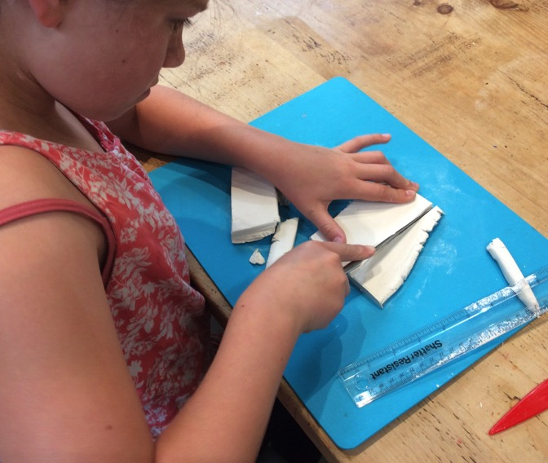
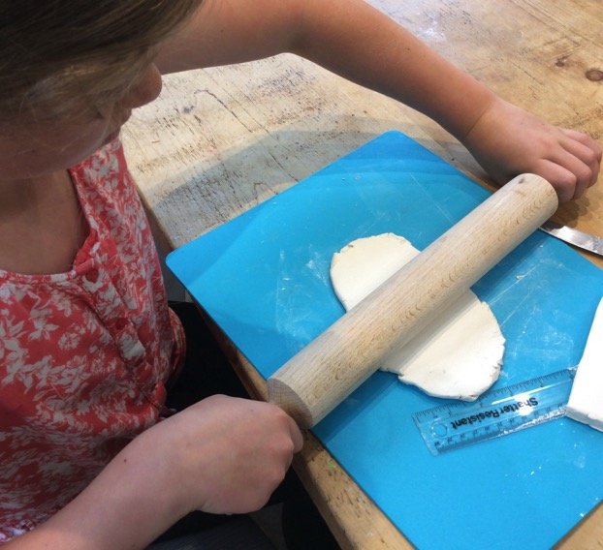
make an akroterion
Step 1
Roll your clay out to a 1cm thickness.
Step 2
Cut out a rectangle 12cm long and 6cm wide. This will be your base.
Step 3
Roll out another piece of clay to a half centimetre thickness.

Slide 11
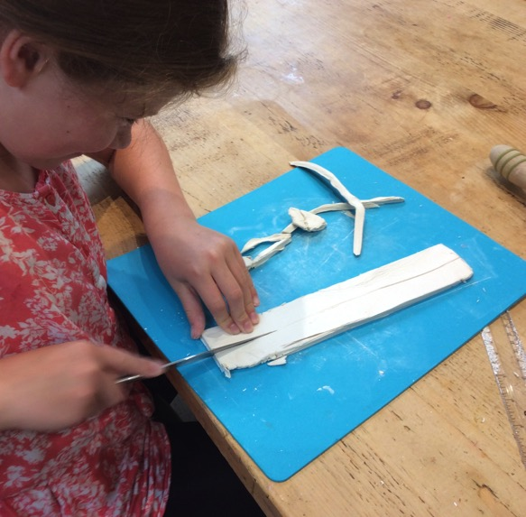
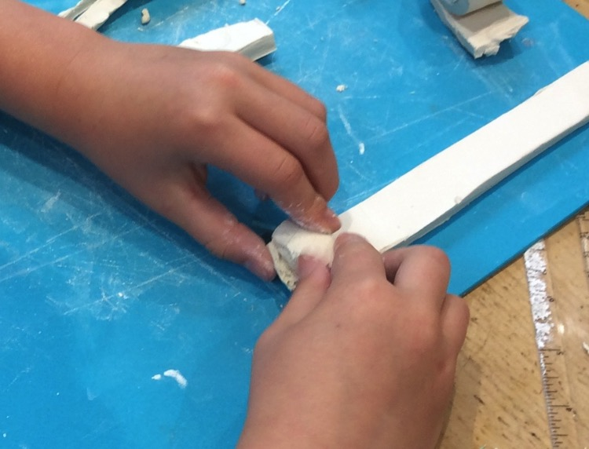
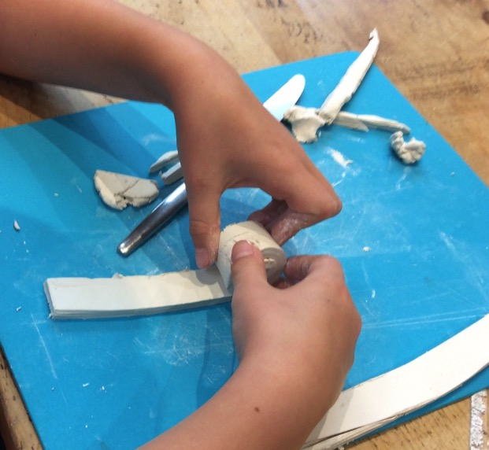
make an akroterion
Step 4
From this, cut out two 20cm by 3cm strips.
Step 5
Make a sausage and put it at the end of one of the strips.
Step 6
Curl the strip of clay around the sausage to make a scroll shape.

Slide 12
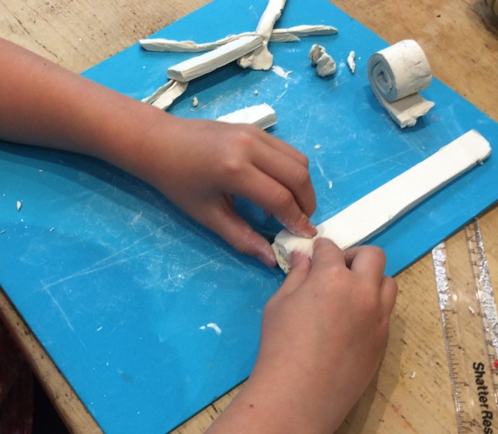
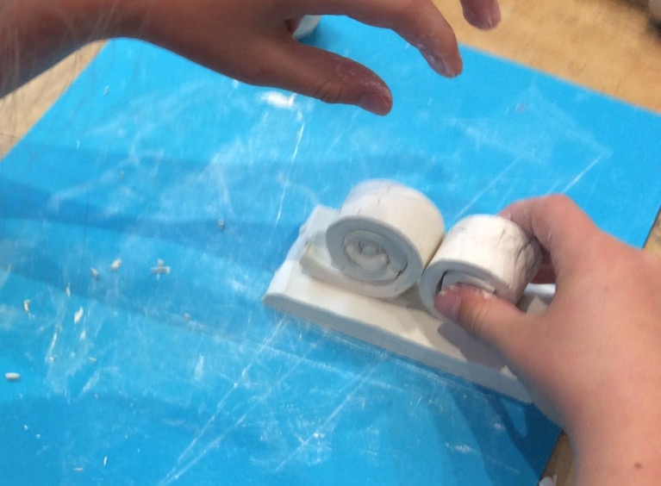
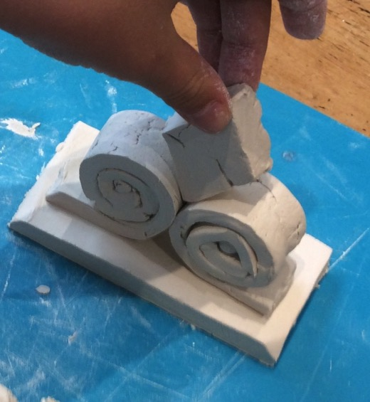
make an akroterion
Step 7
Do the same with the other strip of clay, but curling around the sausage in the opposite direction.
Step 8
Press both scrolls onto the base, touching each other and with ends facing away.
Step 9
Make a diamond shape from clay, roughly the height of the scrolls and 2cm thick. Press it down firmly between the scrolls.

Slide 13
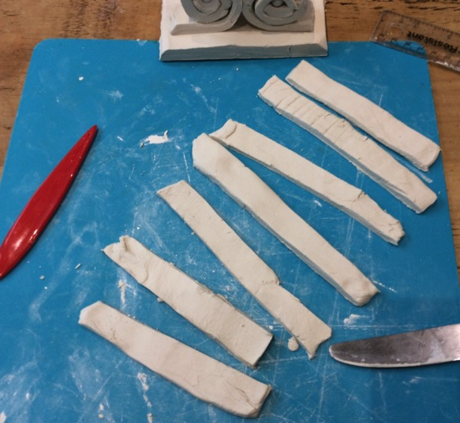
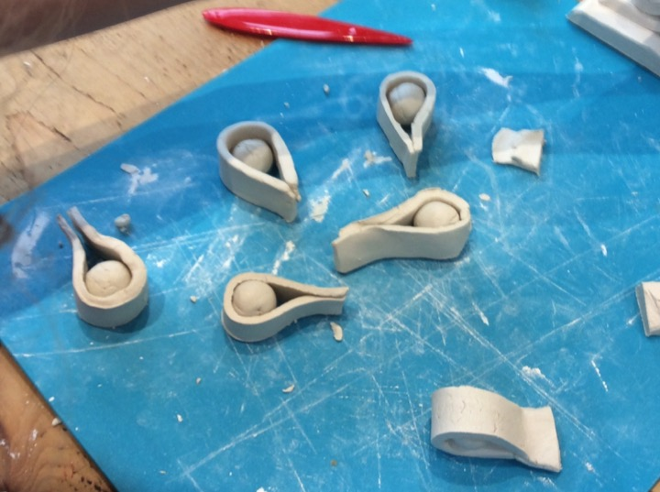
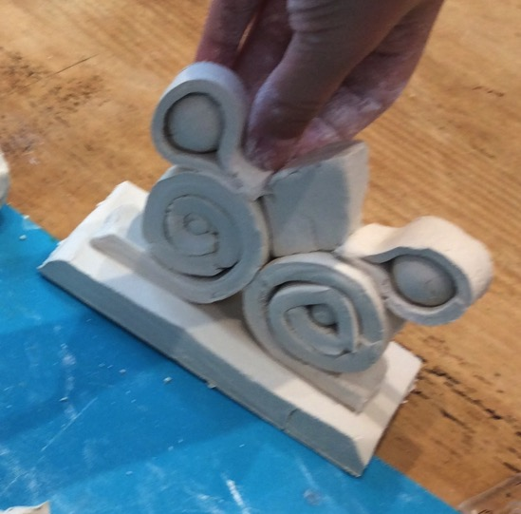
make an akroterion
Step 10
Roll out some more clay to half a centimeter thickness. From this, cut out seven strips 10cm long and 3cm wide.
Step 11
Make seven balls of clay and place one ball in the middle of each strip. Fold the ends of the strip to meet each other and press together.
Step 12
Press two of these shapes onto the scrolls, one on the left and one on the right.

Slide 14
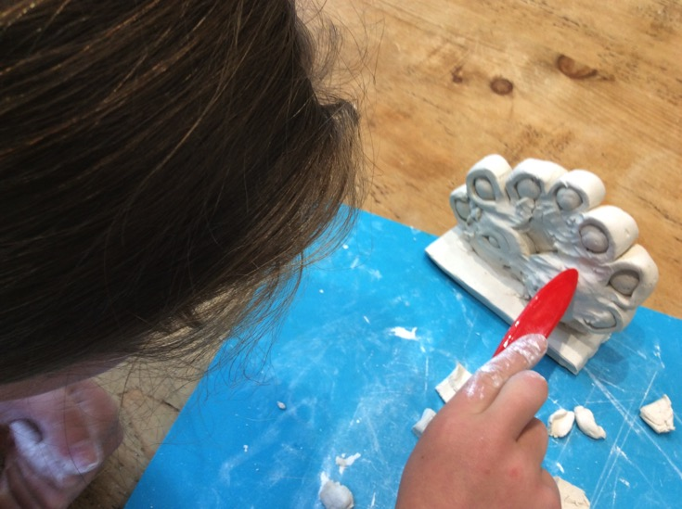
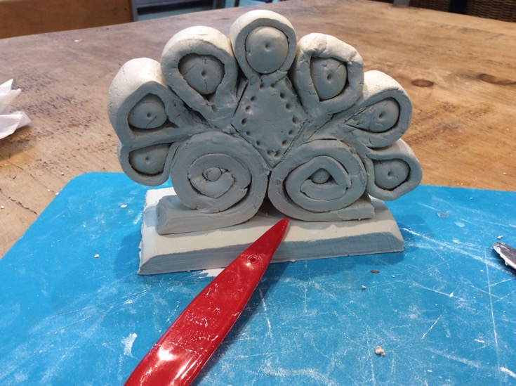
make an akroterion
Step 13
Continue putting the shapes around the diamond.
Step 14
Smooth the joins to make sure everything holds together!
Step 15 (optional)
Scratch or push decorative designs into the clay.

Slide 15
plenary
If I tell you “γραφω,” who is writing?
What is the name of the temple on the Acropolis in Athens that inspired the architecture of the British Museum in London?
© C. Andrew 2017

