Slide 1
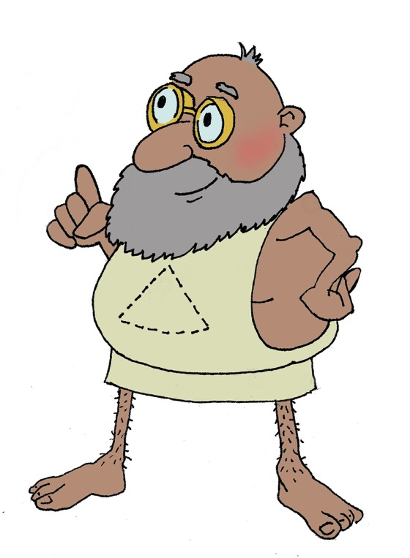
Χαιρετε!
Khairete!
Your guide for today…
Pythagoras
Mega Greek
3: Maths
© C. Andrew 2017

Slide 2
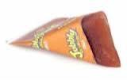
Greek numbers quiz
Ancient Greek number words are very good at sneaking into modern English. See if you can use all the clues to work them out!
‘εξ
hex
=
6
πεντε
pente
=
5
τρεις
treis
=
3
‘εισ
heis
=
1
These guys are having a duel
How many years in a decade?
δυο
duo
=
2
‘επτα
hepta
=
7
Octopuses are named for the number of legs they have
δεκα
deka
=
10
’εννεα
ennea
=
9
Honeycomb is made up of hexagonal cells
’οκτω
okto
=
8
τεσσαρες
tessares
(or tettares)
=
4
This lolly is in the shape of a tetrahedron
This weird shape is called an enneagram
This star is called a pentagram, and this building is called the Pentagon
In the heptathlon, women athletes have to compete in how many events?
Children learn to ride on tricycles
© C. Andrew 2017

Slide 3
transliterate into Greek
Greek word | Write in Greek characters | Related English words | Greek word | Write in Greek characters | Related English words
sphaira |  |  | mathema things learned
polus many |  |  | dia through
arithmein to count |  |  | treis three
skopein to look at |  |  | metrein to measure
trapeza table |  |  | kulindros a roller
σφαιρα
sphere
spherical
μαθημα
maths
mathematical
πολυς
δια
diagonal
diameter
polygon
’αριθμειν
τρεις
triangle
trio
arithmetic
σκοπειν
scope
telescope
μετρειν
metre
centimetre
τραπεζα
trapezium
trapezoid
κυλινδρος
cylinder
cylindrical
© C. Andrew 2017

Slide 4
pythagoras
lived about 570 - 495 BCE
philosophy
science
maths

Slide 5
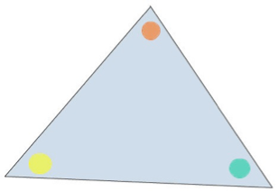
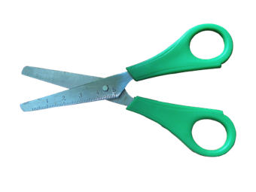
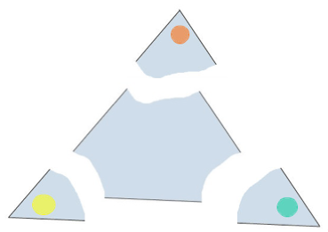
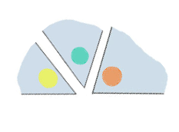
pythagoras & geometry
γη
ge, land
μετρειν
metrein,
to measure
Triangles are AMAZING! Let’s do an experiment to see what I discovered…
Step 1: From the sheet in front of you containing six different triangles, cut out one of the triangles. Mark each angle with a different-coloured dot, like this.
Step 2: Snip the three angles off each of on of your triangles, like this.
Step 3: Draw a straight line (also known as an angle of 180 degrees) with a ruler and put all of the points together, so they sit on it, like this.
Have you noticed the same thing I did? I worked out that whatever shape triangle you use, if you put the angles together, they’ll always sit on a straight line and add up to 180 degrees!

Slide 6
plenary
What modern English words come from the Ancient Greek word τρεις?
All angles in a triangle always add up to how many degrees?
© C. Andrew 2017

