Slide 1
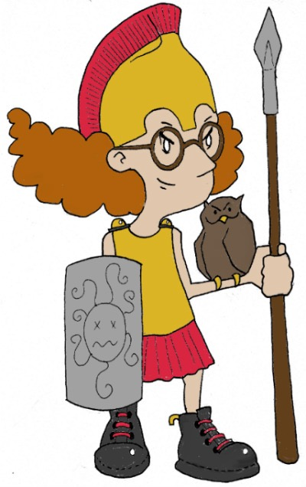
Χαιρετε!
Khairete!
Your guide for today…
Athena
Mega Greek
2: science
© C. Andrew 2017

Slide 2
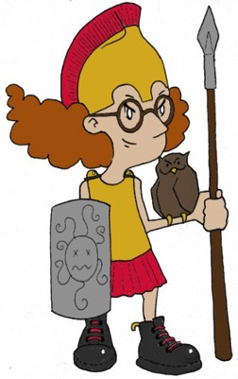
Greek Alphabet
© C. Andrew 2017
Watch out for…
capital and lower case
Α α | alpha | a |  | Ν ν | nu | n
Β β | beta | b |  | Ξ ξ | xi | x
Γ γ | gamma | g |  | Ο ο | omicron | short o
Δ δ | delta | d |  | Π π | pi | p
Ε ε | epsilon | short e |  | Ρ ρ | rho | r
Ζ ζ | zeta | z |  | Σ σ ς (at end of word) | sigma | s
Η η | eta | long e |  | Τ τ | tau | t
Θ θ | theta | th |  | Υ υ | upsilon | u
Ι ι | iota | i |  | Φ φ | phi | ph
Κ κ | kappa | k |  | Χ χ | chi | ch
Λ λ | lambda | l |  | Ψ ψ | psi | ps
Μ μ | mu | m |  | Ω ω | omega | long o
H
‘= h (before vowel at start of word)
!
no soft c, use sigma
no v or f, use phi
no w, use two upsilons
’ = no h (before vowel at start of word)
no sh, use chi
no y, use upsilon
no j, use iota
no qu, use kappa

Slide 3
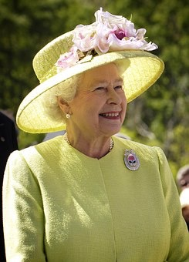
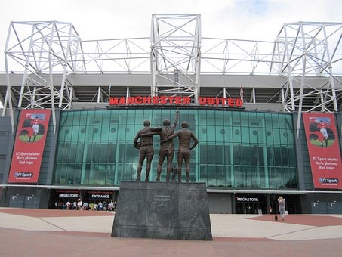
Guess who?
’Ελιζαβεθ
‘Αρρυ Ποττερ
Μανχεστερ ’Υνιτεδ
© C. Andrew 2017

Slide 4
Write your name
Ch a r l ie
Χαρλιε
Χαρλιε
© C. Andrew 2017

Slide 5
transliterate into Greek
Greek word | Write in Greek characters | Related English words | Greek word | Write in Greek characters | Related English words
energeia action |  |  | akouein to hear
bios life |  |  | phusikos natural
metrein to measure |  |  | kinema movement
skopein to look at |  |  | chaos the early universe
micros small |  |  | analusis release
’ενεργεια
energy
energetic
’ακουειν
acoustic
βιος
biology
bionic
φυσικος
physical
physics
μετρειν
metre
metric
κινημα
cinema
kinetic
σκοπειν
scope
telescope
χαος
chaos
chaotic
μικρος
microscope
microbe
’αναλυσις
analyse
analysis
© C. Andrew 2017

Slide 6
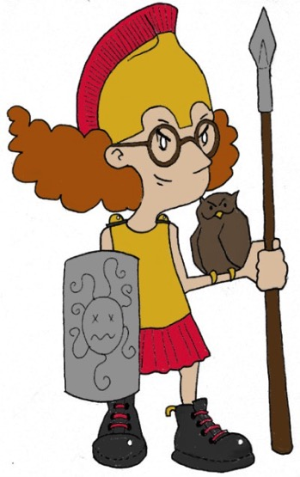
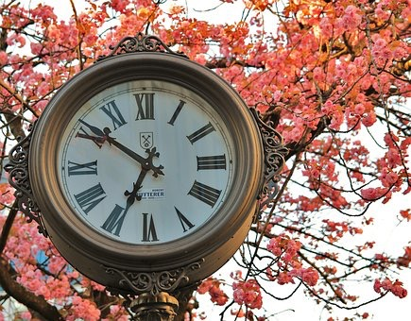
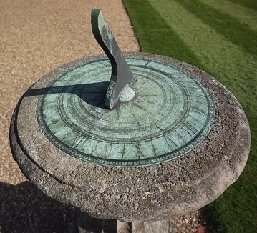
Ancient Greek Science Challenge
The Ancient Greeks made many important scientific discoveries that we still use today. But which ones?
γνωμων
gnomon
κλεψυδρα
klepsydra
water clock
✔️
sundial
Clocks & timekeeping
© C. Andrew 2017

Slide 7
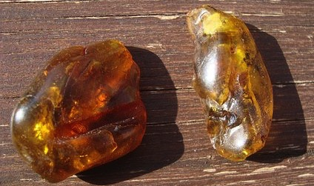
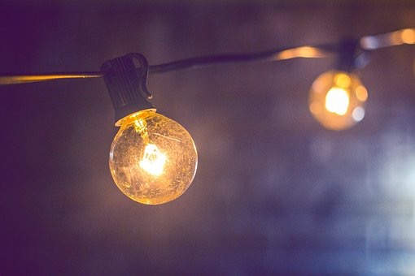
Ancient Greek Science Challenge
’ηλεκτρον
electron
amber
✘
Electricity
© C. Andrew 2017

Slide 8
Ancient Greek Science Challenge
✔️
The importance of healthy eating for a healthy body
‘Ιπποκρατης
Hippokrates
© C. Andrew 2017

Slide 9
Ancient Greek Science Challenge
Earth and other planets revolve around the sun
(heliocentric theory)
‘ηλιος helios (sun)
κεντρον kentron (point, centre)
✔️
© C. Andrew 2017

Slide 10
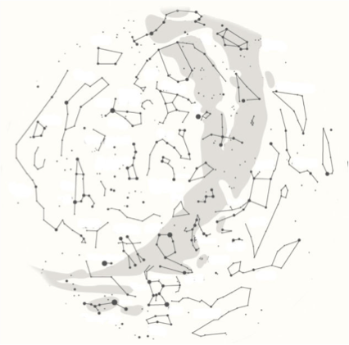
ancient greek astronomy
’αστηρ
aster, star
νομος
nomos, law
‘Ηρακλης
Herakles
Herakles (or Hercules for the Romans) had to carry out twelve impossibly difficult tasks for the King of Mycenae. Using a combination of strength and cunning, he completed all twelve labours (and more besides!), and was commemorated for his heroic life by becoming a constellation.
© C. Andrew 2017

Slide 11
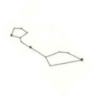
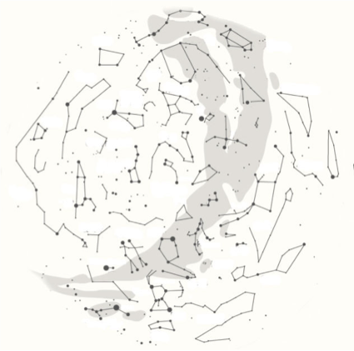
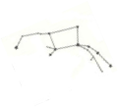
FInd the constellation
Κητος
Ketos - The Whale
A sea monster sent as punishment to Ethiopia. Killed by the hero Perseus, but turned by the gods into a constellation.
Λαιλαψ
Lailaps (Canis Major – The Big Dog)
Lailaps was a magical dog that never failed to catch its prey until it met the Teumessian Fox. Their never-ending chase was commemorated by the gods in the stars.
Δρακων
Dracon – The Dragon
A hundred-headed serpent who guarded the golden apples of the Hesperides. Killed by Hercules, then placed into the night sky by the gods.
Πηγασος
Pegasus
The immortal winged horse who was born from the severed neck of Medusa.
Κυκνος
Kyknos (Cygnus) – The Swan
The form taken by the god Zeus in one of his many visits to mortal Earth.
Διοσκουροι
Dioskouroi – The Sons of Zeus
Castor and Pollux, the twin sons of the god Zeus who rescued sailors in distress. They were commemorated for their bravery by being made into a constellation when they died. Now known as Gemini, the Latin for ‘twins’.
’Ωριων
Orion – The Hunter
Orion was the son of the god Poseidon and the hunting companion of the goddess Artemis. This is why his constellation looks like someone firing an arrow.
Καλλιςτω
Kallisto (Ursa Major - The Big Bear)
Another hunting companion of Artemis, Kallisto was turned into a bear and killed.
© C. Andrew 2017

Slide 12
plenary
Do you enjoy stories about ‘Αρρυ Ποττερ ?
Can you remember one constellation in the night sky named after a character from Greek mythology?
© C. Andrew 2017

