Slide 1
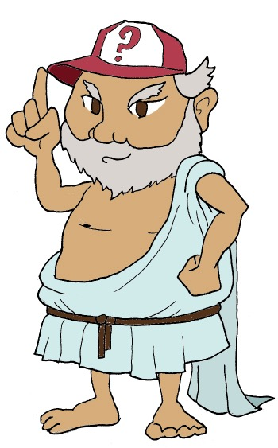
Χαιρετε!
Khairete!
Your guide for today…
Plato
Mega Greek
10: philosophy
© C. Andrew 2017

Slide 2
word roots challenge
σοφος
φιλειν
sophos, wise
philein, to love
λογος
logos, word
’ηθικος
δημος
ethikos, moral
demos, people
© C. Andrew 2017

Slide 3
ancient greek verbs
I
we
😱
ω
ομεν
o
omen
you
you/y’all
εις
ετε
eis
ete
he,she,it
ει
they
ουσι
ei
ousi
© C. Andrew 2017

Slide 4
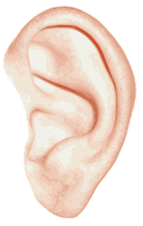
quick-fire Verbs
γραφειν, graphein
φιλειν, philein
’ακουειν, akouein
γραφεις
φιλομεν
φιλει
γραφετε
’ακουω
’ακουουσι
© C. Andrew 2017

Slide 5
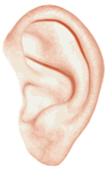
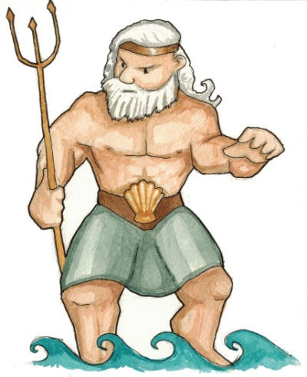
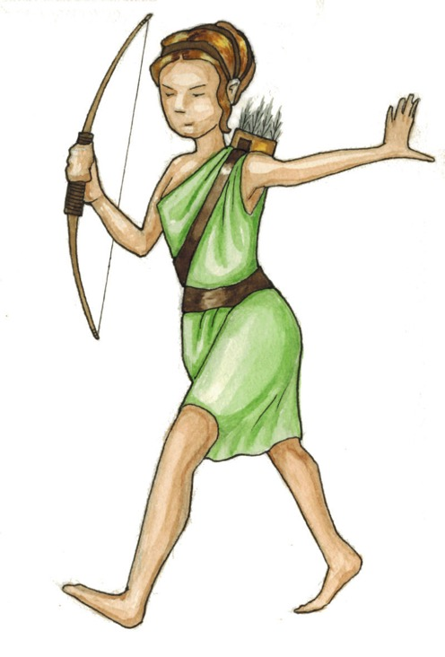
quick-fire SENTENCES
🚫
γραφειν
graphein
’ακουειν,
akouein
φιλειν
philein
’ου, ’ουκ
ou, ouk
Ποσειδων ’ακουει
’Αρτεμις ’ουκ ’ακουει
© C. Andrew 2017

Slide 6
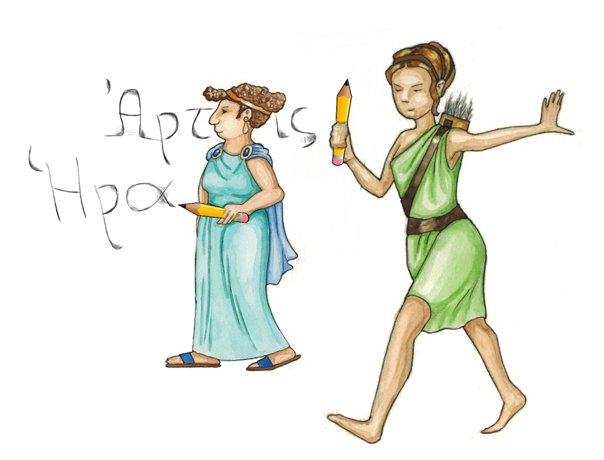
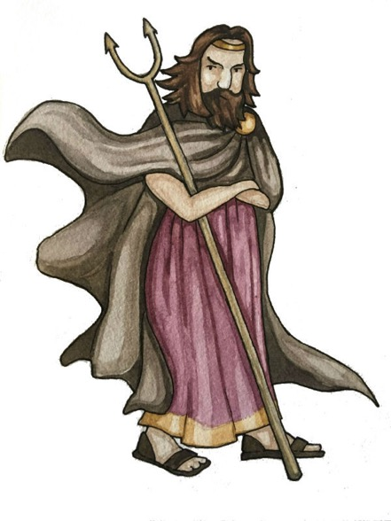
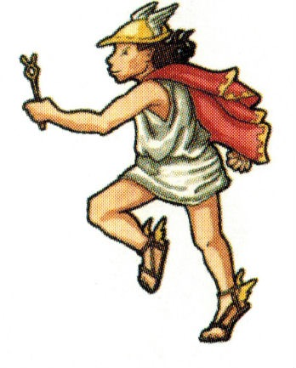
quick-fire SENTENCES
🚫
γραφειν
graphein
’ακουειν,
akouein
φιλειν
philein
’ου, ’ουκ
ou, ouk
‘αι θηαι γραφουσι
‘οι θηοι ’ου γραφουσι
© C. Andrew 2017

Slide 7
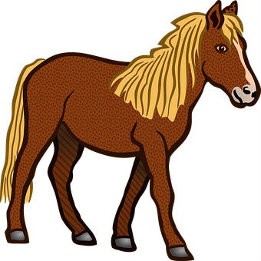
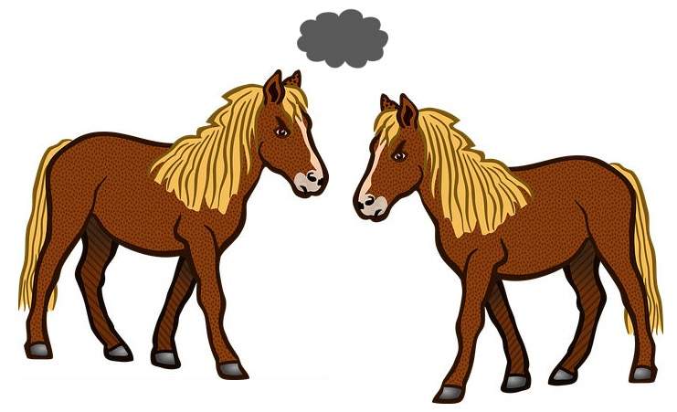
quick-fire SENTENCES
🚫
γραφειν
graphein
’ακουειν,
akouein
φιλειν
philein
’ου, ’ουκ
ou, ouk
‘ο ‘ιππος φιλει
‘οι ‘ιπποι ’ου φιλουσι
© C. Andrew 2017

Slide 8
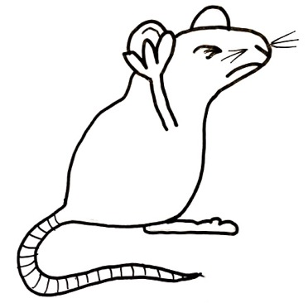
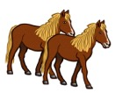
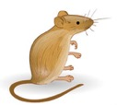
sentences with ‘not’
Handy Hints!
γραφειν
What is not happening? Translate the sentence and add an illustration. The first one has been done to show you how.
σκοπειν
’αριθμειν
’ακουειν
μετρειν
φιλειν
‘ο θεοσ
‘οι θεοι
‘η θεα
‘αι θεαι
‘ο ‘ιππος
‘οι ‘ιπποι
‘ο μυς ’ουκ ’ακουει
‘οι θεοι ’ου μετρει
‘αι θεαι ’ουκ ’αριθμουσι
The mouse is not listening.
The gods are not measuring.
The goddesses are not counting.
‘ο μυς
‘ο ‘ιππος ’ου σκοπει
’Αθηνα ’ου φιλει
Ζευς ’ου γραφει
‘οι ‘ιπποι ’ου σκοπουσι
The horse is not watching.
Athena does not love.
Zeus does not write.
The horses are not watching.

Slide 9
philosophy
φιλειν
σοφος
phil
philein, to love
sophos, wise
soph
o y
love of wisdom
© C. Andrew 2017

Slide 10
plato
427- 347 BCE (roughly!)
Athens
What’s the best way to rule? A king? Let the people decide?
How do we know what’s real?
© C. Andrew 2017

Slide 11
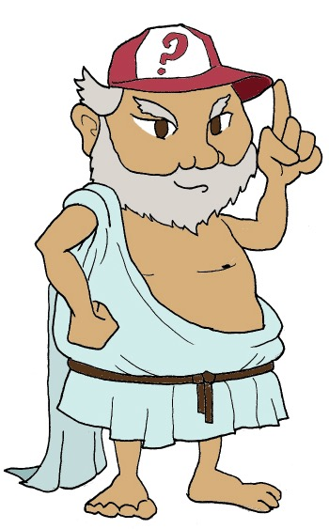
🐏 ⛈💥🕳
What makes people behave how they do?
There was a shepherd called Gyges who worked for the king of Lydia; there was a great storm, and an earthquake made an opening in the earth at the place where he was feeding his flock.
⬇️🕳😮💰💀💍💰🔝
Amazed at the sight, he descended into the opening. Inside, amongst piles of treasure, he saw a dead body wearing a gold ring; this he took and went back above ground to his flock.
🐏💍❗️ 💬 ❗️💍😮
Later, at a meeting of the shepherds, Gyges was fiddling with the ring on his finger. As he turned it, instantly he became invisible to everyone, and they all began to speak of him as if he were no longer there. He was astonished at this, tried turning the ring again, and reappeared.
💍 💰💰🔑🗡💀🗡👑
Over time, Gyges used his power of invisibility to act secretly to make his life better, stealing and breaking into people’s houses. He eventually killed the king and took over the kingdom.
© C. Andrew 2017

Slide 12
💍plato: the tale of gyges 💀
This story tells us that a person is good, not because they want to or because they think that being good is any use to them personally. They are good because they have to be - other people are watching! If anyone thinks they’ll be able to get away with something, they’ll do it.
Do you agree?
© C. Andrew 2017

Slide 13
plenary
If you see ’ου or ’ουκ in a sentence, what does it tell you?
What did Gyges find that turned him invisible?
© C. Andrew 2017
© C. Andrew 2017

