Slide 1
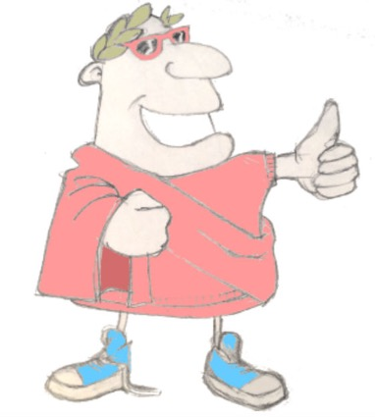
Maximum Classics
salvete!
salve!
salve!
salve!
Unit 2, Session 2
Verb codes
LO: To see how Latin shows who is doing the verb by using codes

Slide 2
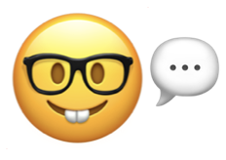
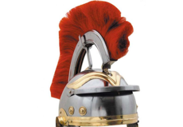
Ecce Centurio!
laborare
to work
videre
to see
Word class?
Verbs
(doing or being)
ridere
to laugh
amare
to love
habitare
to live
2.02 Verb codes

Slide 3
Spot the verbs in English
terrible
he works
some pupils
a dog
the policeman
quickly
we can see
I am
you are going
yellow
London
it won’t work
they don’t like it
you are walking
happiness
she went away
Spiderman
2.02 Verb codes

Slide 4
Latin Golden Rule
word
order
word endings
2.02 Verb codes

Slide 5
Latin verb ending codes
o
s
t
mus
tis
nt
I
you
he she it
we
y’all
they
2.02 Verb codes

Slide 6
Latin verb codes
o
s
t
mus
tis
nt
I
you
we
y’all
they
he she it
amo
I love
amas
you love
amat
he, she, it loves
amare, to love
amamus
we love
amatis
y’all love
amant
they love
2.02 Verb codes

Slide 7
Latin verb codes
o
s
t
mus
tis
nt
I
you
we
y’all
they
he she it
video
I see
vides
you see
videt
he, she, it sees
videre, to see
videmus
we see
videtis
y’all see
vident
they see
2.02 Verb codes

Slide 8
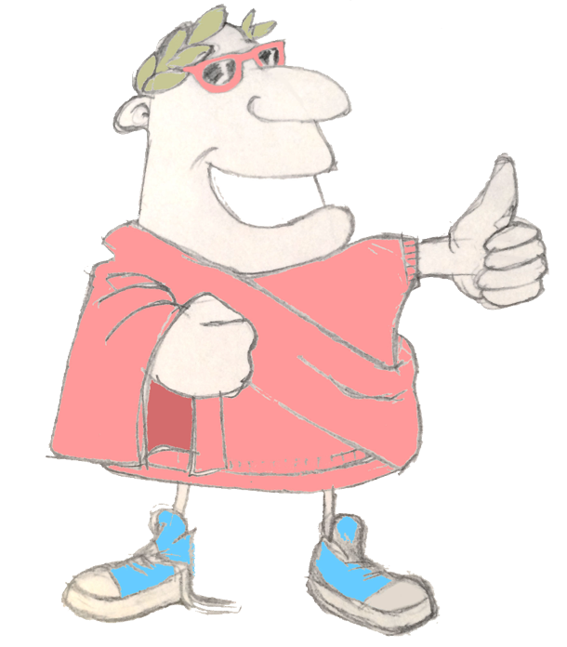
Plenary quiz
valete!
Question 1 How do you say ‘hello’ in Latin?
Question 2 How does Latin show who is doing a verb?
vale!
vale!
Question 3 What does ‘video’ mean in Latin? Can you make a connection with what ‘video’ means in English?
vale!
2.02 Verb codes

