Slide 1
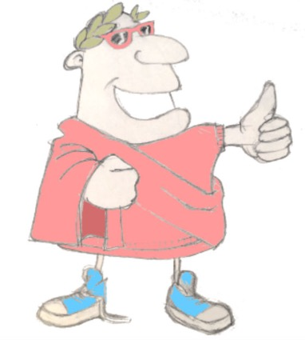
quid tibi maxime placet…
salvete!
salve!
aestas…
aestas!
…aut
hiems?
hiems!
Unit 11, Session 6
Unit quiz
LO: To recap and demonstrate what we’ve learned in Unit 11

Slide 2
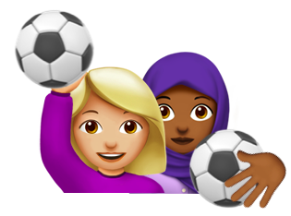
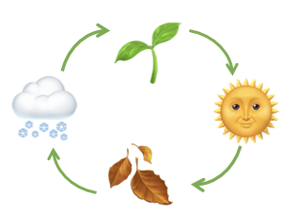
What we’ve learned in Unit 11
English shows possession by using the word ‘of’ or by using ’s or s’
Latin changes the endings of nouns to show possession
The myth of Proserpina (Persephone) explains the changing of the seasons
16 new Latin words
ascendere
quaerere
lacrimare
tacere
nox
visitare
sol
descendere
sentire
surgere
solus/sola
validus/valida
silva
locus
mons
flos
11.06 Unit 11 assessment

Slide 3
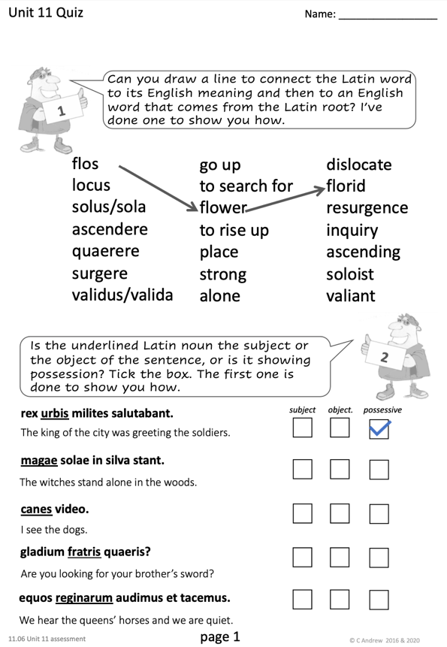
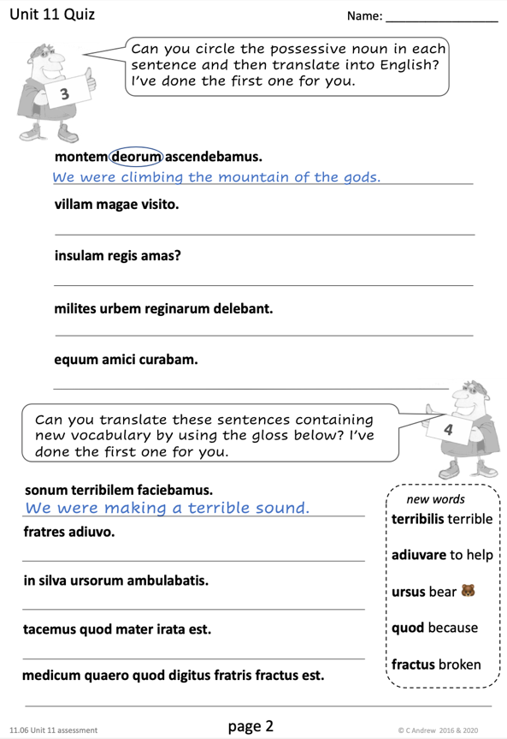
Unit Quiz
📝
11.06 Unit 11 assessment

Slide 4
Unit Quiz – question 1
Can you draw a line to connect the Latin word to its English meaning and then to an English word that comes from the Latin root? I’ve done one to show you how.
flos
locus
solus/sola
ascendere
quaerere
surgere
validus/valida
to go up
to search for
flower
to rise up
place
strong
alone
dislocate
florid
resurgence
inquiry
ascending
soloist
valiant
11.06 Unit 11 assessment

Slide 5
Unit Quiz – question 2
Is the underlined Latin noun the subject or the object of the sentence, or is it showing possession? Tick the box. The first one is done to show you how.
rex urbis milites salutabat.
subject object possessive
The king of the city was greeting the soldiers.
magae solae in silva stant.
The witches stand alone in the woods.
canes video.
I see the dogs.
gladium fratris quaeris?
Are you looking for your brother’s sword?
equos reginarum audimus et tacemus.
We hear the queens’ horses and we are quiet.
11.06 Unit 11 assessment

Slide 6
Unit Quiz – question 3
Can you circle the possessive noun in each sentence and then translate into English? I’ve done the first one for you.
montem deorum ascendebamus.
We were climbing the mountain of the gods.
villam magae visito.
I am visiting the witch’s house.
insulam regis amas?
Do you love the king’s island?
milites urbem reginarum delebant.
The soldiers were destroying the queens’ city.
equum amici curabam.
I was looking after the friend’s horse.
11.06 Unit 11 assessment

Slide 7
Unit Quiz – question 4
Can you translate these sentences containing new vocabulary by using the gloss below? I’ve done the first one for you.
sonum terribilem faciebamus.
We were making a terrible sound.
new words
terribilis terrible
adiuvare to help
ursus bear 🐻
quod because
fractus broken
fratres adiuvo.
I am helping the brothers.
in silva ursorum ambulabatis.
Y’all were walking in the bears’ forest.
tacemus quod mater irata est.
We are quiet because mum is angry.
medicum quaero quod digitus fratris fractus est.
I am looking for a doctor because the brother’s finger is broken.
11.06 Unit 11 assessment

Slide 8
Well done for completing Unit 11!
In the next unit…
negative, nope
it’s a ‘no’ from me
not listening
11.06 Unit 11 assessment

