Slide 1
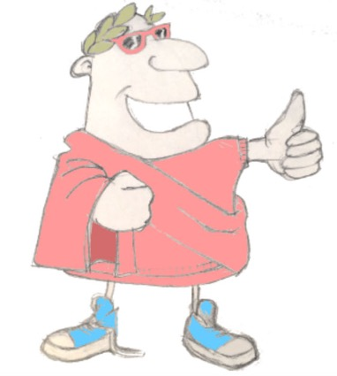
mihi nomen est Iucundus
salvete!
salve!
quid tibi nomen est?
mihi nomen est …………….
Unit 7, Session 5
Adjectival agreement – subject or object
LO: To see how Latin matches adjectives with the nouns being described depending on whether the nouns are subject or object

Slide 2
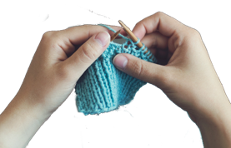
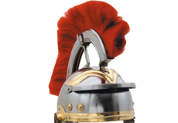
Ecce Centurio!
malus
facere
mirus
scribere
audire
frigidus
iratus
primus
7.05 Adjectival agreement – subject/object

Slide 3
Quick fire sentences
verbs
verbs
esse
esse
facere
scribere
audire
nouns
nouns
sonus
sonus
regina
regina
sumus
magus
mali magi
magus
porcus
porcus
maga
maga
vacca
vacca
adjectives
adjectives
iratus
iratus
frigidus
frigidus
primus
primus
malus
malus
secundus
mirus
secundus
7.05 Adjectival agreement – subject/object

Slide 4
Quick fire sentences
verbs
verbs
esse
esse
facere
scribere
audire
nouns
nouns
sonus
sonus
regina
regina
magus
magus
porcus
porcus
frigidi
estis
?
maga
maga
vacca
vacca
adjectives
adjectives
iratus
iratus
frigidus
frigidus
primus
primus
malus
malus
secundus
mirus
secundus
7.05 Adjectival agreement – subject/object

Slide 5
Quick fire sentences
verbs
verbs
esse
esse
facere
scribere
audire
nouns
nouns
sonus
sonus
regina
regina
porcus secundus
magus
magus
porcus
porcus
sonum
facit
maga
maga
vacca
vacca
adjectives
adjectives
iratus
iratus
frigidus
frigidus
primus
primus
malus
malus
secundus
mirus
secundus
7.05 Adjectival agreement – subject/object

Slide 6
Quick fire sentences
verbs
verbs
esse
esse
facere
scribere
audire
nouns
nouns
sonus
sonus
regina
regina
vaccae iratae
magus
magus
porcus
porcus
magas
audiunt
maga
maga
vacca
vacca
adjectives
adjectives
iratus
iratus
frigidus
frigidus
primus
primus
malus
malus
secundus
mirus
secundus
7.05 Adjectival agreement – subject/object

Slide 7
Quick fire sentences
verbs
verbs
esse
esse
facere
scribere
audire
nouns
nouns
sonus
sonus
regina
regina
magus primus
scribit
,
magus
magus
porcus
porcus
maga
“reginae mirae sunt.”
maga
vacca
vacca
adjectives
adjectives
iratus
iratus
frigidus
frigidus
primus
primus
malus
malus
secundus
mirus
secundus
7.05 Adjectival agreement – subject/object

Slide 8
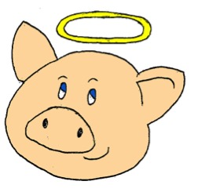
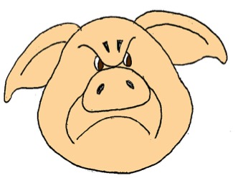
Adjective-noun matching
vacca
sordidus
iratus
porcus
porcus
iratus
7.05 Adjectival agreement – subject/object

Slide 9
Adjective-noun matching
vacca
sordidus
iratus
porcus
vacca
sordida
7.05 Adjectival agreement – subject/object

Slide 10
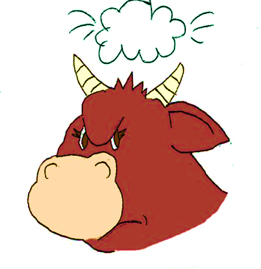
Adjective-noun matching
vacca
sordidus
iratus
porcus
vaccae
iratae
7.05 Adjectival agreement – subject/object

Slide 11
Adjective-noun matching
vacca
sordidus
iratus
porcus
porci
sordidi
7.05 Adjectival agreement – subject/object

Slide 12
Adjective-noun matching
vacca
sordidus
iratus
porcus
sordidum
vacca porcum ……………… videt
7.05 Adjectival agreement – subject/object

Slide 13
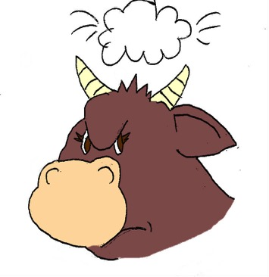
Adjective-noun matching
vacca
sordidus
iratus
porcus
!
iratas
porcus vaccas ………… videt
7.05 Adjectival agreement – subject/object

Slide 14
Adjective-noun matching
Adjectives have to have the same ending as the nouns they’re describing in 3 ways:
feminine or masculine
singular or plural
subject or object
‘a’ noun endings | one (singular) | more than one (plural)
subject
object
‘us’ noun endings | one (singular) | more than one (plural)
subject
object
a
ae
us
i
am
as
um
os
Just remember to look for the rhyming endings!
7.05 Adjectival agreement – subject/object

Slide 15
Plenary quiz
valete!
Question 1 What Latin word gives us the English word ‘malaria’?
Question 2 Can you think of an English word that comes from the Latin verb ‘facere’?
vale!
ita vero!
vale!
Question 3 frigidam aquam amas?
minime!
vale!
7.05 Adjectival agreement – subject/object

