Slide 1
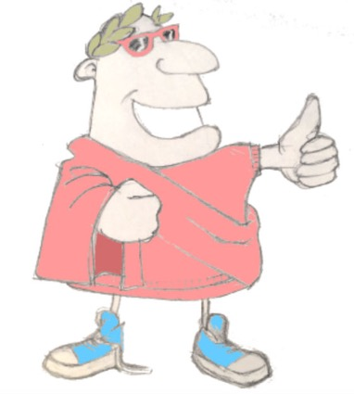
mihi dies natalis est!
salvete!
salve!
felix dies tibi sit!
felix dies tibi sit,
felix dies tibi sit,
felix dies care Iucunde,
felix dies tibi sit!
Unit 6, Session 1
Recap of work so far
LO: To revisit and practice the grammar and vocabulary we’ve learned so far

Slide 2
Word Roots Challenge
bene
aqua
regina
optimus
benefactor
someone who helps and supports another person or charity, often giving money
amateur
a person who does something not because they get paid but because they love doing it
reign
the rule of a king or queen
enumerate
to count out
aquatic
living in or around water
optimise
to make something the best it can be
amare
numerare
6.01 Recap of work so far

Slide 3
Fill the gaps
Just like English, Latin has word classes such as ____________ , ____________ and ____________ .
However, unlike English, Latin does not use word ____________ to show meaning. Word ____________ is much more important.
If you look at a Latin verb, the ending shows us ____________ is doing the action. The ____________ of the verb tells us what is happening.
When translating a Latin sentence, first find the ____________ , next the ____________ and then the ____________ .
beginning
who
ending
subject
object
verbs
adverbs
verb
nouns
order
6.01 Recap of work so far

Slide 4
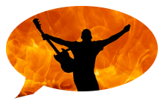
Quick fire sentences
verbs
dare
numerare
audire
amare
videre
nouns
aqua
porcus
victoriam
amamus
sonus
femina
victoria
villa
adverbs
irate
facile
6.01 Recap of work so far

Slide 5
Quick fire sentences
verbs
dare
numerare
audire
amare
videre
nouns
aqua
porcus
facile
villas
vides
sonus
femina
victoria
villa
adverbs
irate
facile
6.01 Recap of work so far

Slide 6
Quick fire sentences
verbs
dare
numerare
audire
amare
videre
nouns
aqua
porcus
sonos
auditis ?
sonus
femina
victoria
villa
adverbs
irate
facile
6.01 Recap of work so far

Slide 7
Quick fire sentences
verbs
dare
numerare
audire
amare
videre
nouns
aqua
porcus
femina
aquam
dat
sonus
femina
victoria
villa
adverbs
irate
facile
6.01 Recap of work so far

Slide 8
Quick fire sentences
verbs
dare
numerare
audire
amare
videre
nouns
feminae
porcos
aqua
porcus
sonus
irate
numerant
femina
victoria
villa
adverbs
irate
facile
6.01 Recap of work so far

Slide 9
Plenary quiz
valete!
Question 1 In which month is your ‘dies natalis’?
Question 2 If I optimize my walk to school, what am I doing?
vale!
vale!
Question 3 cantare amatis?
vale!
6.01 Recap of work so far

