Slide 1
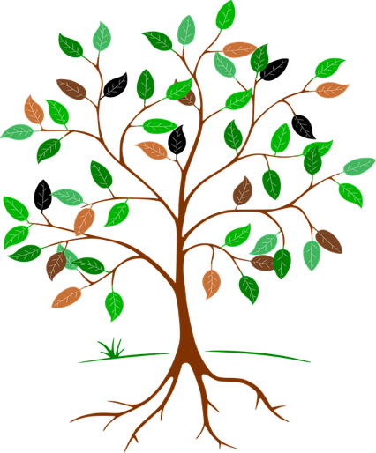
Inventing a product
LO: To see how Latin roots are used to name modern products, and to invent and name a product of our own

Slide 2
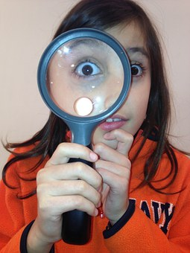
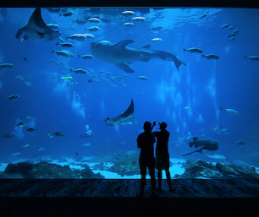
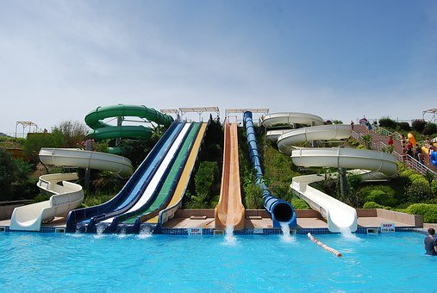
Recap quiz
🤓💬
aqua
(water)
magnus
(big)
optimus
(best)
4 Inventing a product

Slide 3
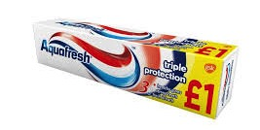
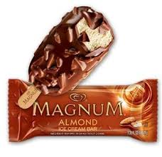
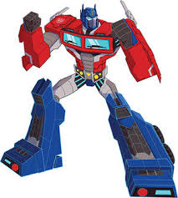
Latin roots in modern products
🤓💬
Aquafresh
toothpaste
magnus
big
aqua
water
Magnum
ice cream
optimus
best
Optimus Prime
4 Inventing a product

Slide 4
My new invention
optimi
best
circ
round
uni
one
cani
dog
primo
first
terra
earth/ground
pute
think
audi
hear
super
above
port
carry
trans
across
tri
three
sub
under
cent
hundred
aqua
water
ped
foot
magni
big
visi
see
porci
pig
magi
magic
📝
4 Inventing a product

Slide 5
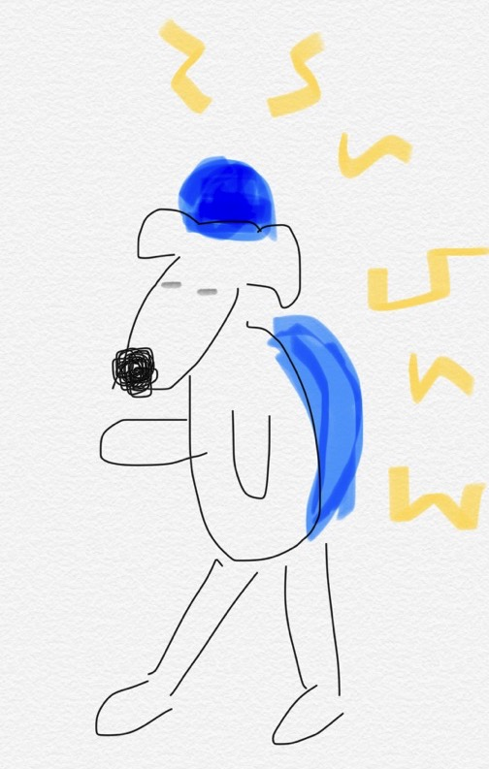
My new invention
word beginning
word
ending
canipute
cani
dog
pute
think
What does your new creation do?
What does it look like?
The Canipute is a special hat you put on your dog. It can read your dog’s brainwaves and translate what it is thinking into human language (options include English, French and German).
………………………………………………
………………………………………………
………………………………………………
………………………………………………
………………………………………………
………………………………………………
………………………………………………
………………………………………………
………………………………………………
………………………………………………
………………………………………………
📝
4 Inventing a product

Slide 6
Plenary quiz
Question 1 What English word or words can you think of that come from the Latin word ‘aqua’ meaning ‘water’? Can you say what their connection with water is?
Question 2 If you see ‘ped’ in a word, it often has something to do with a foot. What ‘ped’ word might you find on a bicycle that has something to do with a foot?
Question 3 If you saw a new product called an ‘Aquaped’, what do you think it could be?
4 Inventing a product

