Slide 1
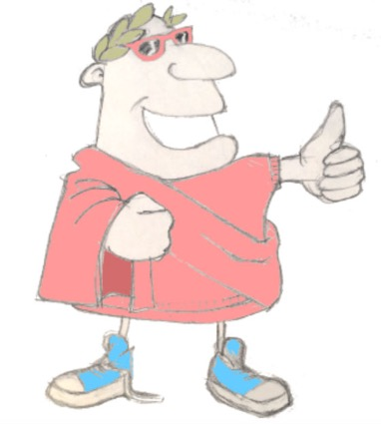
quis adest?
salvete!
salve!
adsum!
quid agistis?
bene!
Unit 4, Session 2
Subject & object recap
male!
LO: To revisit the ideas of subject and object nouns

Slide 2
Word Roots Challenge
vacca
aqua
vaccine
a medicine that prevents you getting a bad disease, first developed for the illness cowpox
porcupine
a small spiky mammal whose name means ‘spiny pig’
equestrian
to do with horse riding
aquarium
a tank of water for creatures to live in
Word class?
medical
to do with doctors or medicine
feminine
with female qualities
medicus
porcus
Nouns
femina
equus
4.02 Subject & object recap

Slide 3
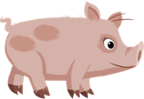
Quick fire sentences
verbs
nouns
medicus
videre
amare
laborare
porcus
maga
femina
femina laborat
medicus videt
porcus amat
femina videt
maga videt
maga laborat
4.02 Subject & object recap

Slide 4
subject and object in English
the dog
eats
the bone
subject
doing the action
object having the action done to it
meaning is made through word order
4.02 Subject & object recap

Slide 5
Latin Golden Rule
word
order
word endings
4.02 Subject & object recap

Slide 6
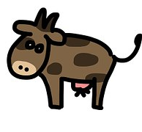
object noun word endings
The woman loves the cow
m
femina vaccam amat
The cow loves the woman
feminam vacca amat
m
on end of a noun = noun is the object
4.02 Subject & object recap

Slide 7
Plenary quiz
valete!
Question 1 Can you think of an English word that comes from the Latin ‘porcus’ (pig)?
Question 2 When a noun is the subject of a sentence, what is it doing?
vale!
vale!
Question 3 What letter on the end of a Latin noun shows you it’s the object of the sentence (having the action done to it)?
vale!
4.02 Subject & object recap

