Slide 1
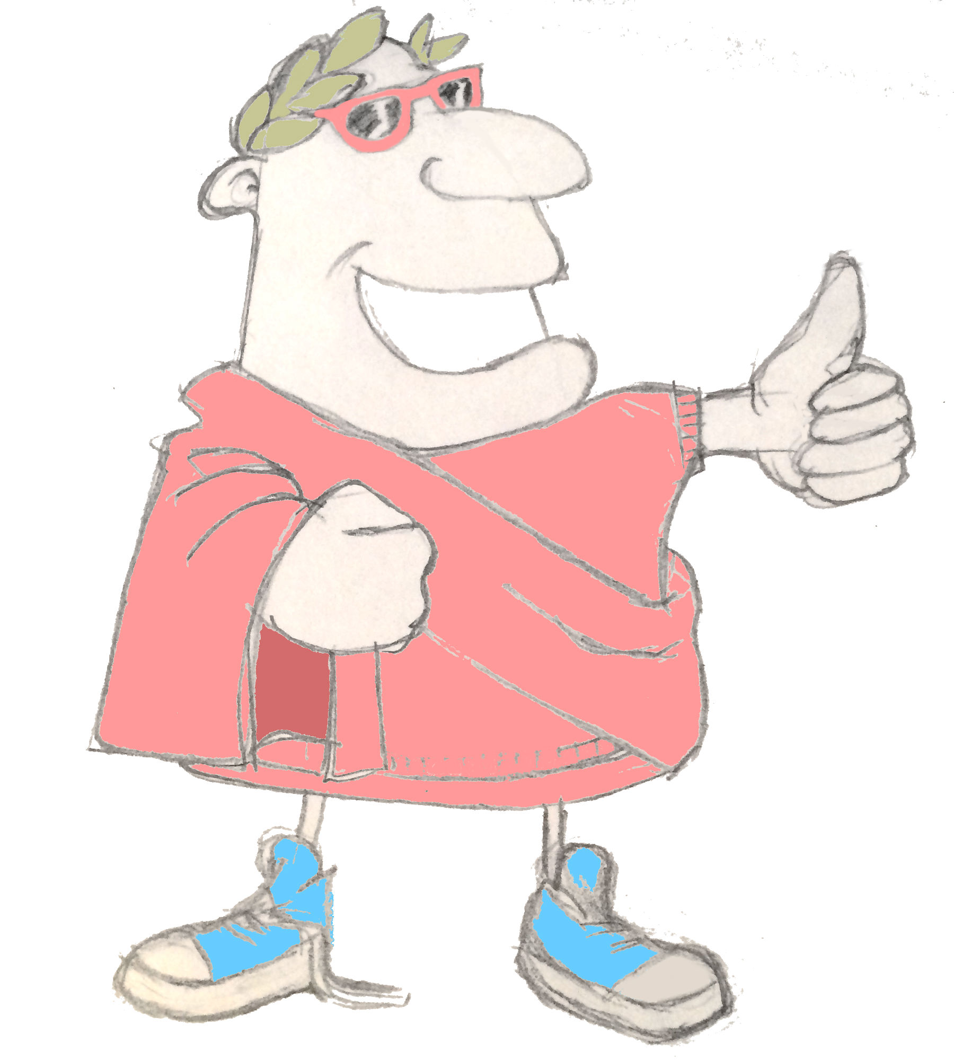
maximum Classics - 11
Why be good?
Language L.O. To translate Latin sentences
Culture L.O. To hear Plato’s tale of Gyges and debate why people are good

Slide 2
Roman Register!
adsum!

Slide 3
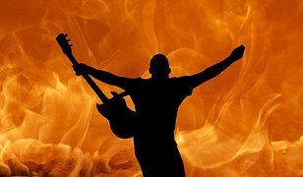
Verb endings

Slide 4
Quick fire verbs
amare
habere
curare
amo
habent
curamus
amatis
habet
habeo
habes
curat

Slide 5
Round up: what we know about
Latin word endings
1. Verb endings show who’s doing the verb
2. Noun endings show if the noun is the subject or object in a sentence
o | I
s | you (singular)
t | he, she, it
mus | we
tis | y’all/you (plural)
nt | they
‘a’ noun endings | one (singular) | more than one (plural)
subject
object
a
ae
am
as
‘us’ noun endings | one (singular) | more than one (plural)
subject
object
us
i
um
os

Slide 6
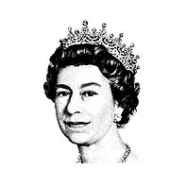
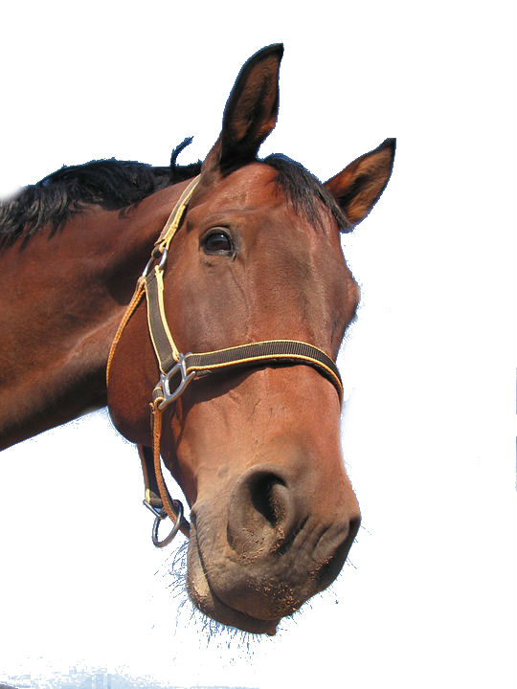
Building a Latin sentence
equum
regina
laete
amat
The queen happily loves the horse.

Slide 7
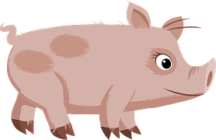
Building a Latin sentence:
words to help
adverbs
nouns
bene
celeriter
gladius
equus
laete
irate
campus
medicus
porcus
verbs
habere
videre
maga
aqua
femina
regina
cantare
curare
stella
vacca
amare
dare

Slide 8
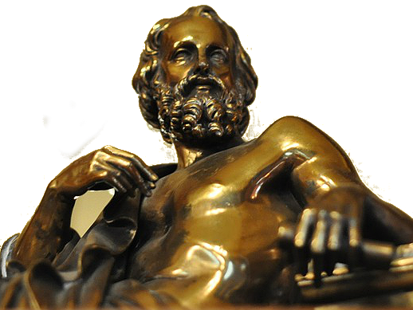
Plato’s tale of Gyges
According to an old story, Gyges was a shepherd working for the king of Lydia; there was a great storm, and an earthquake made an opening in the earth at the place where he was feeding his flock. Amazed at the sight, he descended into the opening, where, among other marvels, he saw a hollow metal horse with doors in it. Inside, he saw a dead body wearing a gold ring; this he took and went back above ground to his flock.
Later, at a meeting of all the shepherds, Gyges was fiddling with the ring on his finger. As he turned it, instantly he became invisible to everyone, and they all began to speak of him as if he were no longer there. He was astonished at this, tried turning the ring again, and reappeared. He volunteered to be one of the messengers who were sent to report back to the king. When he got to the palace, he used his power of invisibility, killed the king and took the kingdom.
Even if a good person got his hands on this ring, would you imagine he could he stick to being good? He could take whatever he wanted from the shops, go into anyone’s house, do whatever he liked: he would be a god among men.
From this story, we can conclude that a person is good, not because they want to or because they think that being good is any use to him individually, but because he has to; if anyone thinks they’ll be able to get away with something, they’ll do it.
Plato, philosopher
Athens, Greece
5th Century B.C.

Slide 9
Plenary
If a Latin verb ends in ‘t’, who is doing it?
Where do you usually find the verb in a Latin sentence?
What did Gyges find that made him invisible?

